Slide 1
RISE 1

Slide 2
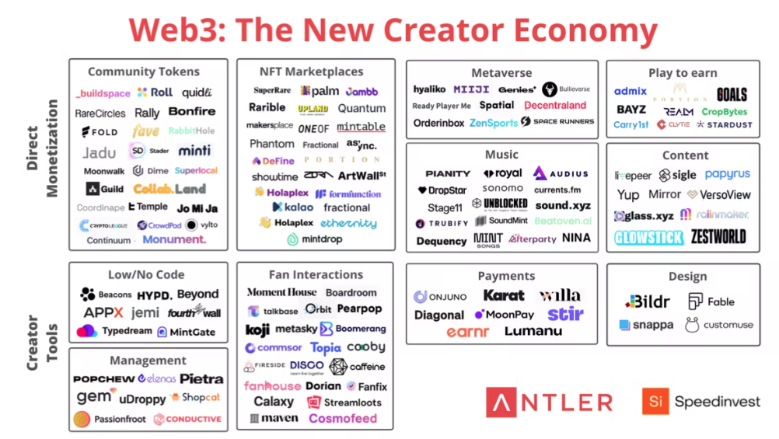

Slide 3


RISE
UP
ESULT PLANNING
DIGITAL BUSINESS ENGINEERING & GROWTH PLANNING
Digital Business Planning
Digital Business Growth
RISE 1
SERVING INDIVIDUALS & BUSINESSES TO SUCCEED IN THE DIGITAL AGE
By helping in Creating and distributing Digital Assets for Knowledge and Creator economy through a P2P model to RISE UP to the Success you are seeking.
RESEARCH FOR WEBINAR
Global Knowledge Management Market to Reach $1.1 Trillion by 2026
Digital knowledge assets or knowledge-based intellectual property.
knowledge industry: an industry whose success depends on having and using knowledge about a particular subject
Knowledge-Based Services, commonly referred to as Advisory and Assistance Services (A&AS), relate to tasks that require the application of detailed processes or technical knowledge.
Knowledge management is a managerial approach through which an organization collects, analyzes, systematizes, stores, and shares its knowledge assets or knowledge-based intellectual property.
Academic institutions, companies engaging in research and development (R&D), programmers developing new software and search engines for data, and health workers using digital data to improve treatments are all components of a knowledge economy.
These economy brokers pass on the results of their research to workers in more traditional fields, such as farmers who use software applications and digital solutions to manage their crops better, advanced technological-based medical procedures such as robot-assistant surgeries, or schools that provide digital study aids and online courses for students.
What Are the Most Valuable Skills in the Knowledge Economy?
While higher education and technical training are obvious assets, communication and teamwork are also essential skills for a knowledge-based economy, according to the Organization for Economic Cooperation and Development. Since it is unlikely that any single knowledge worker can generate groundbreaking innovations alone, these interpersonal and workplace competencies are essential to surviving in a knowledge-based workplace
https://www.springboard.com/blog/business-and-marketing/creator-economy/
Research shows that millennials don’t respond to traditional advertising, which makes influencer partnerships a crucial part of a brand’s marketing strategy. Creators can also sell content such as ebooks, courses, podcasts, and newsletters on their own website in exchange for a monthly subscription, pay-per-view, or donation.
https://www.robosoftin.com/blog/creator-economy-and-role-of-digital-experience
LIVE
STRIVE
THRIVE
CREATORPRENEUR
DIGITAL BUSINESS HUB

Slide 4
RISE
UP
ESULT PLANNING
DIGITAL BUSINESS ENGINEERING & GROWTH PLANNING
Digital Business Planning
Digital Business Growth
RISE 1
SERVING INDIVIDUALS & BUSINESSES TO SUCCEED IN THE DIGITAL AGE
By helping in Creating and distributing Digital Assets for Knowledge and Creator economy through a P2P model to RISE UP to the Success you are seeking.
Niche | Digitalization & Digital Business Planning | Courseware
Target Mkt | Solopreneurs and SME Businesses, Executives of LE
Designation | RISE BUSINESS PARTNER at SOUL
Mission | 1 M people and businesses RISE to their goals
Community | RISE BUSINESS ACADEMY
PRODUCT | RISE BUSINESS MODEL | RISE UP
PRODUCTS & SERVICS
COURSEWARE | Business Planning & Growth | PRODUCT
 | Digitalization
 | Change Management Consulting
 | Course Creation & Selling
CONSULTING | CHANGE MANGEMENT | SERVICE
 | DIGITALIZATION
 | Business Planning for Startup
LIVE
STRIVE
THRIVE
PITCH | I am here to provide the experience to people with deep passion (80%) & some clarity (10%) on the life they want to lead but lack the experience & guidance (10%) to complete their passion circle
 | Hence I want them to RISE WITH SOUL ( soul provides the exp )
PURPOSE | SOUL provides guidance through consulting and experience through courseware
GAP to Fill | People with PASSION lacking experience
 | Knowledge | Purpose | Skill | Desire | = PASSION
Passion Circle
80% Passion + 10% clarity on life to lead + 10% Experience
DIGITAL BUSINESS HUB

Slide 5
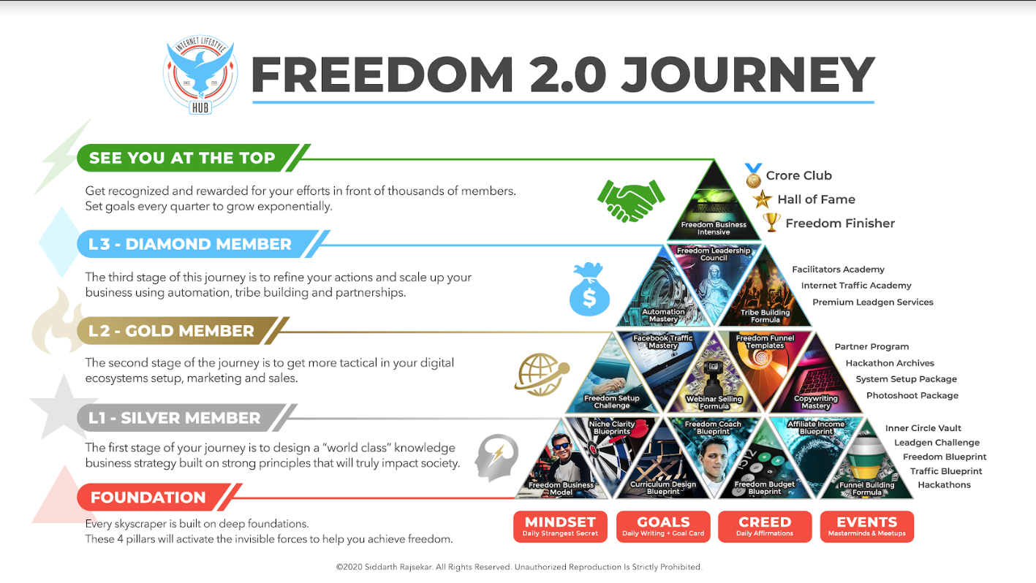
RISE
UP
ESULT PLANNING
DIGITAL BUSINESS ENGINEERING & GROWTH PLANNING
Digital Business Planning
Digital Business Growth
RISE 1
LIVE
STRIVE
THRIVE
DIGITAL BUSINESS HUB

Slide 6
RISE
UP
ESULT PLANNING
DIGITAL BUSINESS ENGINEERING & GROWTH PLANNING: INTRODUCTION
Digital Business ENGINEERING
Digital Business Growth
RISE 1
RISE1 _1
DIGITAL
BUSINESS
PIONEER
DIGITAL PLATFORM FOR INCOME GROWTH
BLITZSCALING
DIGITAL ASSET CREATION & MONETIZATION
DIGITAL BUSINESS ENGINEERING & GROWTH PLANNING
DIGITAL CONSULTING
AS A BUSINESS
RISE1S1
THRIVE
RISE 6
CONSULT AND COACH LARGE CORPORATES WITH MONK MINDSET & 5T SKILLS
RISE 5
BECOMING A POINEER AND CONSULTING FOR DIGITALIZATION & CHANGE MANAGEMENT CONSULTING IN YOUR FIELD
RISE 4
SCALING THE BUSINESS THROUGH AUTOMATION, TRIBE BUILDING & INCOME GROWTH THROUGH VARIOUS PLATFORMS
RISE 3
RISE 2
RISE 1
DIGITAL ECOSYSTEM SETUP FOR SCALING THROUGH SALES & MARKETING
DIGITAL ASSET CREATION FOR MONETIZATION
DIGITAL ASSET FOR KNOWLEDGE BUSINESS, STRATEGY & PLANNING
PIONEERING & PASSING THE LEGACY
UTILIZE & DIVERSIFY
EARNINGS & INCOME MANAGMENT
SALES & MARKETING AS A SERVICE
INNOVATE & CREATE
RESULT PLANNING
SOM
STRIVE
MONK QUANTUM PLATINUM DIAMOND GOLD SILVER
RISEUP IMPACT OPINE TUNE
LIVE
TOB
TIB
FOUNDATION
GOALS
MIND
HABIT
ACTIVITIES
DIGITAL BUSINESS HUB
PASSION
KNOWLEDGE
PURPOSE
SKILL
DESIRE
EXPERIENCE

Slide 7
RISE
UP
ESULT PLANNING
DIGITAL BUSINESS ENGINEERING & GROWTH PLANNING: INTRODUCTION
Digital Business ENGINEERING
Digital Business Growth
RISE 1
DIGITAL
BUSINESS
PIONEER
DIGITAL PLATFORM FOR INCOME GROWTH
BLITZSCALING
DIGITAL ASSET CREATION & MONETIZATION
DIGITAL BUSINESS ENGINEERING & GROWTH PLANNING
DIGITAL CONSULTING
AS A BUSINESS
GOVERNANCE:
Weekly Inner Circle Meet: 1.5 hr
  For clarifications
  Feedback
  Support
Monthly Challenge Achievers Club: 1.5hr
  Practicals / Hacks
  Gamification
  Rewards & Recognition
Quantum Leadership Meet: 1.5 hr.
  Strategic Direction
  Collective Criticism & Opinion
  Event Roadmap creation
  Quantum Nominations
RISE 6
CONSULT AND COACH LARGE CORPORATES WITH MONK MINDSET & 5T SKILLS
RISE 5
BECOMING A POINEER AND CONSULTING FOR DIGITALIZATION & CHANGE MANAGEMENT CONSULTING IN YOUR FIELD
RISE 4
SCALING THE BUSINESS THROUGH AUTOMATION, TRIBE BUILDING & INCOME GROWTH THROUGH VARIOUS PLATFORMS
RISE 3
RISE 2
RISE 1
DIGITAL ECOSYSTEM SETUP FOR SCALING THROUGH SALES & MARKETING
DIGITAL ASSET CREATION FOR MONETIZATION
DIGITAL ASSET FOR KNOWLEDGE BUSINESS, STRATEGY & PLANNING
PIONEERING & PASSING THE LEGACY
UTILIZE & DIVERSIFY
EARNINGS & INCOME MANAGMENT
SALES & MARKETING AS A SERVICE
INNOVATE & CREATE
RESULT PLANNING
THRIVE
SOM
STRIVE
MONK QUANTUM PLATINUM DIAMOND GOLD SILVER
RISEUP IMPACT OPINE TUNE
LIVE
TOB
TIB
FOUNDATION
GOALS
MIND
HABIT
EVENTS
DIGITAL BUSINESS HUB
PASSION
KNOWLEDGE
PURPOSE
SKILL
DESIRE
EXPERIENCE

Slide 8
RISE
UP
ESULT PLANNING
MILLIONAIRE MINDSET
DIGITAL BUSINESS ENGINEERING & GROWTH PLANNING: INTRODUCTION
Digital Business ENGINEERING
Digital Business Growth
RISE 1
1 | What problem do you want to solve
2 | How do you plan to solve this
 | Purpose
3 | Positioning
 | Niche
 | Target Mkt
 | Mission statement
 | Name of the Hub: Community
 | Personal Designation
4 | 3 Secrets
 | How
 | Where
 | When
5 | Methodology
 | Step 1- 6
6 | COURSE : BLUE PRINT : LEVEL 1
 | VALUE with BONUS :
7 | COURSE : CHALLENGE : LEVEL 2
 | VALUE WITH BONUS:
8 | COURSE : CONSULTING : LEVEL 3
 | VALUE :
10 | Entry Webinar
 | Webinar topic 1
 | Webinar Topic 2
 | Webinar TOPIC 3
11 | SETUP: Co. Name | Domains
 | Company name | XYZ Pvt / LLP
 | Website | Yournam.com/brand.com
 | Hub | Hub_brand.com
 | Click Tracking | XYZ.co
 | Manychat (OPT) | askXYZ .com
12 | Governance
 | 1 Wkly – innercircle
 | 1 wkly – challenge / gamification
13 | Philanthrophy
 | Charity
TEMPLATE FOR
BUSINESS
SETUP
DIGITAL BUSINESS HUB

Slide 9
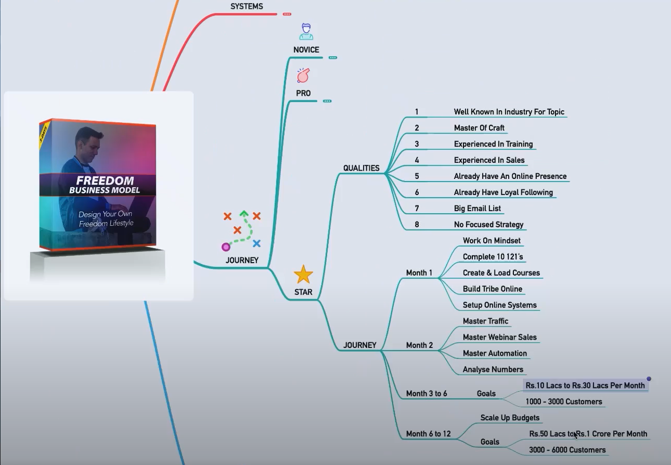
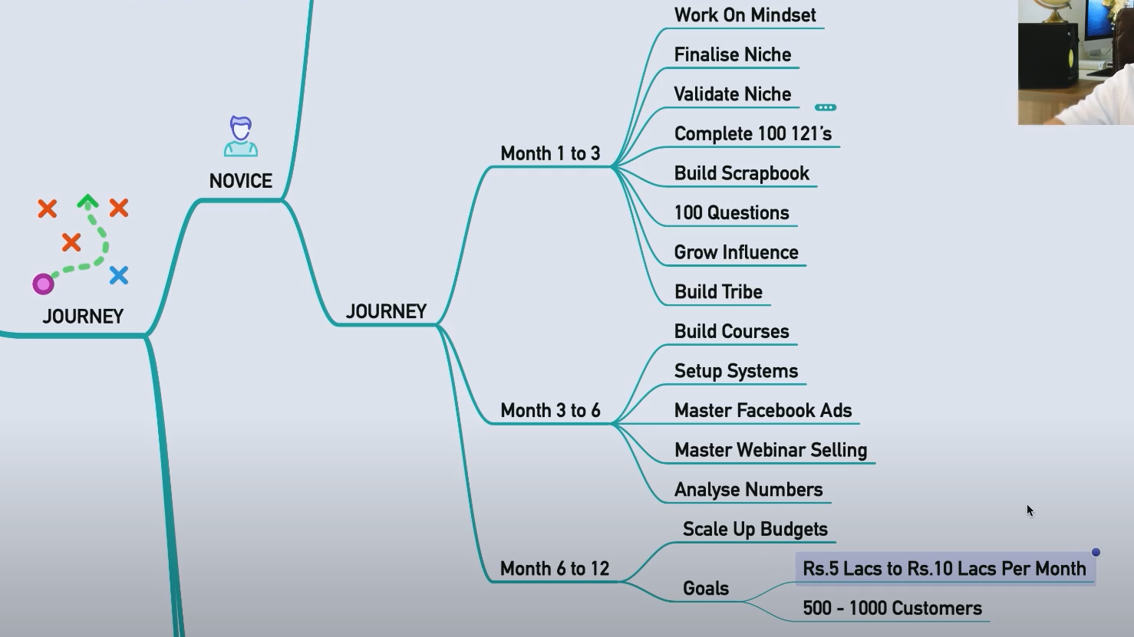
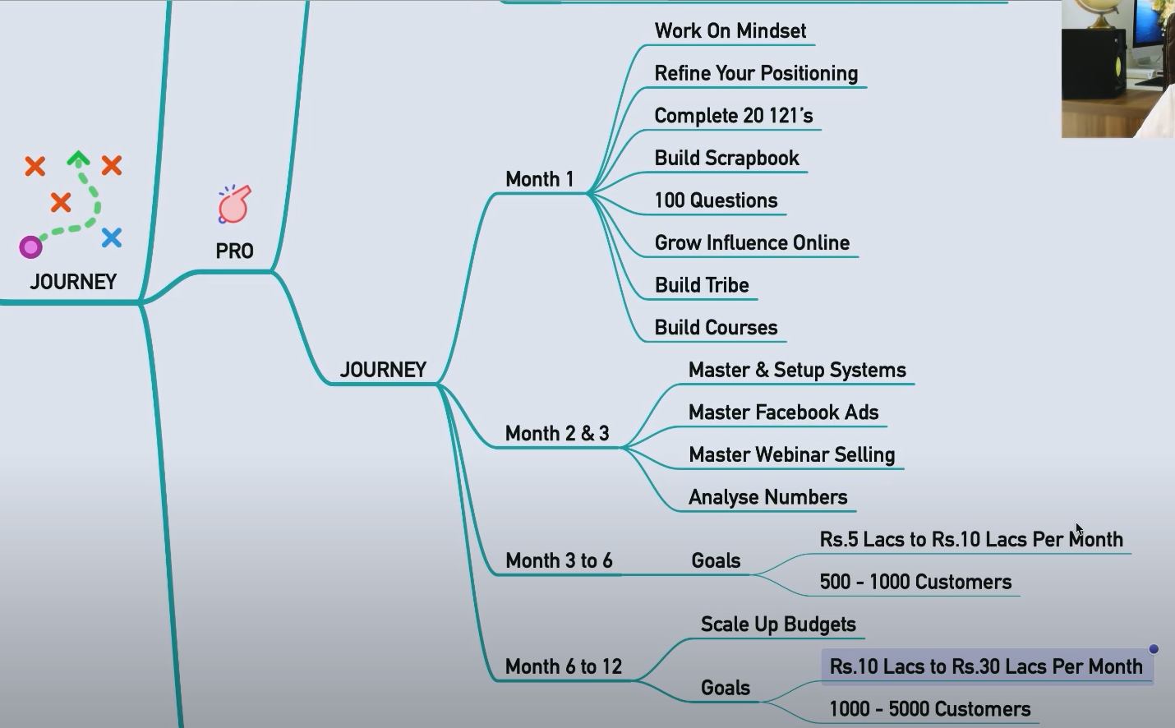
RISE
UP
ESULT PLANNING
DIGITAL BUSINESS ENGINEERING & GROWTH PLANNING: INTRODUCTION
Digital Business ENGINEERING
Digital Business Growth
RISE 1
CATEGORIZE YOURSELF TO PROCEED
RISE1 _2

Slide 10
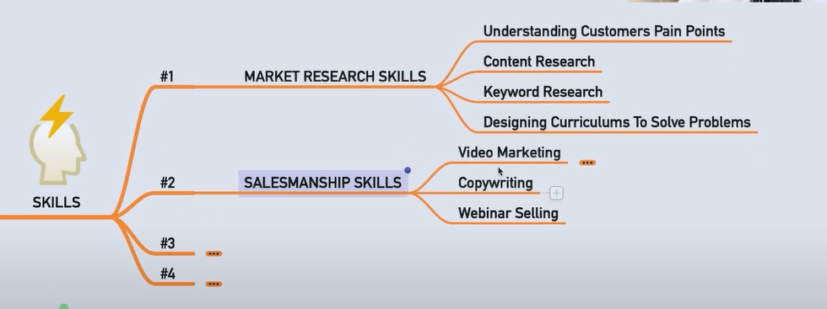
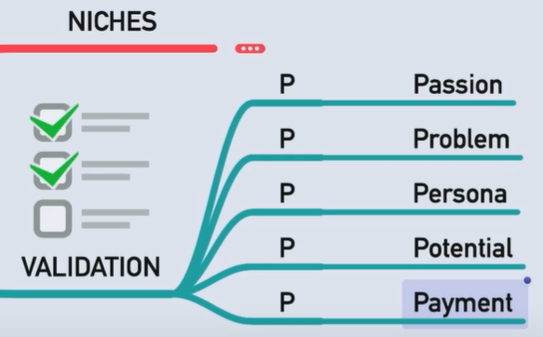
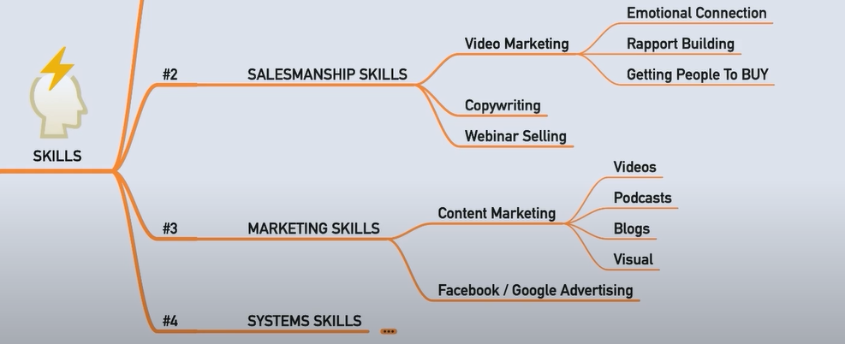
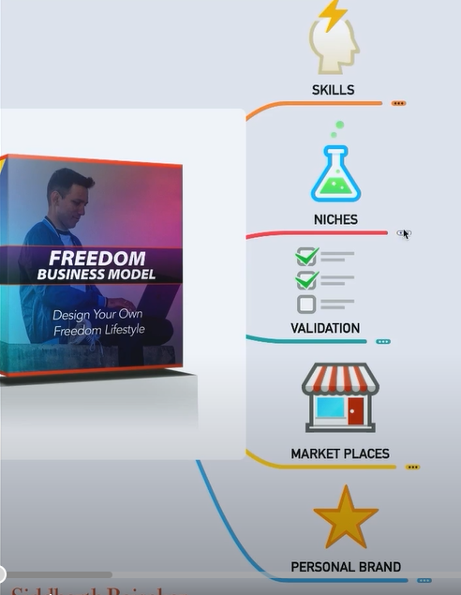
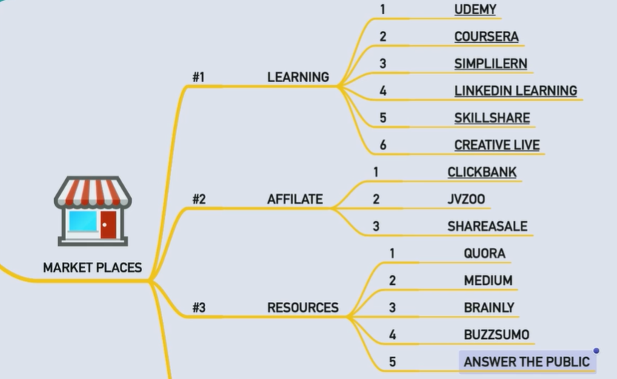
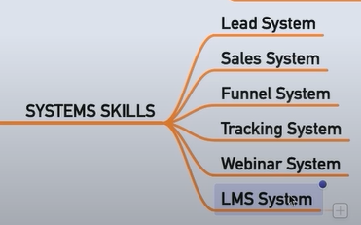
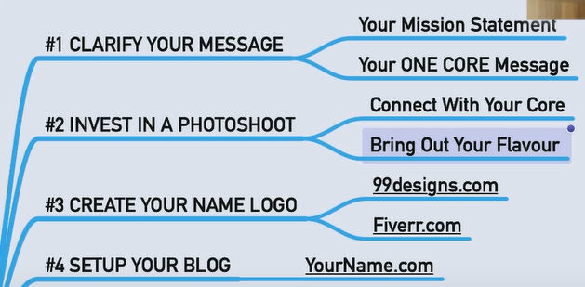
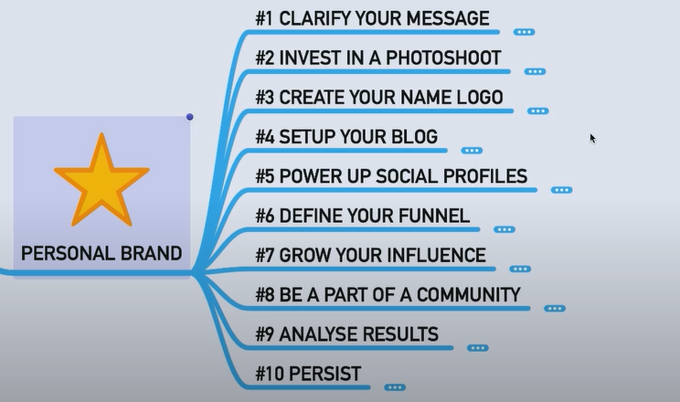
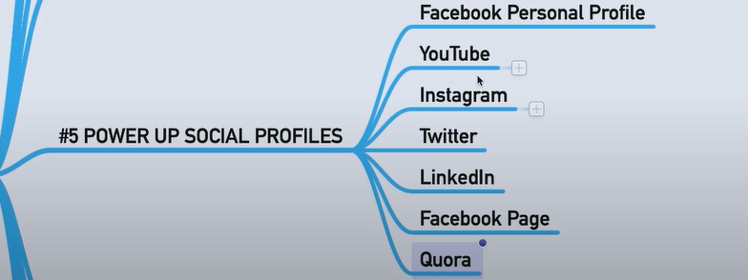
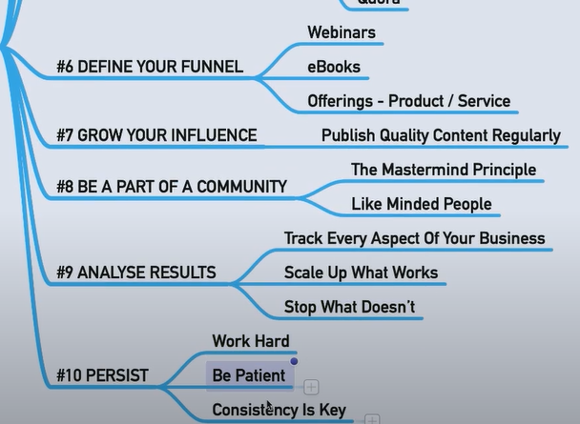
RISE
UP
ESULT PLANNING
DIGITAL BUSINESS ENGINEERING & GROWTH PLANNING: INTRODUCTION
Digital Business ENGINEERING
Digital Business Growth
RISE 1
Skills ORIENTATION
MicroNiche – Validation Process
NEXT SLIDE
RISE1 _2
If Passion doesn’t solve a problem
Then it is just a hobby
Fourpercent.com
For affiliate marketing
PROBLEM YOU CAN SOLVE
NOT THE KNOWLEDGE YOU HAVE

Slide 11
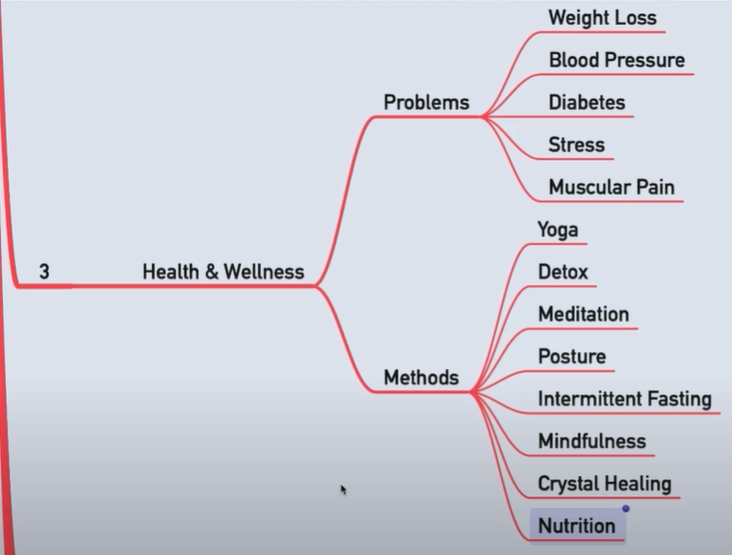
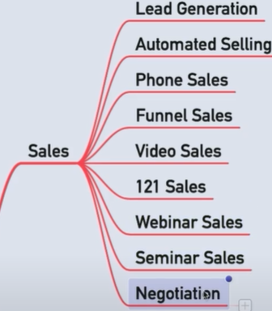
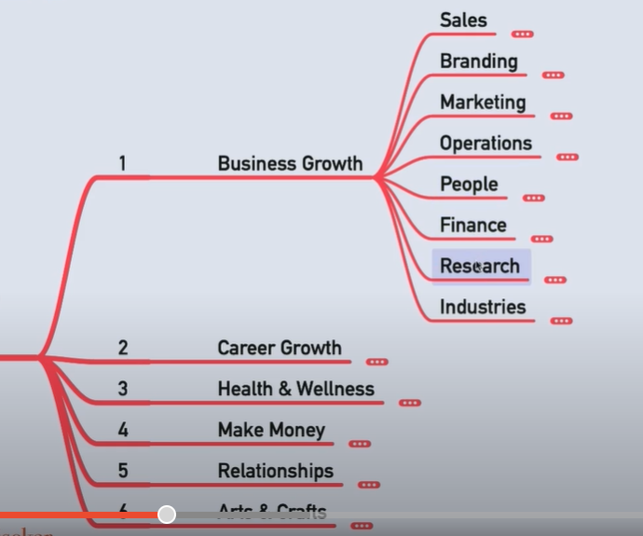
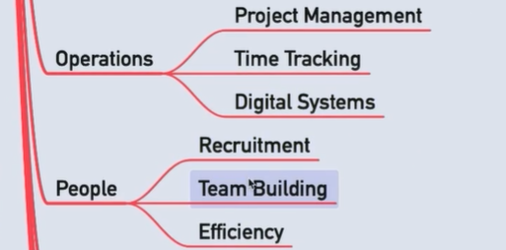
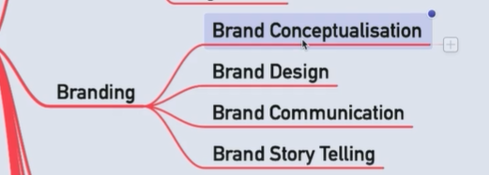
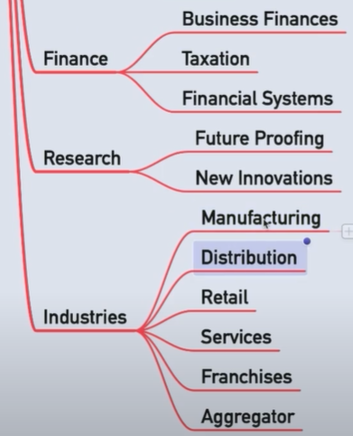
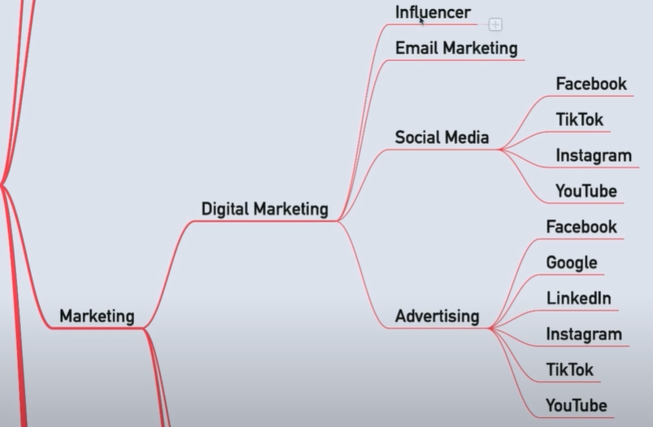
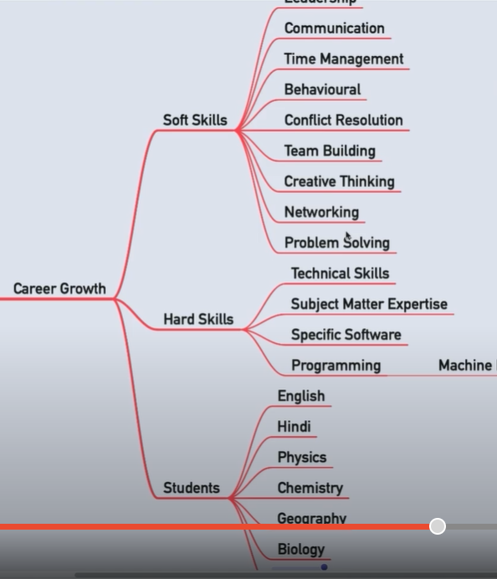
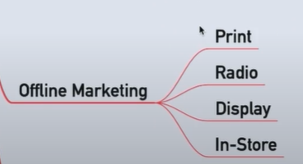

FINDINIG NICHES TOP 6
Choose from 100
RISE1 _2
Leadership
( Corporate)
Leadership

Slide 12
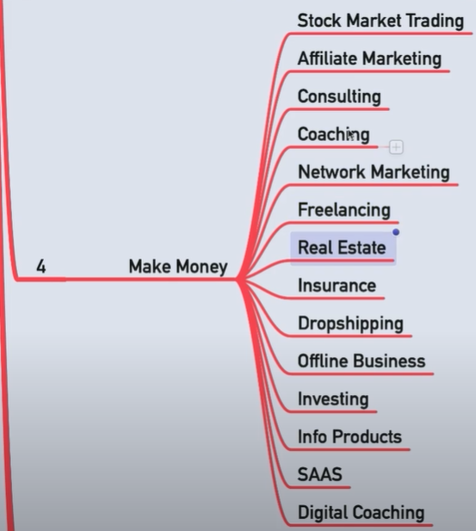
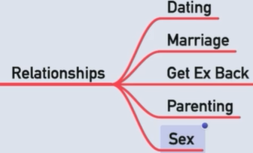
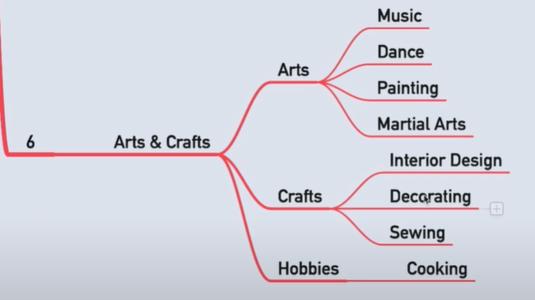
…FINDING NICHES
TOP 6 CHOOSE FROM 100
Leadership
( Corporate)

Slide 13
RISE
UP
ESULT PLANNING
DIGITAL BUSINESS ENGINEERING & GROWTH PLANNING: INTRODUCTION
Digital Business ENGINEERING
Digital Business Growth
RISE 1
NICHE VALIDATION : POTENTIAL
RISE1 _2

Slide 14
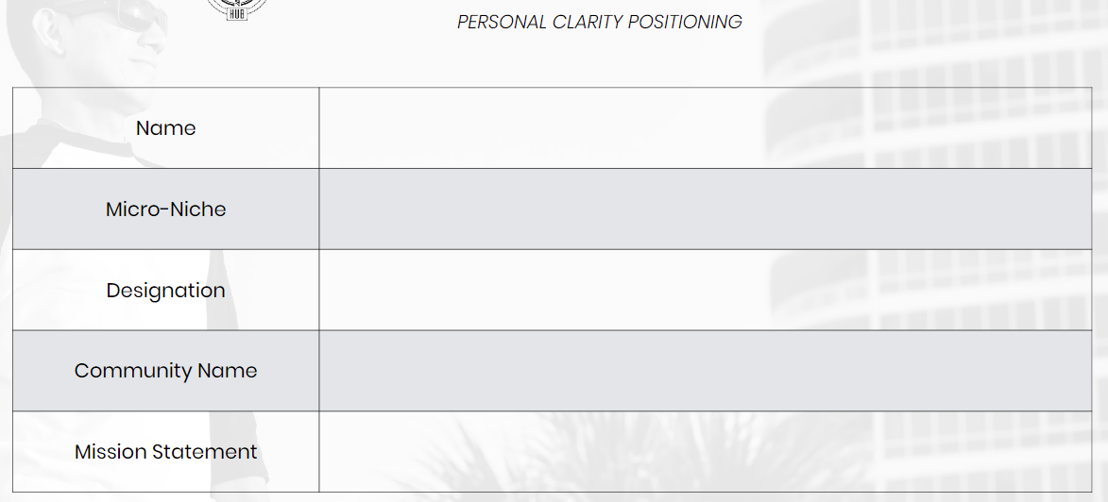
RISE
UP
ESULT PLANNING
DIGITAL BUSINESS ENGINEERING & GROWTH PLANNING: INTRODUCTION
Digital Business ENGINEERING
Digital Business Growth
RISE 1
RISE1 _2
DIGITAL BUSINESS HUB

Slide 15
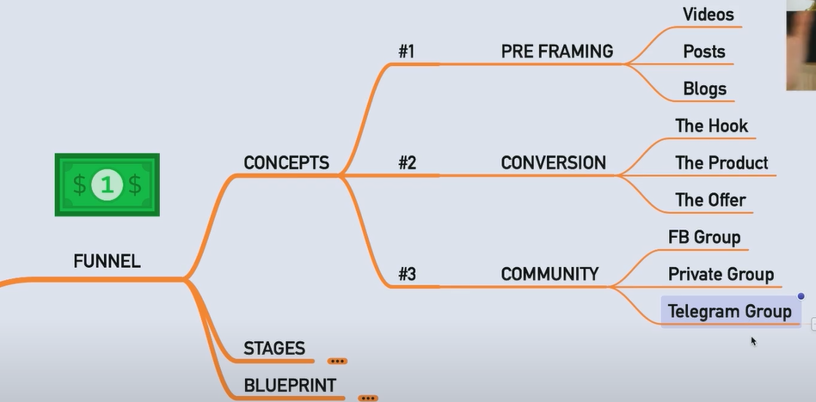
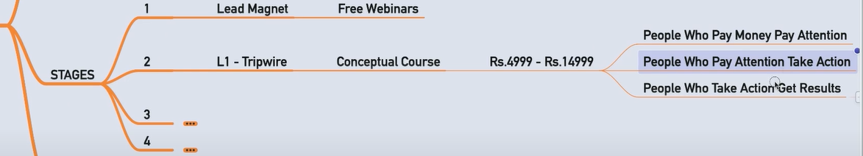
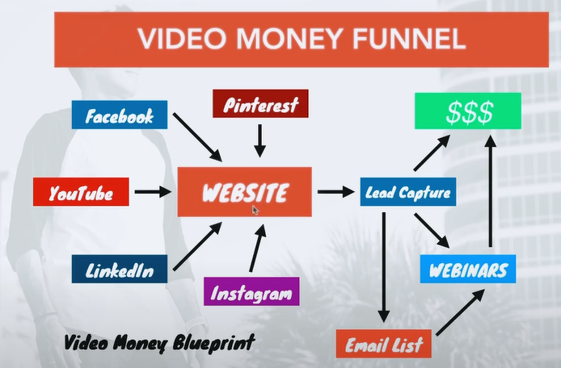
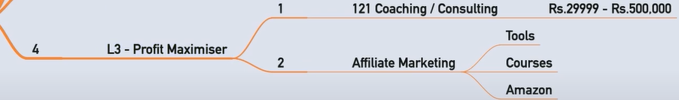
RISE
UP
ESULT PLANNING
DIGITAL BUSINESS ENGINEERING & GROWTH PLANNING: INTRODUCTION
Digital Business ENGINEERING
Digital Business Growth
RISE 1
FUNNEL CREATION
RISE1 _3

Slide 16
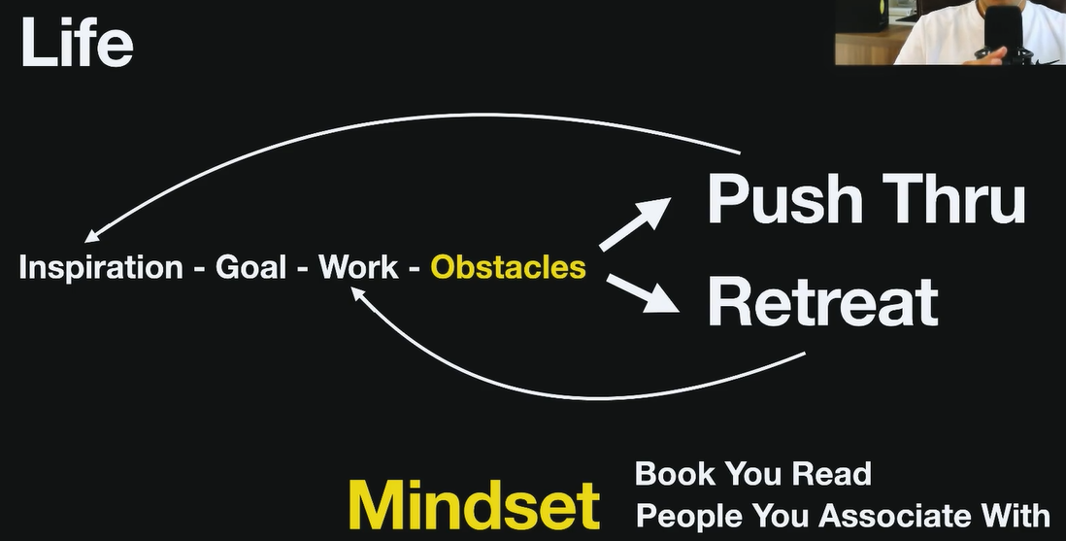
RISE
UP
ESULT PLANNING
DIGITAL BUSINESS ENGINEERING & GROWTH PLANNING: INTRODUCTION
Digital Business ENGINEERING
Digital Business Growth
RISE 1
INITIAL JOURNEY OF GROWTH
RISE1 _3

Slide 17
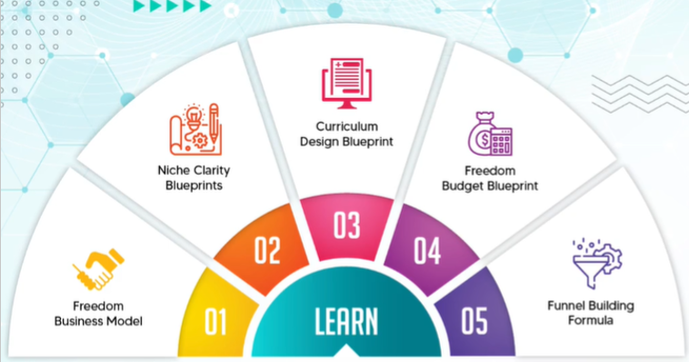
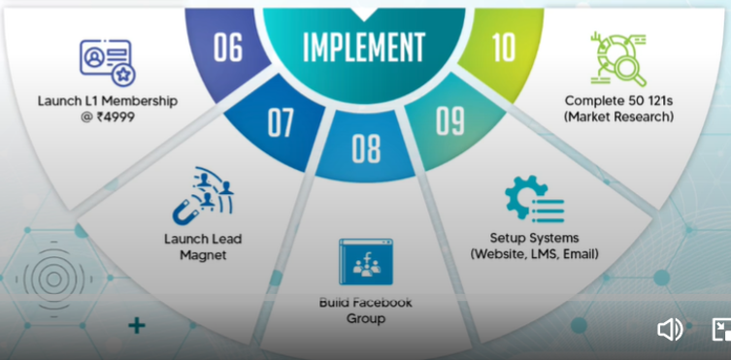
FINISH 3 MONTHS
START

Slide 18
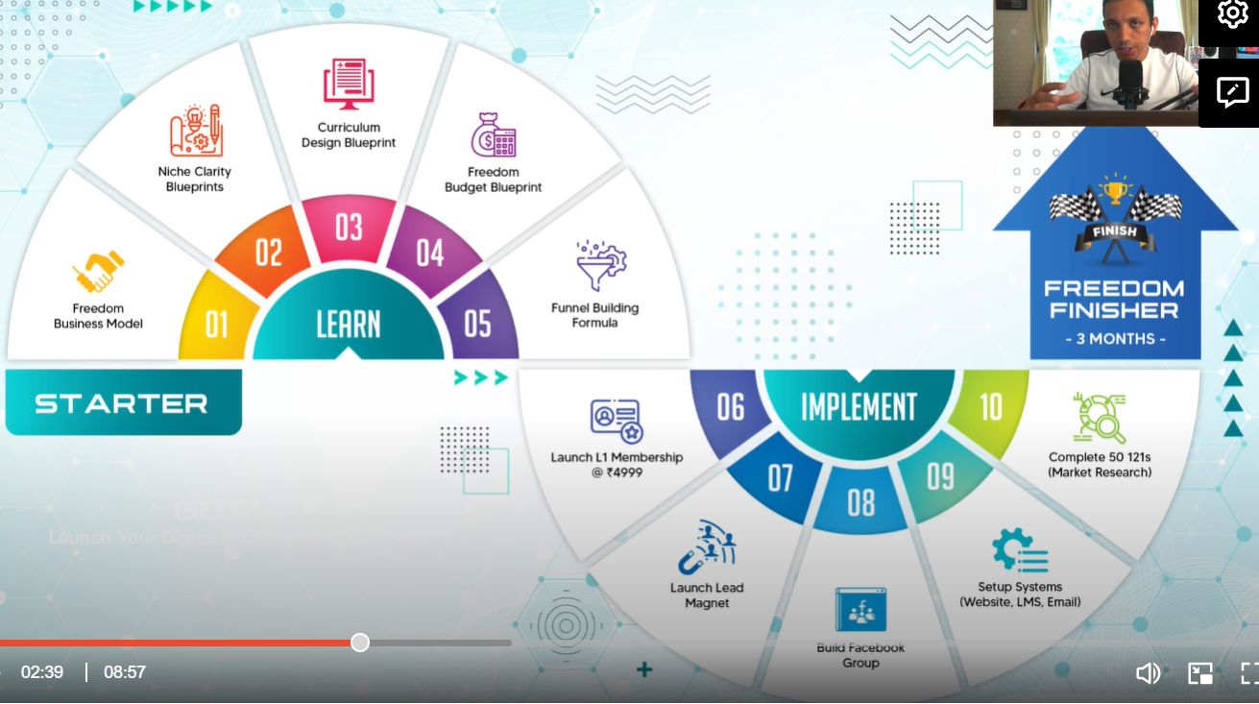

Slide 19
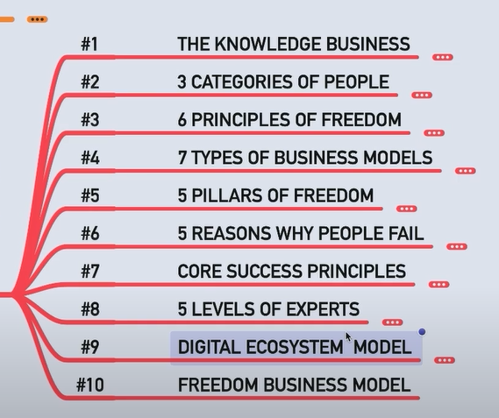
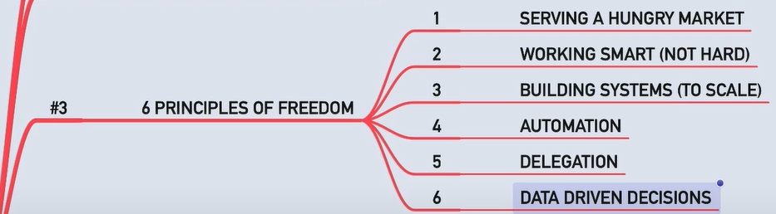
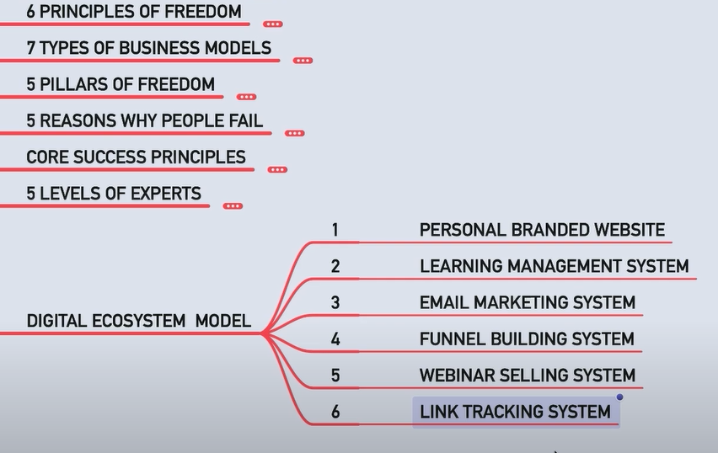
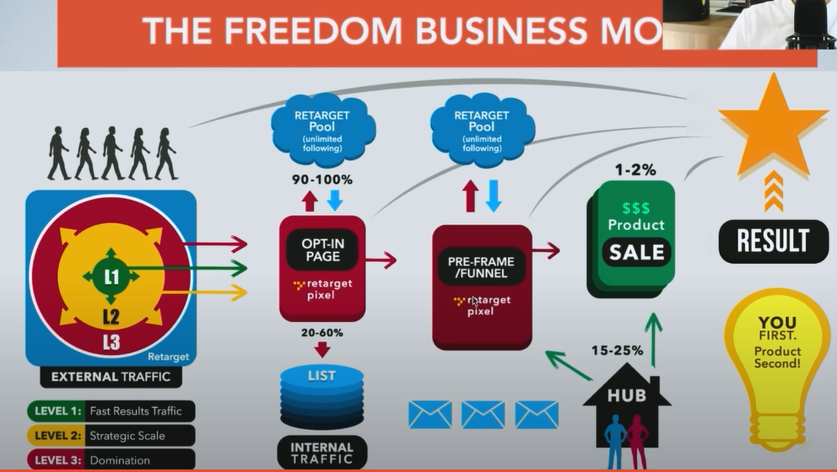
RISE
UP
ESULT PLANNING
DIGITAL BUSINESS ENGINEERING & GROWTH PLANNING: INTRODUCTION
Digital Business ENGINEERING
Digital Business Growth
RISE 1
RISEUP MODEL BASIC PRINCIPLES
RISE1 _1
SLIDE 3
DIGITAL BUSINESS HUB

Slide 20
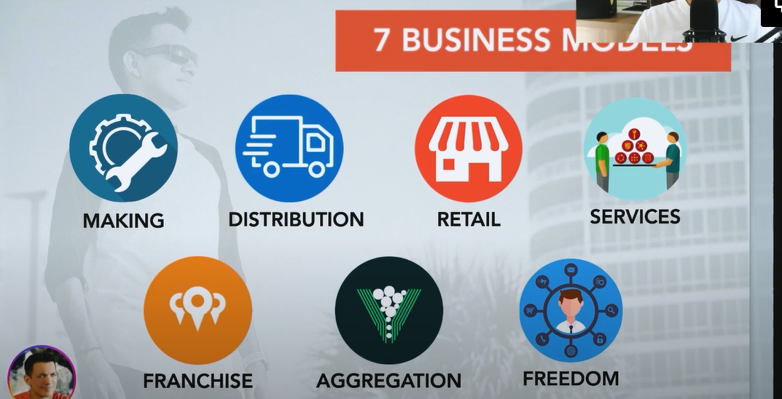
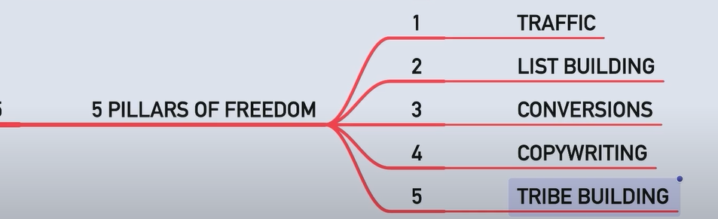

RISE
UP
ESULT PLANNING
DIGITAL BUSINESS ENGINEERING & GROWTH PLANNING: INTRODUCTION
Digital Business ENGINEERING
Digital Business Growth
RISE 1
RISE1 _1
DIGITAL BUSINESS HUB

Slide 21
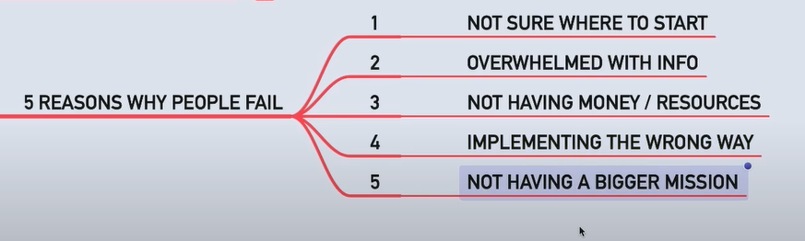
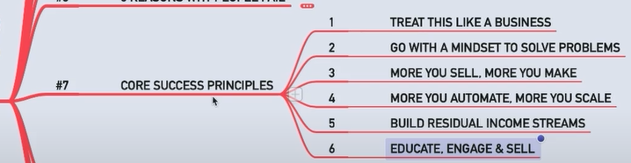
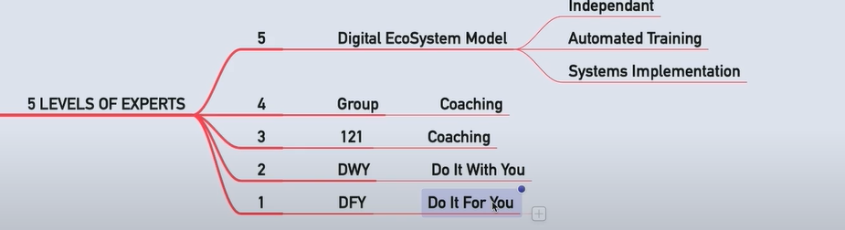
RISE
UP
ESULT PLANNING
DIGITAL BUSINESS ENGINEERING & GROWTH PLANNING: INTRODUCTION
Digital Business ENGINEERING
Digital Business Growth
RISE 1
RISE1 _1
DIGITAL BUSINESS HUB

Slide 22
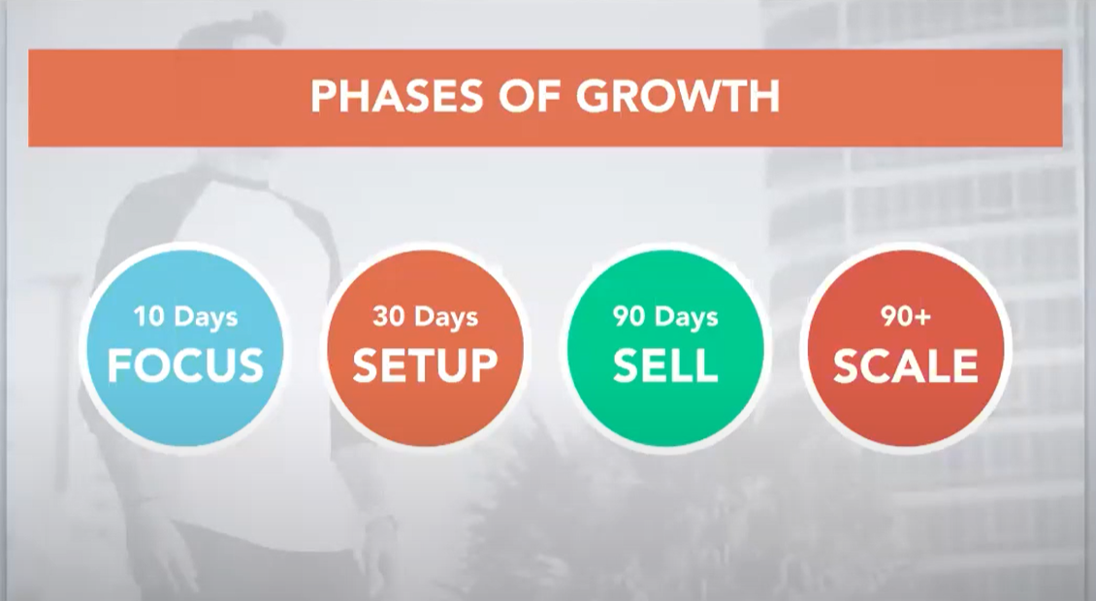
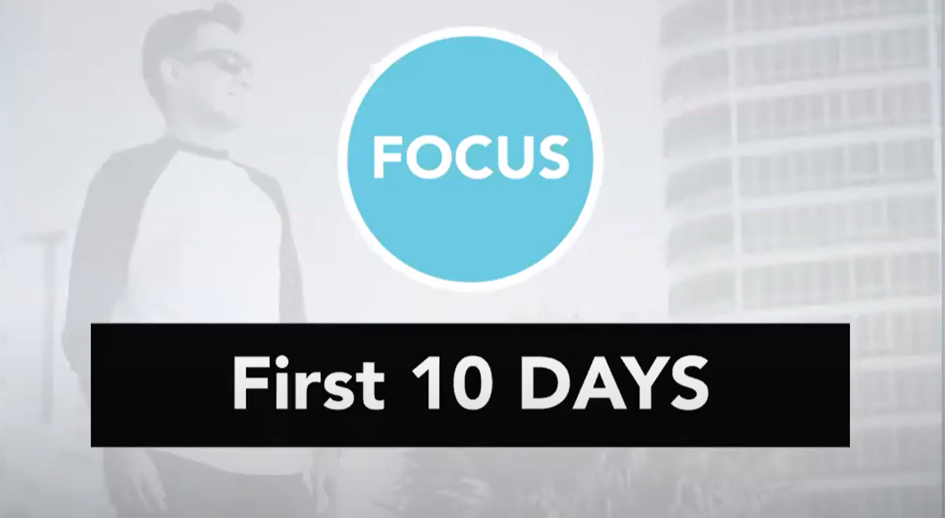
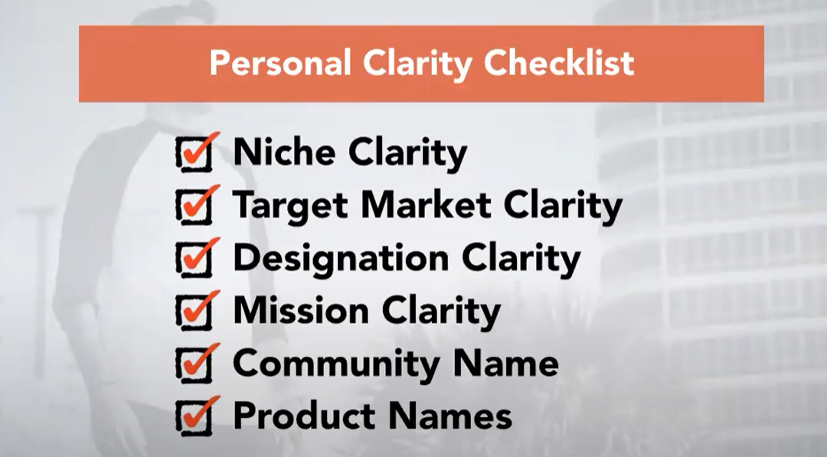
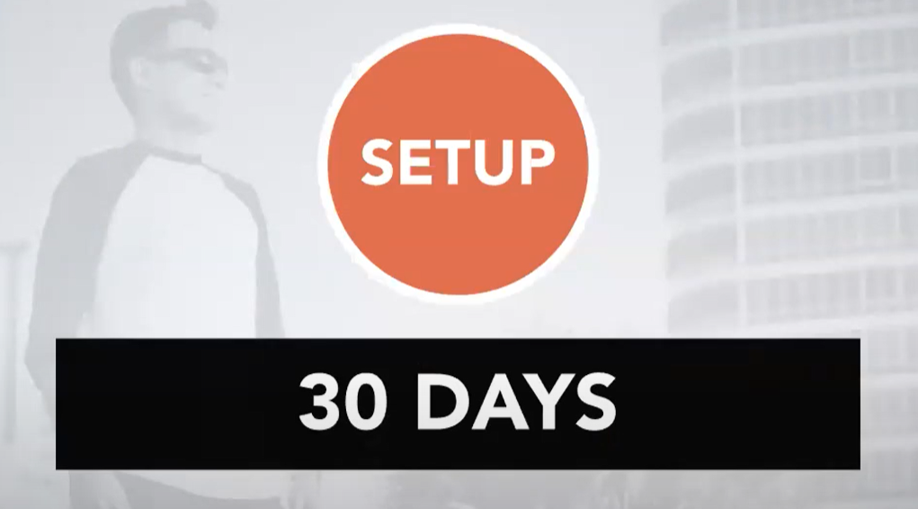
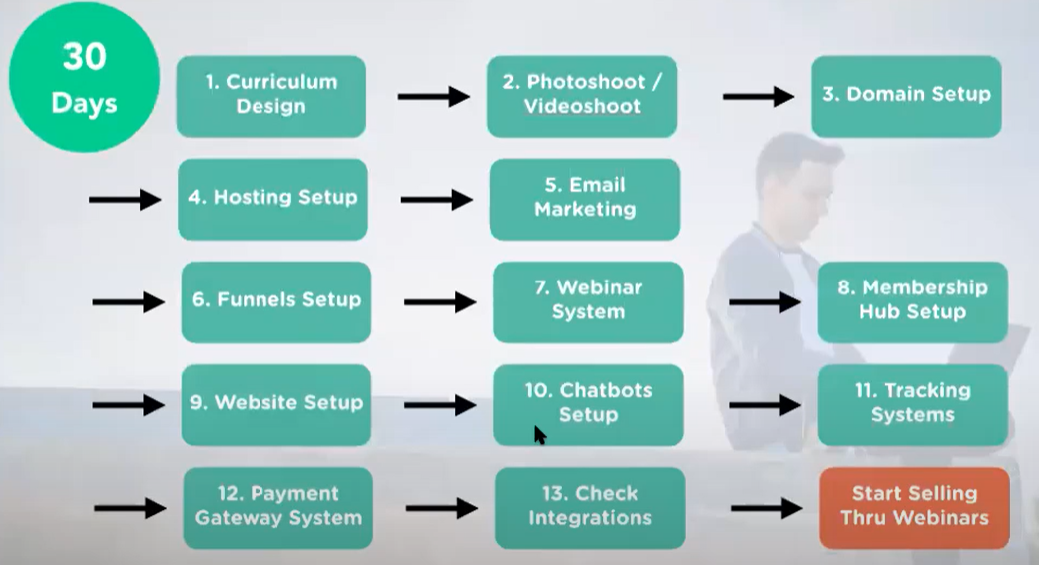

RISE
UP
ESULT PLANNING
DIGITAL BUSINESS ENGINEERING & GROWTH PLANNING: INTRODUCTION
Digital Business ENGINEERING
Digital Business Growth
RISE 1
RISE1 _1

Slide 23
RISE
UP
ESULT PLANNING
DIGITAL BUSINESS ENGINEERING & GROWTH PLANNING: INTRODUCTION
Digital Business ENGINEERING
Digital Business Growth
RISE 1
RISE1 _1
10 step for becoming a focused expert in digital age : Niche to Positioning : FREEDOM_Buss_blueprint_10 steps_nc_workbook.pdf
DIGITAL BUSINESS HUB

Slide 24
RISE
UP
ESULT PLANNING
DIGITAL BUSINESS ENGINEERING & GROWTH PLANNING: INTRODUCTION
Digital Business ENGINEERING
Digital Business Growth
RISE 1
RISE1 _1
3 Categories of people

Slide 25




RISE
UP
ESULT PLANNING
DIGITAL BUSINESS ENGINEERING & GROWTH PLANNING: INTRODUCTION
Digital Business ENGINEERING
Digital Business Growth
RISE 1
RISE1 _1
DIGITAL BUSINESS HUB

Slide 26



RISE
UP
ESULT PLANNING
DIGITAL BUSINESS ENGINEERING & GROWTH PLANNING: INTRODUCTION
Digital Business ENGINEERING
Digital Business Growth
RISE 1
DIGITAL BUSINESS HUB

Slide 27

RISE
UP
ESULT PLANNING
DIGITAL BUSINESS ENGINEERING & GROWTH PLANNING: INTRODUCTION
Digital Business ENGINEERING
Digital Business Growth
RISE 1
SYSTEMS
RISE1 _3

Slide 28












RISE
UP
ESULT PLANNING
DIGITAL BUSINESS ENGINEERING & GROWTH PLANNING: INTRODUCTION
Digital Business ENGINEERING
Digital Business Growth
RISE 1
WEBINAR WORKBOOK
DIGITAL BUSINESS HUB

Slide 29



RISE
UP
ESULT PLANNING
DIGITAL BUSINESS ENGINEERING & GROWTH PLANNING: INTRODUCTION
Digital Business ENGINEERING
Digital Business Growth
RISE 1
WEBINAR WORKBOOK

Slide 30
NICHE PRODUCT BUILDING FRAMEWORK - CURRICULUM
CURRICULUM

Slide 31







Course : Core concepts
4 stages for funnel course building :
#5 curriculum design system
6 STEP System : nothing particular given tib tob and som
#5 curriculum design system – core product : Use tripwire template for working on this

Slide 32




PRICING
TOOLS & GEARS

Slide 33
TRAFFIC GENERATION
CURRICULUM RISE 3
Fundamental
Sourcing
Mastering

Slide 34








This is not in the pdf
Traffic_mindmap_ILH.pdf
Psychology of High Converting Traffic
CHATBOT: MANYCHATS.com
24 Hour Traffic
CPA TRAFFIC ( cost per action)
Display traffic
Displayads.com
Buysell.com
Retargeting Media
Adroll Network
Adroll.com
Facebook Retargetting
Module 11 : Media X
Partnering with others to grow list through syndicate
Module 12 : Ultimate traffic media : through community and in all social media

Slide 35





Login | Four Percent

Slide 36
LEADGEN GENERATION
CURRICULUM RISE 3
Fundamental
Sourcing
Mastering

Slide 37











MILLIONAIRE MINDSET
DIGITAL BUSINESS ENGINEERING & GROWTH PLANNING: LEAD GENERATION
BLITZSCALING
DAY 5
TRAFFIC | LEADGEN | FUNNEL | SCALING | SYSTEM
DIGITAL BUSINESS HUB

Slide 38









MILLIONAIRE MINDSET
DIGITAL BUSINESS ENGINEERING & GROWTH PLANNING: LEAD GENERATION
BLITZSCALING
DAY 5
TRAFFIC | LEADGEN | FUNNEL | SCALING | SYSTEM
Attract.io
DIGITAL BUSINESS HUB

Slide 39


Slide 40


Slide 41


Slide 42


Slide 43
FUNNEL GENERATION : BLITZSCALING
CURRICULUM RISE 3
Fundamental
Sourcing
Mastering

Slide 44


Slide 46









Slide 47










LOW TICKET <$20
Workbook Download for the webinar
Before the webinar thru lending page
FREE LIVE WEBINAR

Slide 48








Slide 49



Same as eariler
30 Minutes challenge as howmework

Slide 50

WEbinar: BLITZSCALING
CURRICULUM RISE 3
WEbinar

Slide 51







WEBINAR FORMULA
Whats in it for me ( i.e your customers)
Predicted conversions
15-20 mins
Components of Successful webinar
5 mins
Frequency
1 webinar / wk : 3 months
9 am on a weekday work best
2 webinar/ wk : 3-6 months

Slide 52
: BLITZSCALING : Facebook
CURRICULUM RISE 3 ( FROM FACEBOOK TRAFFIC MASTERY ILH)

Slide 53




Next slide
Next slide
Next slide
Problem 5 sec
Solution 5 sec
Stats on results 5 sec
Audience persona 5 sec
Introduce webinar 5 sec
Call to action 5 sec
Introduce yourself 5 sec
Your experience 5 Sec
Next slide
https://www.facebook.com/business/help/223106797811279
Fourpercent.com

Slide 54

STEPS FOR CLICK FUNNEL > SETUP wITH FACEBOOK PIXELS
Step 1 : create a pixel
Step 2 : Manually install the pixel > copy
Step 3 : Main landing page >PAGE VIEW : Paste in Clickfunnel >in “edit Page”>in settings>”tracking code”
Step 4 : Thank You page >LEAD : Instead of “PageView” in code change it to “Lead” in the confirmation page by
> Edit page > Tracking code>Paste the entire code again and change>”pageview” to “lead”

Slide 55



2 settings
1.
3 Copy Java Script/ HTML code
4 paste the code in
The “thankyou” Page
STEPS FOR CLICKMAGICK> SETUP wITH FACEBOOK PIXELS
This link from Clickfunnel goes to
Facebook Landing PAge

Slide 56



Step3 atleast 100000 of particular agegrp
In different cities
STEPS for Audience creation in FB
Step 2
Step4 keep on editing by same criteria
And add other cities – save each
Audience of city in different audiences

Slide 57








Video ad on facebook
Step2: “conversion Ads” on FB “campaign Name”
This is the Main Campaign – that will have sub campaigns
STEP 3 :Main campaign – set daily budget
Step 1 : “create Ad” on FB
Step6 : CLICKMAGIC tracking link copy & Paste in FB
Step4 : Chose ad set
e.G “ city”
Step5 : Choose “sing image/video”
Step5 : Choose “Lead”
Upload a video on FB then
Choose A budget
& Schedule
Step7 : CLICKMAGIC tracking link copy & Paste in FB
Choose from
Website & insta
Next slide

Slide 58


Step 8 : Enter text for the AD
Curiosity | Imagine | 3 secret | CTA
Do the same for all cities
By duplicating
PUT A HEADLINE

Slide 59
: BLITZSCALING : COMMUNITY BUILDING
CURRICULUM RISE 3 (Home - Tom Ross)

Slide 60




TYPICALLY, THERE ARE 4 KINDS OF VALUE YOUR COMMUNITY CAN BRING:
Early Direction and Clarity
Starting Your Community
HEREFORE A COMMUNITY WITH A HIGHER CHANCE OF SUCCESS WILL TYPICALLY HAVE:
▪ A sufficient number of potential community members
▪ Potential community members that are not over-served by an abundance of existing, similar communities
▪ Potential community members that care deeply about your community’s purpose/focus
THIS IS HOW ALL RELATIONSHIPS WORK
Nurturing Your Community
Growing Your Community

Slide 61






Fast forming group

Slide 62










Slide 63




Mac Reddin (featured in this book) put together this incredible infographic, breaking down the wide array of options available for community builders in 2021. Whatever kind of community you're looking to build, you should find a suitable tool here:

Slide 64
Here are the 7 steps to build your own online community.
Identify key stakeholders for the online community.
Define the purpose and goal.
Select a community platform.
Build a member profile.
Develop rules and norms.
Set up your community.
Identify key stakeholders for the online community.
Promote your community.
There are two types of online communities:
1. Public social networks.
Think Instagram, Facebook, Twitter, TikTok—even Vine (RIP) was a massive online community. Public social networks are online communities that only require someone to have an account to be part of the community. There aren’t many guidelines or restrictions when it comes to who gets to be part of this type of community.
2. Branded communities.
This type of community is the opposite of a public social network. You’ll need to provide more than an email address and password to get inside of the community. Imagine SOHO house, or a private members club, but online. You’ll need the right credentials (experience, common interests, location, etc.) to have access to the community—even if it’s on a public social media platform.

