Slide 1
RISE UP
INTRODUCTION
DAY 0 : OVERVIEW
INTRO: INTRODUCTION

Slide 2

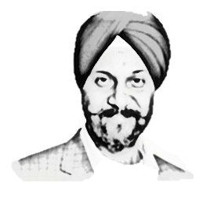



INTRODUCTION
INTRODUCTION
104 $Bn Industry – 50 mn creators
Global Knowledge Mkt - $ 1.1 Tn by 2026
INTRODUCTION
SOUL LLP
LINKS :
  jasvirsinghnagi.com
  SOULLLP.com
  risedigitalhub.com
Quick Intro to RISEUP
DIGITAL BUSINESS HUB
DIGITAL BUSINESS HUB

Slide 3
INTODUCTION: RISEUP QUICK OVERVIEW
DAY 0
DIGITAL
BUSINESS
PIONEER
RISE 6
CONSULT AND COACH LARGE CORPORATES WITH MONK MINDSET & 5T SKILLS
RISE 5
BECOMING A PRO FOR CONSULTING IN DIGITALIZATION & CHANGE MANAGEMENT CONSULTING IN YOUR FIELD
RISE 4
SCALING THE BUSINESS THROUGH AUTOMATION & INCOME GROWTH THROUGH VARIOUS PLATFORMS
RISE 3
RISE 2
RISE 1
DIGITAL ECOSYSTEM SETUP FOR SCALING THROUGH SALES, MARKETING & TRIBE BUILDING
DIGITAL ASSET CREATION FOR MONETIZATION
DIGITAL ASSET FOR KNOWLEDGE BUSINESS, STRATEGY & PLANNING
PIONEERING & PASSING THE LEGACY
UTILIZE & DIVERSIFY
EARNINGS & INCOME MANAGMENT
SALES & MARKETING AS A SERVICE
INNOVATE & CREATE
RESULT PLANNING
THRIVE
DIGITAL CONSULTING
AS A BUSINESS
DIGITAL PLATFORM FOR INCOME GROWTH
STRIVE – 180 D
MONK QUANTUM PLATINUM DIAMOND GOLD SILVER
BLITZSCALING
LIVE -90 Days
DIGITAL ASSET CREATION & MONETIZATION
DIGITAL BUSINESS ENGINEERING & GROWTH PLANNING
FOUNDATION
GOALS
MIND
HABIT
ACTIVITIES
DIGITAL BUSINESS HUB
PASSION
KNOWLEDGE
PURPOSE
SKILL
DESIRE
EXPERIENCE

Slide 4
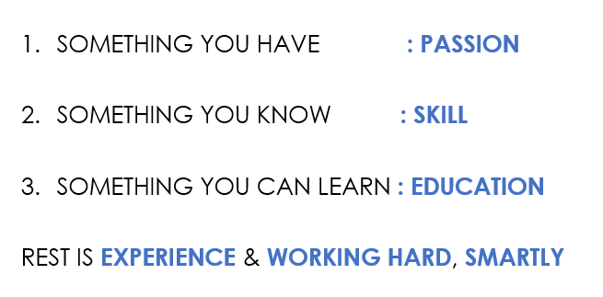
MILLIONAIRE MINDSET
INTRODUCTION: SUCCESS FORMULA
DAY 0
SUCCESS FORMULA :
SOMETHING YOU HAVE : PASSION
SOMETHING YOU KNOW : SKILL
SOMETHING YOU CAN LEARN : EDUCATION
REST IS EXPERIENCE & WORKING HARD, SMARTLY
Passion Circle
80% Passion + 10% clarity on growth or life to lead + 10% Experience
DIGITAL BUSINESS HUB

Slide 5
INTRODUCTION: ONE PAGER CLARITY SHEET
Niche | Digitalization Consulting & Digital Business Planning For Creating & Monetizing Digital Assets
Target Mkt | Solopreneurs and SME Businesses, Executives of LE who would like to be a part of the Knowledge and Creator economy in the Digital Age | Services Through Consulting & Courseware
Designation | RISE BUSINESS PARTNER at SOUL
Mission | To Make 1 M people and businesses RISE to their goals
Community | RISE DIGITAL BUSINESS ACADEMY
PRODUCT | RISE UP DIGITAL BUSINESS MODEL
SERVING INDIVIDUALS & BUSINESSES TO SUCCEED IN THE DIGITAL AGE
By helping in Creating and distributing Digital Assets for Knowledge and Creator economy through a P2P model to RISE UP to the Success they are seeking.
PITCH | To provide the experience to people and businesses with deep passion (80%) & some clarity (10%) on the growth they want the life they want to lead but lack the experience & guidance (10%) to complete their passion circle
 | RISE UP WITH SOUL ( SOUL provides the experience and knowledge ) : Through the RISE UP Framework
PURPOSE | SOUL provides guidance through consulting and experience using courseware and authored books
GAP to Fill | People with PASSION lacking experience
 | Knowledge | Purpose | Skill | Desire | = PASSION
DIGITAL BUSINESS HUB

Slide 6
RISE 1_1
INTRO | MODEL | SELF | GOAL | PERSEVERANCE | SUCCESS
DAY 1 : WINNING MINDSET
INTRO: INTRODUCTION & ORIENTATION
MODEL: RISE UP MODEL & GOVERNANCE
SELF: SELF DISCOVERY
GOAL: KNOW YOUR GOAL
PERSEVERANCE: PERSEVERANCE WHEEL
SUCCESS: FAIL PROOF YOURSELF
SUCCESS KIT - DAILY

Slide 7
MILLIONAIRE MINDSET
DIGITAL BUSINESS ENGINEERING & GROWTH PLANNING: INTRODUCTION
MINDSET
DAY 1
INTRO | MODEL | SELF | GOAL | PERSEVERANCE | SUCCESS
SUCCESS FORMULA :
SOMETHING YOU HAVE : PASSION
SOMETHING YOU KNOW : SKILL
SOMETHING YOU CAN LEARN : EDUCATION
REST IS EXPERIENCE & WORKING HARD, SMARTLY
DIGITAL BUSINESS HUB

Slide 8
MILLIONAIRE MINDSET
DIGITAL BUSINESS ENGINEERING & GROWTH PLANNING: INTRODUCTION
MINDSET
DAY 1
INTRO | MODEL | SELF | GOAL | PERSEVERANCE | SUCCESS
Understanding Knowledge Business:
Application of knowledge and processes – e.g Advisory
The Creator Economy:
Technology facilitated economy that enables creators to earn revenue from their creation – e.g influencers
Business Models :
[GOODs : Mfg : B2C, D2C, B2B] &
[SERVICES: Distribution, Retail|B2C, D2C, B2B, Aggregators /System Integrators, Franchise]
Reasons for Failure:
Initiation/Complacency, Lack of Experience, Lacking Process, Lack of Resources, Lacking a Mission
Principles for Success:
Education, Risk Taking Capabilities, Problem Solver Attitude, Sales as a Service, Automate to Scale, RISE to Grow,
DIGITAL BUSINESS HUB

Slide 9
MILLIONAIRE MINDSET
DIGITAL BUSINESS ENGINEERING & GROWTH PLANNING: INTRODUCTION
MINDSET
DAY 1
INTRO | MODEL | SELF | GOAL | PERSEVERANCE | SUCCESS
Categorize Yourself : 3 Ways
Novice | Expert | Master & Pioneer
The ecosystem in the Digital World
Website|LMS|Commn System|Sales System|Community Building|Payment System|Automation & Integration
Delivering Expertise:
Do it For You | Do It With You | 121 Coaching |Group Coaching | Digital Ecosystem
Pillars To Rise: 4
Passion: Knowledge, Purpose, Skill, Desire | Foundation: Goals, Mind, Habit, Activities
RISE UP Model
LIVE | STRIVE | THRIVE : Result Planning, Innovate & Create, Sales & Mktg as a Service, Earning Management , Utilize and Diversify, Pioneering
DIGITAL BUSINESS HUB

Slide 10

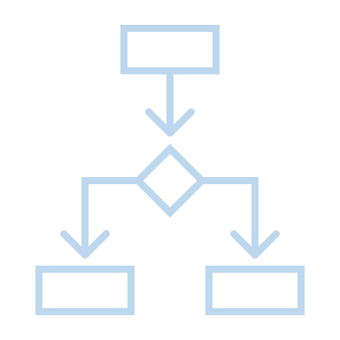

DIGITAL BUSINESS ENGINEERING & GROWTH PLANNING: MODEL ORIENTATION
RISEUP FRAMEWORK
DAY 1
INTRO | MODEL | SELF | GOAL | PERSEVERANCE | SUCCESS
DIGITAL
BUSINESS
PIONEER
RISE 6
CONSULT AND COACH LARGE CORPORATES WITH MONK MINDSET & 5T SKILLS
RISE 5
BECOMING A POINEER AND CONSULTING FOR DIGITALIZATION & CHANGE MANAGEMENT CONSULTING IN YOUR FIELD
RISE 4
SCALING THE BUSINESS THROUGH AUTOMATION & INCOME GROWTH THROUGH VARIOUS PLATFORMS
RISE 3
RISE 2
RISE 1
DIGITAL ECOSYSTEM SETUP FOR SCALING THROUGH SALES, MARKETING & TRIBE BUILDING
DIGITAL ASSET CREATION FOR MONETIZATION
DIGITAL ASSET FOR KNOWLEDGE BUSINESS, STRATEGY & PLANNING
PIONEERING & PASSING THE LEGACY
UTILIZE & DIVERSIFY
EARNINGS & INCOME MANAGMENT
SALES & MARKETING AS A SERVICE
INNOVATE & CREATE
RESULT PLANNING
THRIVE
DIGITAL CONSULTING
AS A BUSINESS
SOM
DIGITAL PLATFORM FOR INCOME GROWTH
STRIVE – 180 D
MONK QUANTUM PLATINUM DIAMOND GOLD SILVER
BLITZSCALING
RISEUP IMPACT OPINE TUNE
LIVE -90 Days
DIGITAL ASSET CREATION & MONETIZATION
TOB
DIGITAL BUSINESS ENGINEERING & GROWTH PLANNING
TIB
FOUNDATION
GOALS
MIND
HABIT
ACTIVITIES
DIGITAL BUSINESS HUB
PASSION
KNOWLEDGE
PURPOSE
SKILL
DESIRE
EXPERIENCE

Slide 11
DIGITAL BUSINESS ENGINEERING & GROWTH PLANNING: GOVERNANCE
RISEUP FRAMEWORK
DAY 1
INTRO | MODEL | SELF | GOAL | PERSEVERANCE | SUCCESS
DIGITAL
BUSINESS
PIONEER
DIGITAL PLATFORM FOR INCOME GROWTH
BLITZSCALING
DIGITAL ASSET CREATION & MONETIZATION
DIGITAL BUSINESS ENGINEERING & GROWTH PLANNING
DIGITAL CONSULTING
AS A BUSINESS
GOVERNANCE:
Weekly Inner Circle Meet: 1.5 hr
  For clarifications
  Feedback
  Support
Monthly Challenge Achievers Club: 1.5hr
  Practicals / Hacks
  Gamification
  Rewards & Recognition
Quantum Leadership Meet: 1.5 hr.
  Strategic Direction
  Collective Criticism & Opinion
  Event Roadmap creation
  Quantum Nominations
RISE 6
CONSULT AND COACH LARGE CORPORATES WITH MONK MINDSET & 5T SKILLS
RISE 5
BECOMING A POINEER AND CONSULTING FOR DIGITALIZATION & CHANGE MANAGEMENT CONSULTING IN YOUR FIELD
RISE 4
SCALING THE BUSINESS THROUGH AUTOMATION & INCOME GROWTH THROUGH VARIOUS PLATFORMS
RISE 3
RISE 2
RISE 1
DIGITAL ECOSYSTEM SETUP FOR SCALING THROUGH SALES, MARKETING & TRIBE BUILDING
DIGITAL ASSET CREATION FOR MONETIZATION
DIGITAL ASSET FOR KNOWLEDGE BUSINESS, STRATEGY & PLANNING
PIONEERING & PASSING THE LEGACY
UTILIZE & DIVERSIFY
EARNINGS & INCOME MANAGMENT
SALES & MARKETING AS A SERVICE
INNOVATE & CREATE
RESULT PLANNING
THRIVE
SOM
STRIVE
MONK QUANTUM PLATINUM DIAMOND GOLD SILVER
RISEUP IMPACT OPINE TUNE
LIVE
TOB
TIB
FOUNDATION
GOALS
MIND
HABIT
EVENTS
DIGITAL BUSINESS HUB
PASSION
KNOWLEDGE
PURPOSE
SKILL
DESIRE
EXPERIENCE

Slide 12
DIGITAL BUSINESS ENGINEERING & GROWTH PLANNING: PHASES
RISEUP FRAMEWORK
DAY 1
INTRO | MODEL | SELF | GOAL | PERSEVERANCE | SUCCESS
DIGITAL
BUSINESS
PIONEER
DIGITAL PLATFORM FOR INCOME GROWTH
BLITZSCALING
DIGITAL ASSET CREATION & MONETIZATION
DIGITAL BUSINESS ENGINEERING & GROWTH PLANNING
DIGITAL CONSULTING
AS A BUSINESS
RISE 6
CONSULT AND COACH LARGE CORPORATES WITH MONK MINDSET & 5T SKILLS
RISE 5
BECOMING A PRO FOR CONSULTING IN DIGITALIZATION & CHANGE MANAGEMENT CONSULTING IN YOUR FIELD
RISE 4
SCALING THE BUSINESS THROUGH AUTOMATION & INCOME GROWTH THROUGH VARIOUS PLATFORMS
RISE 3
RISE 2
RISE 1
DIGITAL ECOSYSTEM SETUP FOR SCALING THROUGH SALES, MARKETING & TRIBE BUILDING
DIGITAL ASSET CREATION FOR MONETIZATION
DIGITAL ASSET FOR KNOWLEDGE BUSINESS, STRATEGY & PLANNING
PIONEERING & PASSING THE LEGACY
UTILIZE & DIVERSIFY
EARNINGS & INCOME MANAGMENT
SALES & MARKETING AS A SERVICE
INNOVATE & CREATE
RESULT PLANNING
THRIVE
SCALE
SOM
STRIVE
90DAYS
SELL
MONK QUANTUM PLATINUM DIAMOND GOLD SILVER
RISEUP IMPACT OPINE TUNE
30DAYS
SETUP
LIVE
TOB
10DAYS
MIDSET FOCUS
PLAN
TIB
FOUNDATION
GOALS
MIND
HABIT
EVENTS
DIGITAL BUSINESS HUB
PASSION
KNOWLEDGE
PURPOSE
SKILL
DESIRE
EXPERIENCE

Slide 13
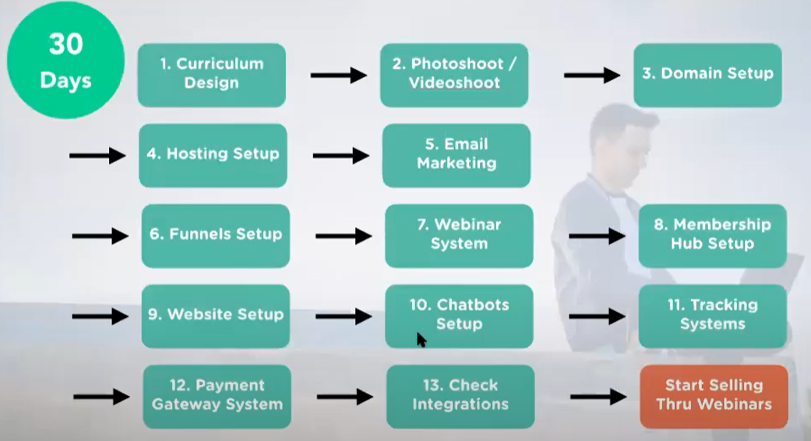












DIGITAL BUSINESS ENGINEERING & GROWTH PLANNING: 90 Day Plan
RISEUP SCHEDULLE
DAY 1
INTRO | MODEL | SELF | GOAL | PERSEVERANCE | SUCCESS
FINISH 90 DAYS
30 DAYS
DIGITAL ASSET CREATION
DIGITAL ASSET
CREATION
COMPLETE 50
Consultations
RESULT PLANNING
FUNNEL
BUILDING
BUILD
SOCIAL GROUP
SCALE
90DAYS
SELL
NICHE CLARITY
LAUNCH ASSET
SETUP SYSTEMS
30DAYS
SETUP
RISE UP MODEL
LEAD MAGNET
LAUNCH
10DAYS
MIDSET FOCUS
START

Slide 14

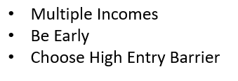

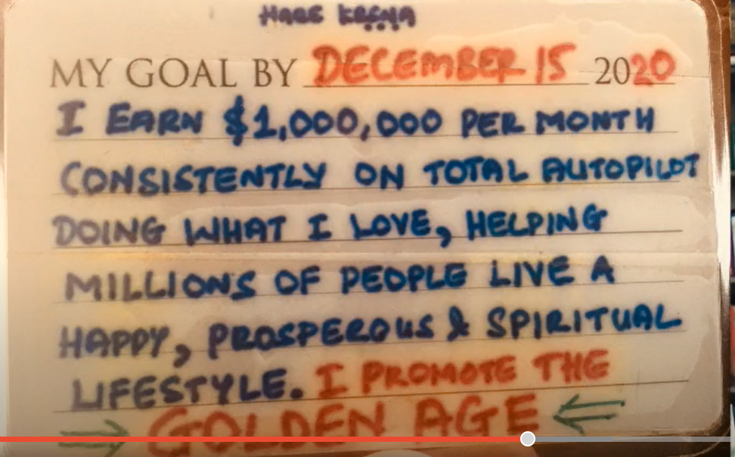
DIGITAL BUSINESS ENGINEERING & GROWTH PLANNING: KNOW YOUR GOAL
SELF DISCOVERY
DAY 1
INTRO | MODEL | SELF | GOAL | PERSEVERANCE | SUCCESS
What is Your PQ
Immediate goal : short term goal 1-2 years
Aspirational goals
Set your intentions and goals
2023 FORMULA
Multiple Incomes
Be Early
Choose High Entry Barrier
MONK QUANTUM PLATINUM DIAMOND GOLD SILVER
MY GOAL CARD
MY GOAL CARD
20____
DIGITAL BUSINESS HUB

Slide 15




DIGITAL BUSINESS ENGINEERING & GROWTH PLANNING: PERSEVERANCE WHEEL
GOAL PERSEVERANCE WHEEL
DAY 1
INTRO | MODEL | SELF | GOAL | PERSEVERANCE | SUCCESS
INSPIRATION
GOAL
WORK
RETREAT
OBSTACLES
MONK QUANTUM PLATINUM DIAMOND GOLD SILVER
PUSH & PERSEVERANCE
MINDSET & MISSION
BOOKS & THE COMPANY YOU KEEP
Motivation video : Eagles Flight
Strangest Secret: EARL Nightingale
DIGITAL BUSINESS HUB

Slide 16

DIGITAL BUSINESS ENGINEERING & GROWTH PLANNING: MAKE YOURSELF RESILIENT
FAIL-PROOF YOURSELF
DAY 1
INTRO | MODEL | SELF | GOAL | PERSEVERANCE | SUCCESS
SUCCESS FORMULA :
SOMETHING YOU HAVE : PASSION
SOMETHING YOU KNOW : SKILL
SOMETHING YOU CAN LEARN : EDUCATION
REST IS EXPERIENCE & WORKING HARD, SMARTLY
MONK QUANTUM PLATINUM DIAMOND GOLD SILVER
Motivation video: EAGLES Flight
Strangest Secret: EARL Nightingale
https://www.youtube.com/watch?v=XLPqy2oO-Eg&t=8s
https://www.youtube.com/watch?v=NbBHR_CD56M&t=22s
DIGITAL BUSINESS HUB
BUILD YOUR COMMUNITY

Slide 17
DIGITAL BUSINESS ENGINEERING & GROWTH PLANNING: YOUR DIGITAL KIT
EVERYDAY DIGITAL KIT
DAY 1
INTRO | MODEL | SELF | GOAL | PERSEVERANCE | SUCCESS
DOWNLOAD
Goal card
Ebook of success: https://jsnagi.ck.page/higherself
Wall Placard: RISE UP
MY GOAL CARD
RISE
UP
1. FOLLOW THE HIGHWAY
Create the Treasure Chest
2.TUNE TO THE FREQUENCY OF YOUR THOUGHT .PATTERN
Understand thought pattern from the Treasure Chest
3. USE POWER OF INTENT
Use the right attitude to form intent
4. 6 SPIRITUAL LAWS OF SUCCESS
USE 4 SPIRITUAL RULES
DIGITAL BUSINESS HUB
MONK QUANTUM PLATINUM DIAMOND GOLD SILVER
INFINITY
MY GOAL CARD
20____
Know Yourself
Find Your Capacity to Give and Accept
Avoid Blocks
Passion Aligned with Natures Positivity
DIGITAL BUSINESS HUB

Slide 18
MILLIONAIRE MINDSET
DIGITAL BUSINESS ENGINEERING & GROWTH PLANNING: YOUR SELF CLARIFICATION SHEET
Digital Business ENGINEERING
Digital Business Growth
DAY 1 : HOMEWORK BUSINESS TEMPLATE
1 | What problem do you want to solve
2 | How do you plan to solve this
 | Purpose
3 | Positioning
 | Niche
 | Target Mkt
 | Mission statement
 | Name of the Hub: Community
 | Personal Designation
4 | 3 Secrets
 | How
 | Where
 | When
5 | Methodology
 | Step 1- 6
6 | COURSE : BLUEPRINT : LEVEL 1
 | VALUE with BONUS :
7 | COURSE : CHALLENGE : LEVEL 2
 | VALUE WITH BONUS:
8 | COURSE : CONSULTING : LEVEL 3
 | VALUE :
10 | Entry Webinar
 | Webinar topic 1
 | Webinar Topic 2
 | Webinar TOPIC 3
11 | SETUP: Co. Name | Domains
 | Company name | XYZ Pvt / LLP
 | Website | Yournam.com/brand.com
 | Hub | Hub_brand.com
 | Click Tracking | XYZ.co
 | Manychat (OPT) | askXYZ .com
12 | Governance
 | 1 Wkly – innercircle
 | 1 Wkly – challenge / gamification
13 | Philanthrophy
 | Charity
DOWNLOAD
10 steps for becoming a focused expert in the digital age: Niche to Positioning :
RISE1_FOCUSED EXPERT_Playbook.pdf
DIGITAL BUSINESS HUB

Slide 19
SAMPLE

Slide 20
RISE 1_2
SKILL | NICHE | MARKET | PERSONAL BRAND
DAY 2 – FINALIZING THE MILLIONAIRE NICHE IDEA
CATEGORISE
SKILL
NICHE SELECTION
DESIGN THINKING OVERVIEW
MARKET VALIDATION
PERSONAL BRAND

Slide 21

RISE
UP
ESULT PLANNING
MILLIONAIRE MINDSET
DIGITAL BUSINESS ENGINEERING & GROWTH PLANNING: CATEGORIZE YOURSELF
NICHE VALIDATION
RISE 1
DAY 2 : SKILL | NICHE | MARKET | PERSONAL BRAND
 | NOVICE | PRO | MASTER
Passion | Passion To Grow | Passion to Grow | Growing
Niche | Not Sure of the Niche | Somewhat clear on the Niche – Not Sub Niche | Understands the Market very well
Experience | Not Experienced in the Craft | Know the craft well | Well known in the industry for the topic & Master at the craft
Tech Skills | Not having Technical Skills | Adequate Technical Skills | Experienced in training possess technical Skills
Sales Experience | Not confident Selling | Somewhat Confident in Selling | Experienced in selling
Content Mktg | Never done Content Mktg | Done Some Content Mktg | Online presence with loyal followers
Email List | No Email List | Some Email List | Big Email List
Strategy | No Strategy, | Strategy not working | Alternate Strategy required for growth
DIGITAL BUSINESS HUB

Slide 22
RISE
UP
ESULT PLANNING
MILLIONAIRE MINDSET
DIGITAL BUSINESS ENGINEERING & GROWTH PLANNING: CATEGORY JOURNEY
NICHE VALIDATION
RISE 1
DAY 2 : SKILL | NICHE | MARKET | PERSONAL BRAND
 | NOVICE | PRO | MASTER
Month 1 | Mindset Niche 121 consultation #100 100 Questions Grow Influence Build Tribe | Mindset Positioning 121 Consultation #20 100 Questions Grow online influence Build Tribe Build Other complementing Digital Assets | Mindset 121 Consultations #10 Grow the Tribe Setup advanced online systems
Month 2 |  | Master & Setup Systems Master FB Ads Master Webinar Selling Reiterate Business Plan | Master Traffic Master Webinar Sales Master Automation Reiterate Business Plan
Month 3 |  |  | Goals > INR 5 Mn / month Customers > 3000
Month 3-6 | Design Asset Setup Systems Master Facebook Ads Master Webinar Selling Reiterate Business Plan | Scale Budget to Grow Goals > INR 1Mn / month Customers > 1000
Month 6-12 | Scale Budget to Grow Goals > INR 0.5 Mn / month Customers > 500 | Scale Budget for further Growth Goals > INR 3 Mn / month Customers > 5000 | Scale Budget for further Grow Goals > INR 10 Mn / month Customers > 5000
DIGITAL BUSINESS HUB

Slide 23
RISE
UP
ESULT PLANNING
MILLIONAIRE MINDSET
DIGITAL BUSINESS ENGINEERING & GROWTH PLANNING: SKILLS ORIENTATION
NICHE VALIDATION
RISE 1
DAY 2 : SKILL | NICHE | MARKET | PERSONAL BRAND
BUSINESS SKILLS | PRIMARY | TERTIARY
MARKET RESEARCH | Customer Centricity Content Keyword Assets to Solve Problems | Market Awareness Macro & Micro Scenario
SALES | Video Marketing Copywriting Webinar Selling | Emotional Connect Rapport Building Getting people to Trust
MARKETING | Content FB & Google Ads | Videos Podcasts Blog Vlogs
SYSTEMS | Lead Sales Funnel Tracking Webinar LMS | Automation Skill Orientation
“If Passion doesn’t solve a problem, then it is just a hobby”
DIGITAL BUSINESS HUB

Slide 24
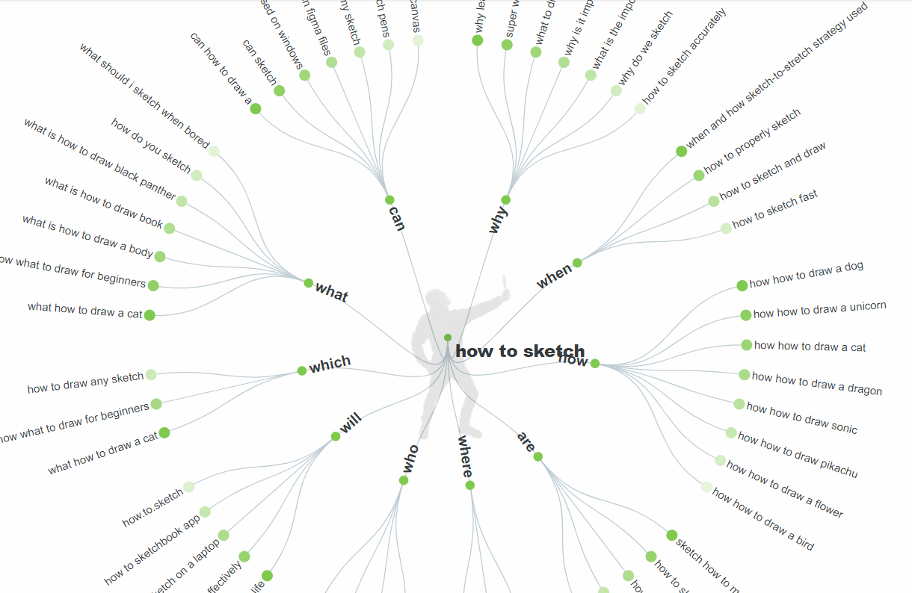
RISE
UP
ESULT PLANNING
MILLIONAIRE MINDSET
DIGITAL BUSINESS ENGINEERING & GROWTH PLANNING: NICHE FINALIZATION
NICHE VALIDATION
RISE 1
DAY 2 : SKILL | NICHE | MARKET | PERSONAL BRAND
 | Theme | Question - answerthepublic.com | Story 1 | Story 2 | Story 3
1 | Industry Facts | What Are The Different Type Of Digital Assets?
2 | Industry Facts | What Are Benefits of creating Digital Assets?
3 | Industry Facts | What Are The Most popular Digital Assets Being Consumed ?
4 | Industry Facts
5 | Industry Facts
6 | Industry Facts
7 | Industry Facts
8 | Industry Facts
9 | Industry Facts
10 | Industry Facts
11 | SUBJECT
12 | SUBJECT
13 | SUBJECT
14 | SUBJECT
15 | SUBJECT
16 | SUBJECT
17 | SUBJECT
18 | SUBJECT
19 | SUBJECT
20 | SUBJECT
21 | Theme 3
22 | Theme 3
23 | Theme 3
24 | Theme 3
25-100 | Theme 3
“If Passion doesn’t solve a problem, then it is just a hobby”
DIGITAL BUSINESS HUB

Slide 25
RISE
UP
ESULT PLANNING
MILLIONAIRE MINDSET
DIGITAL BUSINESS ENGINEERING & GROWTH PLANNING: NICHE FINALIZATION
NICHE VALIDATION
RISE 1
DAY 2 : SKILL | NICHE | MARKET | PERSONAL BRAND
NICHE | SUB NICHE | E.G. MICRO NICHE | E.G. MICRO NICHE
Business Growth | Sales Branding Marketing Operations People Finance Research Industries | SALES Lead Generation Automated Selling Direct Sales Funnel Sales Video Sales Webinar Seminar Negotiation | MARKETING Digital Marketing Influencer Social FB Google Insta Twitter YouTube Offline Print | Radio | Display
Career Growth
Health & Wellness
Money Making
Relationships
Art & Crafts
DIGITAL BUSINESS HUB

Slide 26
RISE
UP
ESULT PLANNING
MILLIONAIRE MINDSET
DIGITAL BUSINESS ENGINEERING & GROWTH PLANNING: MICRO NICHE FINALIZATION
NICHE VALIDATION
RISE 1
DAY 2 : SKILL | NICHE | MARKET | PERSONAL BRAND
MICRO NICHE :
your Passion should solve Problems within a targeted marketplace focused on the decided Persona of the audience showing Potential in their requirements and capable of finding value in the Payment requested.
MARKET PLACES | KEY PLAYERS | Example
Learning | UDEMY COURSERA SIMPLILEARN LINKEDIN LEARNING SKILLSHARE CREATIVE LIVE | Udemy.com/featured-topics/
Affiliate | CLICKBANK JVZOO SHAREASALE
Resources | QUORA MEDIUM BRAINLY BUZZSUMO ANSWERTHEPUBLIC | Raise Questions & Collect 100 answers for 100 questions
Use the Market Place to research, validate and finalize the MICRO-NICHE
DIGITAL BUSINESS HUB

Slide 27
RISE
UP
ESULT PLANNING
MILLIONAIRE MINDSET
DIGITAL BUSINESS ENGINEERING & GROWTH PLANNING: DIGITAL ASSET GUIDELINES
NICHE VALIDATION
RISE 1
DAY 2 : SKILL | NICHE | MARKET | PERSONAL BRAND
DESIGN THINKING
Prioritize According to your skills
Choose the Asset to productize
Initiate Selling for Feedback amongst a close group
EMPATHIZE
Persona
Decisions
DEFINE
Seek to Understand
Non Judgemental
IDEATE
Prioritize
Share & Feedback
PROTOTYPE
TEST
Iterate
Keep It Simple
Challenges
Pain Points
Interviews
Experiment
Shortlist what works
Iterate Quickly
Minimal Viable Product
100 Questions
100 Answers
DIGITAL BUSINESS HUB

Slide 28
RISE
UP
ESULT PLANNING
MILLIONAIRE MINDSET
DIGITAL BUSINESS ENGINEERING & GROWTH PLANNING: SOCIAL PRESENCE
NICHE VALIDATION
RISE 1
DAY 2 : SKILL | NICHE | MARKET | PERSONAL BRAND
TOPIC | ACTIVITY
Clarify Your Message | MISSION STATEMENT CORE MESSAGE
Personal Representation | BRING OUT YOUR PERSONA YOUR FUTURE YOU
Create Your Logo | CANVA FIVERR 99designs.com
Setup Your Blog | YOURNAME.COM
Create a Social Profile | FB | YouTube| Insta | Twitter | LinkedIn | PF Page | Quora
“ Your Passion should solve Problems within a targeted marketplace focused on the decided Persona of the audience showing Potential in their requirements and capable of finding value in the Payment requested ”
TOPIC | ACTIVITY
Define Your Funnel | WEBINARS Ebooks TERTIARY PRODUCTS/ SERVICES
Grow Your Influence | PUBLISH QUALITY CONTENT REGULARLY
Be Part Of A Community | JOIN VARIOUS COMMUNITY OF LIKEMINDED PEOPLE
Analyze Results Regularly | TRACK ALL ASPECTS OF THE BUSINESS CLOSELY FAIL FAST – STOP WHAT DOESN’T WORK SCALE WHAT DOES
Persist | WORK HARD & SMART BE PATIENT BE CONSISTENT
DOWNLOAD
REVIEW YOUR PLAYBOOK
10 steps for becoming a focused expert in the digital age: Niche to Positioning :
RISE1_FOCUSED EXPERT_Playbook.pdf
DIGITAL BUSINESS HUB

Slide 29
DIGITAL BUSINESS ENGINEERING & GROWTH PLANNING: CHALLENGE
NICHE VALIDATION
TOPIC | ACTIVITY
Clarify Your Message
Personal Representation
Create Your Logo
Setup Your Blog
Create a Social Profile
CHALLENGE
TOPIC | ACTIVITY
Define Your Funnel
Grow Your Influence
Be Part Of A Community
Analyze Results Regularly
Persist

Slide 30
RISE 1_3
SYSTEM | FUNNEL | JOURNEY | GO
DAY 3 – DIGITAL SYSTEM BUILDING FRAMEWORK
SYSTEM: DIGITAL SYSTEM
FUNNEL: PRINCIPLES OF FUNNEL GENERATION
JOURNEY: CATEGORIZE & MANAGE THE JOURNEY
GO: PUTTING IT ALL TOGETHER

Slide 31
RISE
UP
MILLIONAIRE MINDSET
DIGITAL BUSINESS ENGINEERING & GROWTH PLANNING: DIGITAL SYSTEM
Digital Business ENGINEERING
Digital Business Growth
DAY 3 :
SYSTEM | FUNNEL | JOURNEY | GO
SYSTEMS | Purpose | Vendors (e.g.)
WEBSITE | Hosting Domains Documents & Reports | Bluehost Wpx Hosting Namecheap Google Drive
LMS | Courseware creation | Teachable
COMMUNICATION | Email Marketing Chatbots | Convertkit Getresponse Manychat
FUNNEL | Funnel Building | ClickFunnel
WEBINAR | Webinar On Demand Webinar | Demio Zoom Webinar Jam Ever Webinar
COMMUNITY | PC / Laptop Phone-based community building | Mighty Networks Telegram WA
LINK TRACKING | Click tracking system for Analysis and follow through | ClickMagick
PAYMENT | Online Payments Mobile Payments International Payments | RazorPay Instamojo Paypal Mint
AUTOMATION | Integrations between various systems for complete automation | Zapier
THE RISE BAAP SYSTEM
DATA ANALYSIS & FEEDBACK MECHANISM WITH REPORTS
PROLIFERATE
Target 4
Target 3
Target 2
Target 1
ADMINISTER : CONTROL & MANAGE
Marketing campaigns
System &
The Control Hub
Community
FUNNEL
Lead Segregation
Automated Traffic & Retargeting System
ACTIVATE
Website – Blogs/Vlogs
Communication
Webinar
Landing Pages
Automated Tracking
SOCIAL MEDIA
( Pick one Source when beginning)
YOUR CUSTOMERS
DIGITAL ASSET CONSUMPTION`
DIGITAL BUSINESS HUB

Slide 32
MILLIONAIRE MINDSET
DIGITAL BUSINESS ENGINEERING & GROWTH PLANNING: PRINCIPLES OF FUNNEL GENERATION
Digital Business ENGINEERING
Digital Business Growth
DAY 3 :
SYSTEM | FUNNEL | JOURNEY | GO
Facebook
YouTube
LinkedIn
..
FUNNEL
PREFRAMING
Videos
Conversion
Stages
Posts
Blogs
The Hook
The Product
The Offer
Community
FB Group
Private Group
Telegram Group
Concepts
Lead Magnet
Free Webinar
Tripwire
Conceptual Course
Core Product
Implementation
Profit Maximiser
Coaching
Affiliate
Blueprint
Maximum Potential
BAAP System
RFM RISE FUNNEL MONETIZATION SYSTEM
MONETIZATION
WEBSITE /
LANDING PAGES
Lead Capture
WEBINARS
OTHER SOCIAL SOURCES
EMAILS
DIGITAL BUSINESS HUB

Slide 33
MILLIONAIRE MINDSET
DIGITAL BUSINESS ENGINEERING & GROWTH PLANNING: CATEGORY JOURNEY
Digital Business ENGINEERING
Digital Business Growth
DAY 3 :
SYSTEM | FUNNEL | JOURNEY | GO
30 DAYS
 | NOVICE | PRO | MASTER
Month 1 | Mindset Niche 121 consultation #100 100 Questions Grow Influence Build Tribe | Mindset Positioning 121 Consultation #20 100 Questions Grow online influence Build Tribe Build Other complementing Digital Assets | Mindset 121 Consultations #10 Grow the Tribe Setup advanced online systems
Month 2 |  | Master & Setup Systems Master FB Ads Master Webinar Selling Reiterate Business Plan | Master Traffic Master Webinar Sales Master Automation Reiterate Business Plan
Month 3 |  |  | Goals > INR 5 Mn / month Customers > 3000
Month 3-6 | Design Asset Setup Systems Master Facebook Ads Master Webinar Selling Reiterate Business Plan | Scale Budget to Grow Goals > INR 1Mn / month Customers > 1000
Month 6-12 | Scale Budget to Grow Goals > INR 0.5 Mn / month Customers > 500 | Scale Budget for further Growth Goals > INR 3 Mn / month Customers > 5000 | Scale Budget for further Grow Goals > INR 10 Mn / month Customers > 5000
DIGITAL ASSET CREATION
SCALE
90DAYS
SELL
30DAYS
SETUP
10DAYS
MIDSET FOCUS
DIGITAL BUSINESS HUB

Slide 34
MILLIONAIRE MINDSET
DIGITAL BUSINESS ENGINEERING & GROWTH PLANNING: PUTTING IT ALL TOGETHER
Digital Business ENGINEERING
Digital Business Growth
DAY 3 :
SYSTEM | FUNNEL | JOURNEY | GO
FINISH 90 DAYS
DIGITAL ASSET
CREATION
COMPLETE 50
Consultations
INSPIRATION
GOAL
WORK
RETREAT
RESULT PLANNING
FUNNEL
BUILDING
BUILD
SOCIAL GROUP
OBSTACLES
PUSH & PERSEVERANCE
MINDSET & MISSION
BOOKS & THE COMPANY YOU KEEP
NICHE CLARITY
LAUNCH ASSET
SETUP SYSTEMS
Motivation video : Eagles Flight
Strangest Secret: EARL Nightingale
RISE UP MODEL
LEAD MAGNET
LAUNCH
PERSEVERANCE WHEEL
START
DIGITAL BUSINESS HUB

Slide 35
RISE 1_4
CHANGE | EPIC | RIOT | TIB | TOB | SOM
DAY 4 – CHANGE & CONTINUOUS IMPROVEMENT
WHAT IS CHANGE MANAGEMENT
EPIC MODEL & RIOT METHODOLOGY
3M STRATEGY USING TIB | TOB | SOM

Slide 36
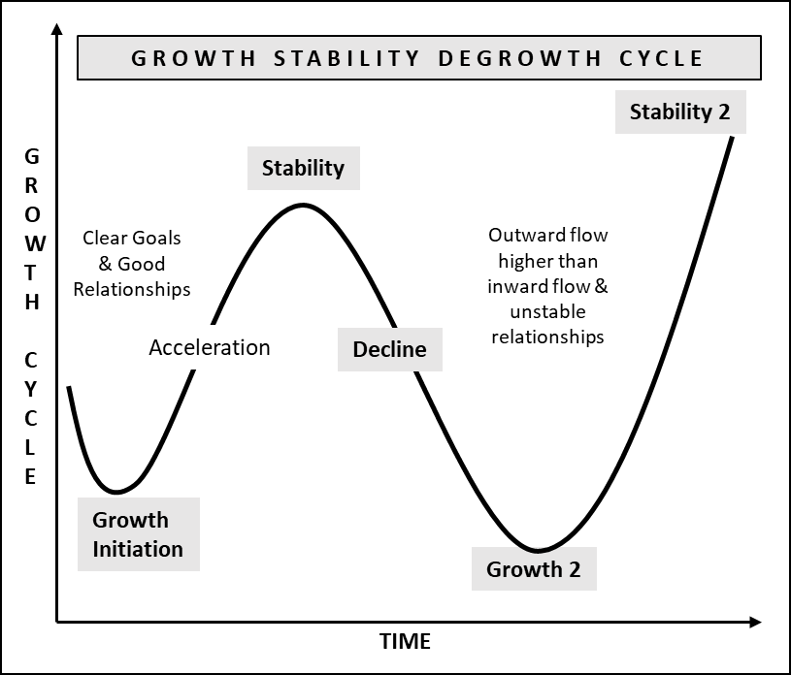
MILLIONAIRE MINDSET
DIGITAL BUSINESS ENGINEERING & GROWTH PLANNING: CHANGE MGMT THE MILLIONAIRE WAY
CHANGE MANAGEMENT
DAY 4 :
CHANGE | EPIC | RIOT | TIB | TOB | SOM
Change management is a systematic approach to dealing with the transition and discrete changes to achieve short-term goals.
Transformational change doesn’t focus on a few discrete, well-defined shifts, but rather on a portfolio of initiatives, which are interdependent or intersecting to meet the larger strategic goal.
DIGITAL BUSINESS HUB

Slide 37
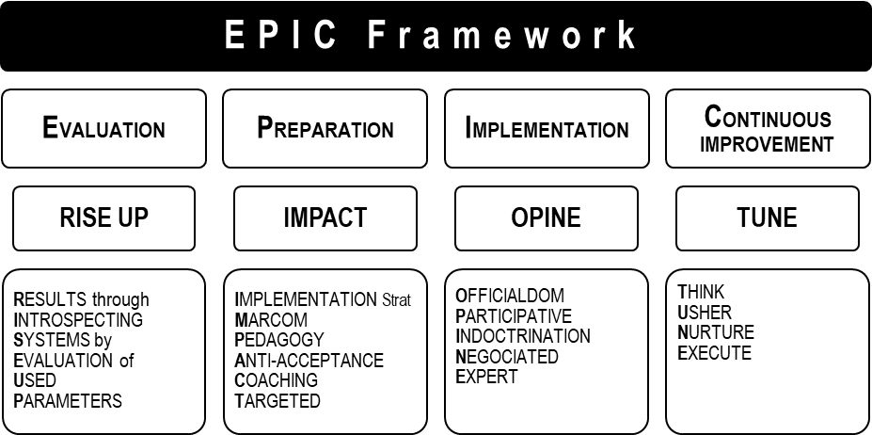
MILLIONAIRE MINDSET
DIGITAL BUSINESS ENGINEERING & GROWTH PLANNING: CHANGE MGMT THE MILLIONAIRE WAY
CHANGE MANAGEMENT
DAY 4 :
CHANGE | EPIC | RIOT | TIB | TOB | SOM
TRANSFORMATION USING EPIC FRAMEWORK and applying RIOT Methodology
ORGANIZATION CHANGE :
Human Change
Technology Change
  E.g., Digitalization
DIGITAL BUSINESS HUB

Slide 38
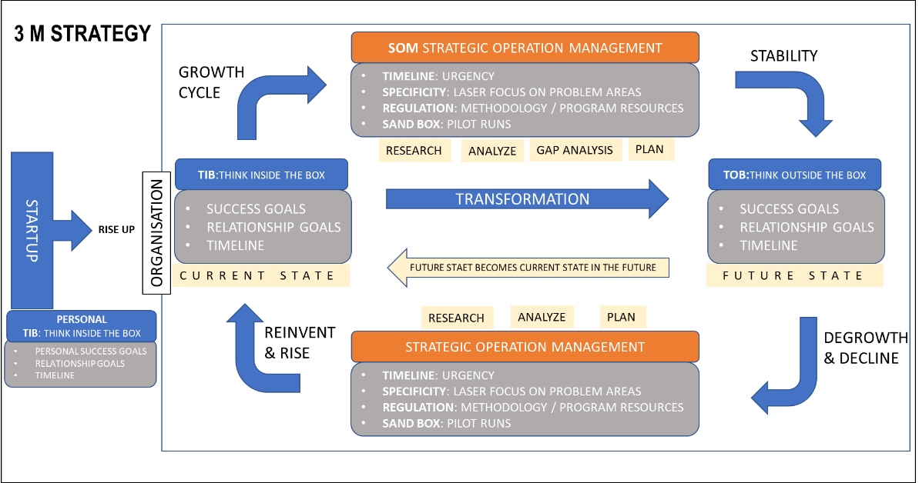
MILLIONAIRE MINDSET
DIGITAL BUSINESS ENGINEERING & GROWTH PLANNING: CHANGE MGMT THE MILLIONAIRE WAY
TRANSFORMATION STRATEGY
DAY 4 :
CHANGE | EPIC | RIOT | TIB | TOB | SOM
TRANSFORMATION WITH 3M STRATEGY
DIGITAL BUSINESS HUB

Slide 39
RISE 1_5
OVERVIEW | TEMPLATE | PRACTICAL
DAY 5 – BUSINESS PLANNING BLUEPRINT
RESULT PLANNING OVERVIEW
BUSINESS PLAN TEMPLATE
BUSINESS PLAN CHALLENGE – 3 YR. Plan : PRACTICAL

Slide 40
MILLIONAIRE MINDSET
DIGITAL BUSINESS ENGINEERING & GROWTH PLANNING: BUSINESS PLANNING
BUSINESS PLANNING TEMPLATE
DAY 5 :
OVERVIEW | TEMPLATE | PRACTICAL
TOPIC | DESCRIPTION
OVERVIEW
( Digital Business Fundamentals ) | •INTRODUCTION : RISE WITH SOUL : BUSINESS OVERVIEW | RISE UP MODEL
STRATEGY | •STRATEGIC PLANNING : | TIB | TOB | SOM
( Digital Business Strategy Fundamentals ) | •Vision | Mission | Purpose
 | •Digital Asset to be Productized ( service as a product )
 | •Current State | Future State |
 | •Competitive Advantage : NICHE
 | •Road Map: 1 yr. : Curr State to Future State (3M Strategy)
CUSTOMER EXPERIENCE | •CUSTOMER ACQUISITION Overview
 | •Customer Engagement & Communication Strategy : WEBINAR, FUNNEL - DIGITAL SYSTEM
 | •Customer Experience
SALES GROWTH | •SALEs Overview
 | •Revenue Goal
 | •Growing Sales < Lead Gen +Traffic + Plan > : TOOLS : DIGITAL SYSTEM
 | •Team Size [ Tuckman model ]
OPERATION AUTOMATION | •OPERATION EFFICIENCY & ORGANIZATION STRUCTURE
 | •Sales | HR | IT & Admin | Legal | Finance & Accounting | Operations : Mfg., Delivery, Fulfilment, SCM
GROWTH @ Speed of Change | •EXPANSION:
 | •INORG : JV | Partnerships | M&A
 | •ORG : Franchising | Verticalisation | Niche | Mkt Penetration
 | •DIVERSIFICATION: Secondary Prod | Tertiatry Products | Backward Integration
DIGITAL BUSINESS HUB

Slide 41
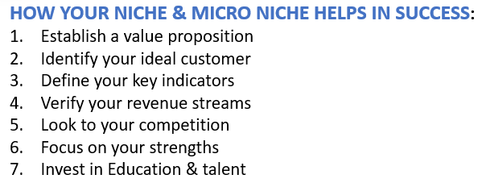
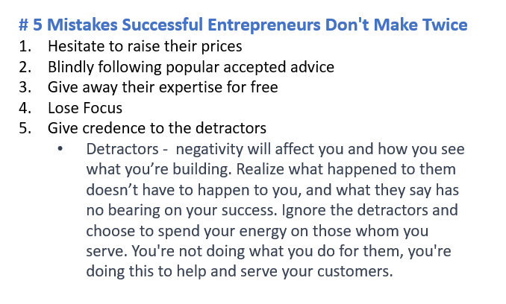
MILLIONAIRE MINDSET
DIGITAL BUSINESS ENGINEERING & GROWTH PLANNING: BUSINESS PLANNING
Digital Business ENGINEERING
Digital Business Growth
DAY 5 :
OVERVIEW | TEMPLATE | PRACTICAL
HOW YOUR NICHE & MICRO NICHE HELPS IN SUCCESS:
Establish a value proposition
Identify your ideal customer
Define your key indicators
Verify your revenue streams
Look to your competition
Focus on your strengths
Invest in Education & talent
# 5 Mistakes Successful Entrepreneurs Don't Make Twice
Hesitate to raise their prices
Blindly following popular accepted advice
Give away their expertise for free
Lose Focus
Give credence to the detractors
  Detractors - negativity will affect you and how you see what you’re building. Realize what happened to them doesn’t have to happen to you, and what they say has no bearing on your success. Ignore the detractors and choose to spend your energy on those whom you serve. You're not doing what you do for them, you're doing this to help and serve your customers.
DIGITAL BUSINESS HUB

Slide 42
MILLIONAIRE MINDSET
DIGITAL BUSINESS ENGINEERING & GROWTH PLANNING: BUSINESS PLANNING
Digital Business ENGINEERING
Digital Business Growth
DAY 5 :
OVERVIEW | TEMPLATE | PRACTICAL
TUCKMAN MODEL : FOR WORKING WITH TEMPORARY TEAMS e.g., FREELANCERS
FORMING | STORMING | NORMING | PERFORMING | ADJOURNING
Introduction of team members and their hobbies, interests and skills | Conflicts arise during meetings or work sessions | Conflicts are much less frequent, and if they do arise, it's easy to solve them | The leader rarely intervenes but instead helps facilitate only when needed | Accolate at the project's ending
Polite, quiet team members | The team questions the authority of the leader or supervisor | All team members understand their specific roles and responsibilities | Team members work autonomously on tasks | Keep in touch – even though Uncertainty about the future
Reliance on the group leader | Team members work to establish what their roles and responsibilities are within the project | The team leader helps delegate work and answers any questions from the team | The project is nearing completion | Show gratitude - A sense of loss over the separation of the team
Focus on establishing roles, responsibilities and goals | The team functions more as individual members than as a cohesive unit | The team might socialize together outside of a professional setting | Any conflict is usually constructive and related directly to the project rather than personal disagreements
Development of a project timeline
DIGITAL BUSINESS HUB

Slide 43
MILLIONAIRE MINDSET
DIGITAL BUSINESS ENGINEERING & GROWTH PLANNING: BUSINESS PLANNING
Digital Business ENGINEERING
Digital Business Growth
DAY 5 :
OVERVIEW | TEMPLATE | PRACTICAL
PRACTICAL -WORK
DOWNLOAD :
  RISE1_BUSS_PLAN_WORKING.xlsx
  RISE_1_SAMPLE BUSS PLAN_RISE.docx
FILL out your estimated goals for the revenue in xls
Come prepared for the Practical Session and raise queries if any?
RESULT PLANNING : COMPLETE & CERTIFY YOURSELF
DIGITAL BUSINESS HUB

Slide 44
MILLIONAIRE MINDSET
DIGITAL BUSINESS ENGINEERING & GROWTH PLANNING: BUSINESS PLANNING
Digital Business ENGINEERING
Digital Business Growth
DAY 5 :
OVERVIEW | TEMPLATE | PRACTICAL
END OF RISE 1
DIGITAL BUSINESS HUB

Slide 45
DIGITAL BUSINESS ENGINEERING & GROWTH PLANNING
Globalnewswire23 June 2021
Global Knowledge Management Market to Reach $1.1 Trillion by 2026
Digital knowledge assets or knowledge-based intellectual property.
knowledge industry: an industry whose success depends on having and using knowledge about a particular subject
Knowledge-Based Services, commonly referred to as Advisory and Assistance Services (A&AS), relate to tasks that require the application of detailed processes or technical knowledge.
Knowledge management is a managerial approach through which an organization collects, analyzes, systematizes, stores, and shares its knowledge assets or knowledge-based intellectual property.
Academic institutions, companies engaging in research and development (R&D), programmers developing new software and search engines for data, and health workers using digital data to improve treatments are all components of a knowledge economy.
These economy brokers pass on the results of their research to workers in more traditional fields, such as farmers who use software applications and digital solutions to manage their crops better, advanced technological-based medical procedures such as robot-assistant surgeries, or schools that provide digital study aids and online courses for students.
What Are the Most Valuable Skills in the Knowledge Economy?
While higher education and technical training are obvious assets, communication and teamwork are also essential skills for a knowledge-based economy, according to the Organization for Economic Cooperation and Development. Since it is unlikely that any single knowledge worker can generate groundbreaking innovations alone, these interpersonal and workplace competencies are essential to surviving in a knowledge-based workplace
https://www.springboard.com/blog/business-and-marketing/creator-economy/
Research shows that millennials don’t respond to traditional advertising, which makes influencer partnerships a crucial part of a brand’s marketing strategy. Creators can also sell content such as ebooks, courses, podcasts, and newsletters on their own website in exchange for a monthly subscription, pay-per-view, or donation.
https://www.robosoftin.com/blog/creator-economy-and-role-of-digital-experience
104 $Bn Industry – 50 mn creators
DIGITAL BUSINESS HUB

Slide 46
INTRODUCTION: ONE PAGER CLARITY SHEET
Niche | Digitalization Consulting & Digital Business Planning For Creating & Monetizing Digital Assets
Target Mkt | Solopreneurs and SME Businesses, Executives of LE who would like to be a part of the Knowledge and Creator economy in the Digital Age | Services Through Consulting & Courseware
Designation | RISE BUSINESS PARTNER at SOUL
Mission | To Make 1 M people and businesses RISE to their goals
Community | RISE DIGITAL BUSINESS ACADEMY
PRODUCT | RISE UP DIGITAL BUSINESS MODEL
SERVING INDIVIDUALS & BUSINESSES TO SUCCEED IN THE DIGITAL AGE
By helping in Creating and distributing Digital Assets for Knowledge and Creator economy through a P2P model to RISE UP to the Success they are seeking.
PITCH | To provide the experience to people and businesses with deep passion (80%) & some clarity (10%) on the growth they want the life they want to lead but lack the experience & guidance (10%) to complete their passion circle
 | RISE UP WITH SOUL ( SOUL provides the experience and knowledge ) : Through the RISE UP Framework
PURPOSE | SOUL provides guidance through consulting and experience using courseware and authored books
GAP to Fill | People with PASSION lacking experience
 | Knowledge | Purpose | Skill | Desire | = PASSION
PRODUCTS & SERVICS
COURSEWARE & BOOKS | Business Planning & Growth | PRODUCT
B/VLOGS & PODCAST | Digitalization
 | Change Management Consulting
 | Digital Asset Creation & Selling
CONSULTING | CHANGE MANGEMENT | SERVICES
ADVISORY | DIGITALIZATION
 | Digital Business Planning for Solopreneurs & Startup
DIGITAL BUSINESS HUB

