Slide 1
RISE 2_1
DAY 1 : DIGITALIZATION
UNDERSTAND : INTRO: WHAT IS DIGITALIZATION ?
DECIDE : DIGITAL ASSET DECISION MAKING PROCESS
STRATEGIZE : DIGITAL ASSET FOCUSSED STRATEGY

Slide 2
MILLIONAIRE MINDSET
DIGITAL ASSET CREATION & MONETIZATION: UNDERSTAND
DIGITALIZATION
DAY 1
UNDERSTAND | DECIDE | STRATEGIZE
Digitalization also known as Digital Transformation is the use of digital technologies for transforming business models to improve eﬃciencies for better top and bottom lines in the process of creating a highly efficient ecosystem.
Digitalization is necessary in the current stage of the digital era to maintain a competitive edge, since digitalization will help organizations to:
  Promptly change business models to accommodate the changes ushered in by digitalization
  Manage large ecosystems that emerge due to Digitalization
  Enhance user experience
  Increase their services or products portfolio to cover a large user group, quickly
Ecosystem
[consisting of internal and external stakeholders]
Platform Based
[Using platforms to create digital assets like courses, eCommerce activities, Publishing, Vlogs, sales, and Mktg. through various platforms]
WHAT IS DIGITALIZATION ?
Digitally Enhanced:
[creating eBooks/Blogs, configuring mobile, social media with the application, etc.]
Digitization
(at the individual level) :[digitally enabled: use of computing, application software, etc.]
DIGITALIZATION AT INDIVIDUAL P2P level
DIGITAL BUSINESS HUB

Slide 3
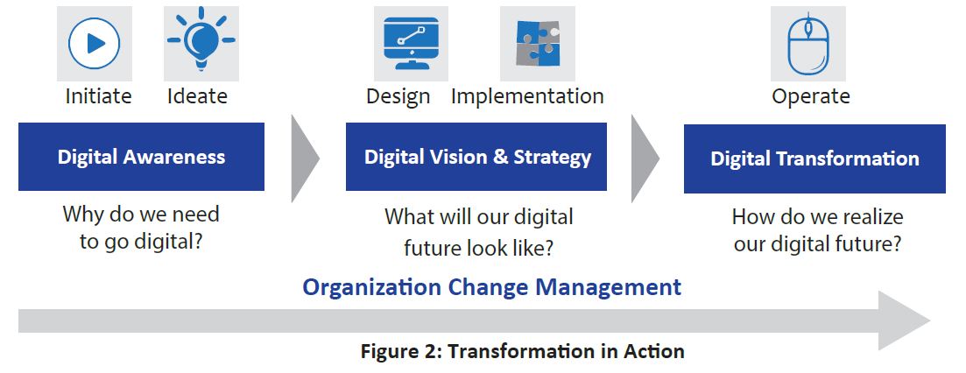
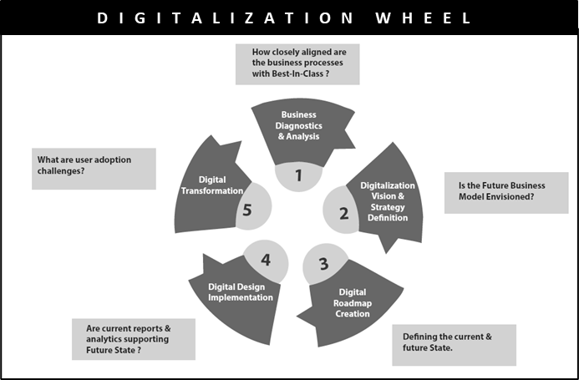
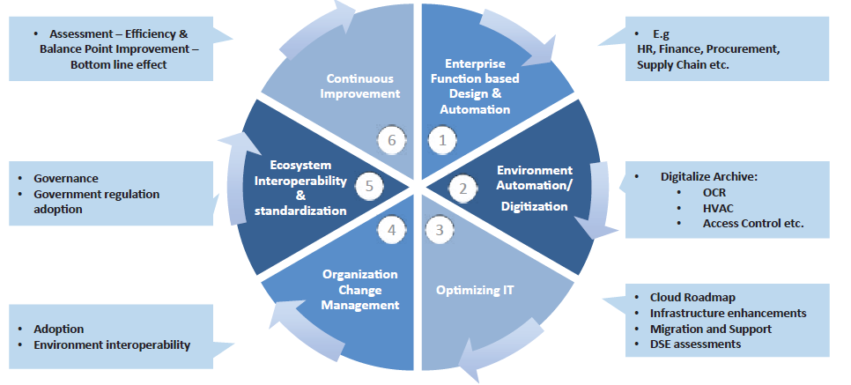
MILLIONAIRE MINDSET
DIGITAL ASSET CREATION & MONETIZATION : UNDERSTAND
DIGITALIZATION
DAY 1
UNDERSTAND | DECIDE | STRATEGIZE
IIDIO : DIGITALIZATION PRINCIPLES
DIGITALIZATION PREPARATION
HOW IS DIGITALIZATION EXECUTED?
DIGITAL BUSINESS HUB
DIGITALIZATION EXECUTION

Slide 4
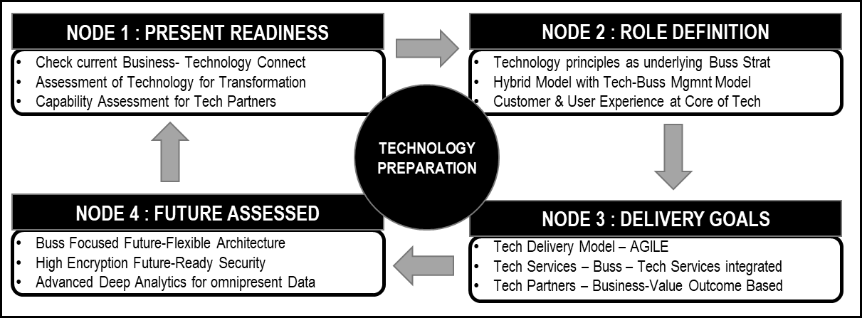
MILLIONAIRE MINDSET
DIGITAL ASSET CREATION & MONETIZATION: DECIDE
DIGITALIZATION
DAY 1
UNDERSTAND | DECIDE | STRATEGIZE
DESIGN THINKING
Prioritize According to your skills
Choose the Asset to productize
Initiate Selling for Feedback amongst a close group
EMPATHIZE
Persona
Decisions
DEFINE
Seek to Understand
Non Judgemental
IDEATE
Prioritize
Share & Feedback
PROTOTYPE
TEST
Iterate
Keep It Simple
Challenges
Pain Points
Interviews
Experiment
Shortlist what works
Iterate Quickly
Minimal Viable Product
100 Questions
100 Answers
DIGITAL ASSET DECISION MAKING PROCESS?
CHECK YOU RACE SCORE:
www.seesiminc.com
DIGITAL BUSINESS HUB

Slide 5
MILLIONAIRE MINDSET
DIGITAL ASSET CREATION & MONETIZATION: STRATEGIZE
DIGITALIZATION
DAY 1
UNDERSTAND | DECIDE | STRATEGIZE
GOAL Q1 : 90 DAY PLAN FROM RISE 1
Y1:Q1
Ecosystem
[consisting of internal and external stakeholders]
No. of Digital Assets :
Revenue Goal :
Current Gaps
Monthly & Qtly Roadmap:
Platform Based
[Using platforms to create digital assets like courses, eCommerce activities, Publishing, Vlogs, sales, and Mktg. through various platforms]
Q2
GOAL Q2
WHAT IS YOUR DIGITAL ASSET FOCUSSED STRATEGY AND ITS ACTION PLAN ?
No. of Digital Assets :
Revenue Goal :
Current Gaps
Monthly & Qtly Roadmap:
Digitally Enhanced:
[creating eBooks/Blogs, configuring mobile, social media with the application, etc.]
Q3
GOAL Q3
Digitization
(at the individual level) :[digitally enabled: use of computing, application software, etc.]
No. of Digital Assets :
Revenue Goal :
Current Gaps
Monthly & Qtly Roadmap:
Q4
GOAL Q4
DIGITALIZATION AT INDIVIDUAL P2P level
No. of Digital Assets :
Revenue Goal :
Current Gaps
Monthly & Qtly Roadmap:
DIGITAL BUSINESS HUB

Slide 6
MILLIONAIRE MINDSET
DIGITAL ASSET CREATION & MONETIZATION: STRATEGIZE
DIGITALIZATION
DAY 1
UNDERSTAND | DECIDE | STRATEGIZE
CHALLENGE
TWEAK YOUR BUSINESS PLAN AS PER YOUR CURRENT UNDERSTANDING
USING THE DIGITALIZATION PRINCIPLES
DIGITAL BUSINESS HUB

Slide 7
RISE 2_2
DAY 2 : DIGITAL PRODUCT DESIGN
DESIGN PRINCIPLES
PASSION V/s TREND
SUCCESS STEPS
BOTTOMLINE
BRINGING IT ALL TOGETHER TO DESING YOUR PRODUCT

Slide 8

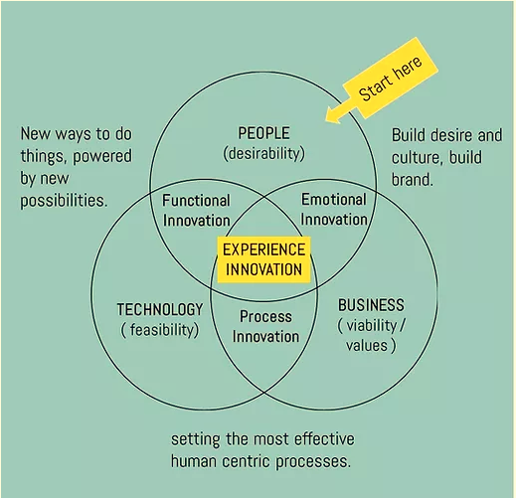
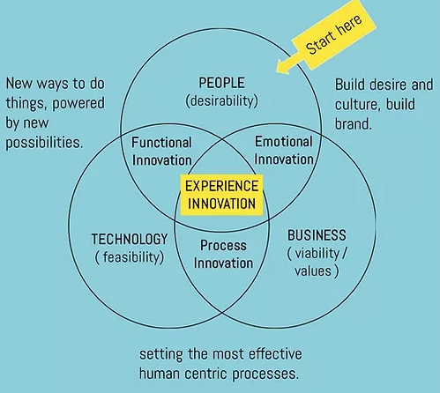
MILLIONAIRE MINDSET
DIGITAL ASSET CREATION & MONETIZATION: DESIGN PRINCIPLES
DIGITAL PRODUCT DESIGN
DAY 2
DESIGN | PASSION | SUCCESS | BOTTOMLINE
DESIGN PRINCIPLES – 7 P’s
Purpose
Persona
Promise
Personalization
Personality
Price (VALUE)
Promotion
DIGITAL PRODUCT DESIGN
QUALITY
RE-DESIGN
RADICAL DESIGN
INNOVATIONS:
Functional
Process
Emotional
KISS & BEEP WITH 7 P’s
DIGITAL BUSINESS HUB

Slide 9
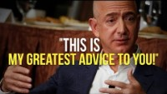
MILLIONAIRE MINDSET
DIGITAL ASSET CREATION & MONETIZATION: DESIGN PRINCIPLES
DIGITAL PRODUCT DESIGN
DAY 2
DESIGN | PASSION | SUCCESS | BOTTOMLINE
Passion Vs Trend : video : Jeff Bezos
HOW TO
DESIGN
DIGITAL
PRODUCTs?
DIGITAL PRODUCT DESIGN
QUALITY
RE-DESIGN
RADICAL DESIGN
DIGITAL BUSINESS HUB

Slide 10

MILLIONAIRE MINDSET
DIGITAL ASSET CREATION & MONETIZATION: DESIGN PRINCIPLES
DIGITAL PRODUCT DESIGN
DAY 2
DESIGN | PASSION | SUCCESS | BOTTOMLINE
Success Steps : Jeff Bezos
HOW TO
DESIGN
DIGITAL
PRODUCTs?
DIGITAL PRODUCT DESIGN
QUALITY
RE-DESIGN
RADICAL DESIGN
DIGITAL BUSINESS HUB

Slide 11
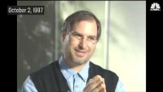
MILLIONAIRE MINDSET
DIGITAL ASSET CREATION & MONETIZATION: DESIGN PRINCIPLES
DIGITAL PRODUCT DESIGN
DESIGN | PASSION | SUCCESS | BOTTOMLINE
Bottomline : Steve Jobs
HOW TO
DESIGN
DIGITAL
PRODUCTs?
DIGITAL PRODUCT DESIGN
QUALITY
RE-DESIGN
RADICAL DESIGN
DIGITAL BUSINESS HUB

Slide 12
MILLIONAIRE MINDSET
DIGITAL ASSET CREATION & MONETIZATION: DESIGN PRINCIPLES
DIGITAL PRODUCT CHOICE
DAY 2
DESIGN | PASSION | SUCCESS | BOTTOMLINE
KEY PHILOSOPHY?
KISS : KEEP IT SUPER SIMPLE
&
BEEP : BEAUTIFUL, EXQUISITE, ELEGANT, PERTINENT
DIGITAL PRODUCT DESIGN
QUALITY
RE-DESIGN
RADICAL DESIGN
CHOOSING A DIGITAL PRODUCT TO CREATE AS AN ASSET ?
Endless Inventory
Asset with recurring revenue stream
Easy Linear Scaling
Low startup costs with high ROI
Direct connect with End User always
Flexibility and Freedom of Time
Quick Global expansions
DIGITAL BUSINESS HUB

Slide 13
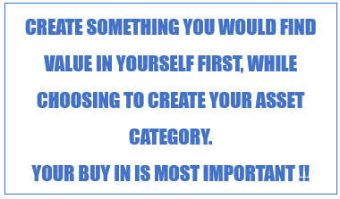
MILLIONAIRE MINDSET
DIGITAL ASSET CREATION & MONETIZATION: DESIGN PRINCIPLES
DIGITAL PRODUCT CHOICE
DAY 2
DESIGN | PASSION | SUCCESS | BOTTOMLINE
MAIN CATGORIES:
Online Courses :
You love Educating
Ebooks & PDF Documents :
You love Writing
Software & Web-based applications :
You love Automation
Affiliate Network :
You love Selling
USING
Platforms
Video
Audio and Music
Photography
Graphics & Digital Art
CHOOSING A DIGITAL PRODUCT TO CREATE ?
CREATE SOMETHING YOU WOULD FIND VALUE IN YOURSELF FIRST, WHILE CHOOSING TO CREATE YOUR ASSET CATEGORY.
YOUR BUY IN IS MOST IMPORTANT !!
DOWNLOAD :
RISE2_75 digital Asset Categorization.pdf
DIGITAL BUSINESS HUB

Slide 14
MILLIONAIRE MINDSET
DIGITAL ASSET CREATION & MONETIZATION: BRINGING IT ALL TOGETHER
PRODUCT DESIGN THINKING
DAY 2
DESIGN | PASSION | SUCCESS | BOTTOMLINE
DESIGN THINKING
Prioritize According to your skills
Choose the Asset to productize
Initiate Selling for Feedback amongst a close group
EMPATHIZE
Persona
Decisions
DEFINE
Seek to Understand
Non Judgemental
IDEATE
Prioritize
Share & Feedback
PROTOTYPE
TEST
Iterate
Keep It Simple
Challenges
Pain Points
Interviews
Experiment
Shortlist what works
Iterate Quickly
Minimal Viable Product
DIGITAL PRODUCT DESIGN
QUALITY
RE-DESIGN
RADICAL DESIGN
100 Questions
100 Answers
MVP
KISS & BEEP WITH 7 P’s
DIGITAL BUSINESS HUB
Notes:
KISS : KEEP IT SUPER SIMPLE | BEEP : BEAUTIFUL, EXQUISITE, ELEGANT, PERTINENT

Slide 15
MILLIONAIRE MINDSET
DIGITAL ASSET CREATION & MONETIZATION: ADDITIONAL CATEGORIES
DIGITAL PRODUCT : CATEGORIES
DAY 2
CHALLENGE : ADDITIONAL CATEGORIES
CHALLENGE
CHOOSE YOUR CATEGORIES THAT YOU WOULD LIKE TO CREATE AT LEAST 3 DIGITAL ASSETS OF
FROM THE LIST OF 75
YOU MIGHT ALREADY HAVE ONE OF THE CATEGORIES FROM RISE 1 IN THAT CASE ADD 2 MORE
DIGITAL BUSINESS HUB

Slide 16
RISE 2_3
DAY 3 : DIGITAL ASSET CREATION & MONETIZATION – ONLINE COURSES
PURPOSE :KEY CONCEPT
PERSONA & PROMISE : 3 STEP SYSTEM USING 3M STRATEGY As Technique
PERSONALITY :PRODUCT NAMING SYSTEM
PERSONALIZATION :CURRICULUM DESIGNING SYSTEM
PROMOTION : FUNNEL METHODOLOGY
PRICE :PRICING STRATEGY
TOOLS SUGGESTION : TOOLS

Slide 17
MILLIONAIRE MINDSET
DIGITAL ASSET CREATION & MONETIZATION: 7 P’s – KEY CONCEPT
DIGITAL PRODUCT: Online Courses
DAY 3
7 P : PURPOSE
PURPOSE :KEY CONCEPT
PERSONA & PROMISE :3 STEP SYSTEM USING 3M FRAMEWORK TECHNIQUE
PERSONALITY :PRODUCT NAMING SYSTEM
PERSONALIZATION :CURRICULUM DESIGNING SYSTEM
PRICE :PRICING STRATEGY
PROMOTION : FUNNEL METHODOLOGY
TOOLS SUGGESTION : TOOLS
DIGITAL BUSINESS HUB

Slide 18
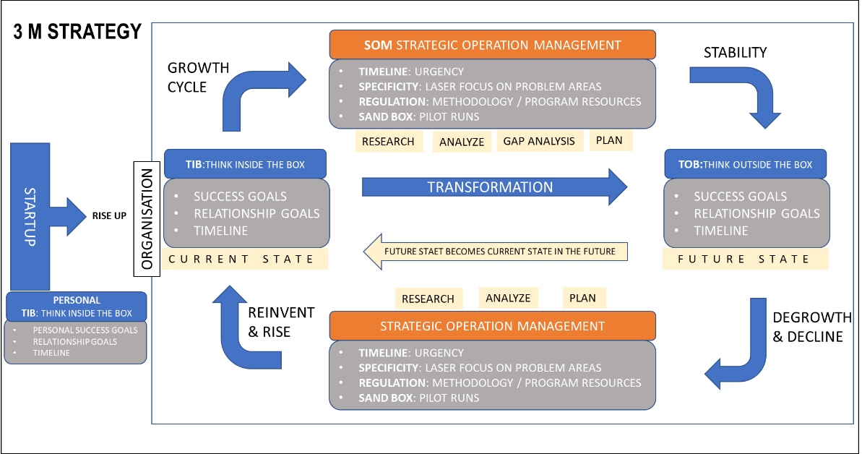
MILLIONAIRE MINDSET
DIGITAL ASSET CREATION & MONETIZATION: 3M STRATEGY
DIGITAL PRODUCT : Online Courses
DAY 3
7 P : PERSONA & PROMISE
DIGITAL BUSINESS HUB

Slide 19
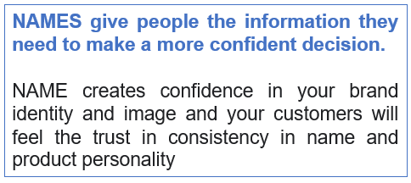
MILLIONAIRE MINDSET
DIGITAL ASSET CREATION & MONETIZATION: PRODUCT NAMING SYSTEM
DIGITAL PRODUCT : Online Courses
DAY 3
7 P : PRODUCT PERSONALITY
Descriptive or Literal :
Clear Positioning - Toys ‘R’US
Suggestive :
Builds on Idea your customers already understand –Twitter
Synthesized:
Joining two words or prefixes or derived from other languages: Micro Soft ( Two words ), Oracle ( Greek god )
Metaphorical or Empty vessel :
Infinitely flexible – Kodak, Apple
NAMES give people the information they need to make a more confident decision.
NAME creates confidence in your brand identity and image and your customers will feel the trust in consistency in name and product personality
DIGITAL BUSINESS HUB

Slide 20
MILLIONAIRE MINDSET
DIGITAL ASSET CREATION & MONETIZATION: PRODUCT NAMING SYSTEM
DIGITAL PRODUCT : Online Courses
DAY 3
7 P : PRODUCT PERSONALITY
PRODUCT NAME CONVENTIONS
First Word | Middle | Last Word
Digital | Business | Blueprint
Tech | Scale-Up | Formula
Lifestyle | Funnel | Model
Startup | Automation | System
Women | Money | Challenge
Passion | Career | Mastery
Online | Marketing | Intensive
Sales | Growth | Empire
Wellness | Step-Up
Natural | Launch
Mindfulness | Sales
Yoga | Optimisation
Personal | Weightloss
Minfulness | Healing
Parenting | Productivity
Marriage | Preneur
Millennial | Finance
Forex | Power
Investor | Traffic
Success | Affiliate
Mind | Selling
Mega | Profits
Turbo | Elite
 | Setup
First Word | Middle Name | Last Word
First Word | Last Word
Middle Name | Last World
3 NAME CONVENTION
School Name
Buss Model
Framework
Co. Name
Tag Name
DIGITAL BUSINESS HUB

Slide 21
MILLIONAIRE MINDSET
DIGITAL ASSET CREATION & MONETIZATION: CURRICULUM DESIGNING SYSTEM
DIGITAL PRODUCT : Online Courses
DAY 3
7 P : PERSONALIZATION
Core Product
30 Day Challenge
Main Course 1
CONCEPT
5 Bonuses
Conceptual
MINDSET
121 / 12M Session
Action
ACTION / PRACTICAL
Conceptual Course
Day 1
Context
Day 2-3
Secret /Strategy #1
Case Study
Secret / Strategy #2
Action / Case Study
Goals/Practical
Advanced Level Lever
Curriculum
Tripwire
Conceptual Course
2-5 Bonuses
Core Product
Implementation
Principles
Strategies
Tactics
Action
Evaluation
Techniques
Practical
121 Session
CONCEPT & MINDSET SETTING
CONCEPT & MINDSET SETTING
ACTION
121 / 12M COACHING
Birds Eye View of the course and Learning Benefits & Expectation
ACTION
CONCEPT
MINDSET
ACTION
121 / 12M COACHING
ACTION OUTCOME = EXPECTATION / FEEDBACK
DIGITAL BUSINESS HUB
COACH = 121 or 12M (One to Many)) : Doubt Clarifications

Slide 22
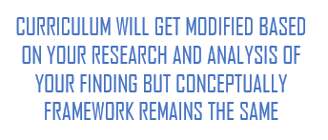
MILLIONAIRE MINDSET
DIGITAL ASSET CREATION & MONETIZATION: CURRICULUM DESIGNING SYSTEM
DIGITAL PRODUCT : Online Courses
DAY 3
7 P : PERSONALIZATION
TRIPWIRE: Stock Trading Example
 | DAY 1 - CONCEPTS | GOLDEN NUGGET | TOTAL DURATION
1 | Welcome. Context Setting. |  | 10
2 | 3 Stories / Principles / Methods |  | 10
3 | Research Work |  | 10
4 | Goal Setting Exercise | MINDSET | 10
 | DAY 2 - CONCEPTS | GOLDEN NUGGET | TOTAL DURATION
1 | What Skills You Need To Be Successful |  | 10
2 | Breakthru Concept 1 (2 Stories) | AWARENESS | 10
3 | Breakthru Concept 2 (2 Stories) | GOAL SETTING | 10
4 | Breakthru Concept 3 (2 Stories) | PLAN CREATION | 10
5 | Practical Steps To Take Before Next Day |  | 10
 | DAY 3 - CONCEPTS | GOLDEN NUGGET | TOTAL DURATION
1 | Journey To Achieve Desired Goal |  | 10
2 | Breakthru Concept 4 (2 Stories) | ACCOUNTABILITY | 10
3 | Breakthru Concept 5 (2 Stories) | DAILY ACTION | 10
4 | Breakthru Concept 6 (2 Stories) | RESULTS TRACKING | 10
5 | Sales Pitch - Special Offer For Level 2 |  | 30
BONUS 1 - 5
 |  | GOLDEN NUGGET | TOTAL DURATION
1 |  |  | 5
2-5 |  |  | 5
Conceptual Course
Day 1
Context
Day 2-3
Secret /Strategy #1
Case Study
Secret / Strategy #2
Action / Case Study
Goals/Practical
Advanced Level Lever
CONCEPT & MINDSET SETTING
CURRICULUM WILL GET MODIFIED BASED ON YOUR RESEARCH AND ANALYSIS OF YOUR FINDING BUT CONCEPTUALLY
FRAMEWORK REMAINS THE SAME
121 / 12M COACHING
DIGITAL BUSINESS HUB

Slide 23
MILLIONAIRE MINDSET
DIGITAL ASSET CREATION & MONETIZATION: FUNNEL METHODOLOGY
DIGITAL PRODUCT : Online Courses
DAY 4
7 P : PROMOTION
Facebook
YouTube
LinkedIn
..
FUNNEL
LEAD MAGNET
Live Webinar 2Hrs
Tripwire
Core Product
L2 Implementation
Live Online Seminar 1D
Mini Course (Recorded)
Tactics
Action
L1 Conceptual Course
Principles
Strategies
5 Day Mini Course
10 Day Challenge
Profit Maximiser
L3 Group Coaching
121 Coaching
High Tkt. Program
MONETIZATION
WEBSITE
Lead Capture
WEBINARS
EMAILS
REFFER TO RISE 1 - Day 3
DIGITAL BUSINESS HUB
L3 : Group/ 121 / 12M COACHING

Slide 24
MILLIONAIRE MINDSET
DIGITAL ASSET CREATION & MONETIZATION: PRICING STRATEGY
DIGITAL PRODUCT : Online Courses
DAY 5
7 P : PRICE
PRODUCT PRICING
TRIPWIRE
X
CORE PRODUCT
PROFIT MAXIMISER
2-5 X
2-5X
"Price is what you pay.
Value is what you get”
- WARREN BUFFET
L3 : Group/ 121 / 12M COACHING
DIGITAL BUSINESS HUB

Slide 25
MILLIONAIRE MINDSET
DIGITAL ASSET CREATION & MONETIZATION: TOOLS
DIGITAL PRODUCT : Online Courses
DAY 6
TOOLS
SYSTEMS | Purpose | Vendors (e.g.)
WEBSITE | Hosting Domains Documents & Reports | Bluehost Wpx Hosting Namecheap Google Drive
LMS | Courseware creation | Teachable
COMMUNICATION | Email Marketing Chatbots | Convertkit Getresponse Manychat
FUNNEL | Funnel Building | ClickFunnel
WEBINAR | Webinar On Demand Webinar | Demio Zoom Webinar Jam Ever Webinar
COMMUNITY | PC / Laptop Phone-based community building | Mighty Networks Telegram WA
LINK TRACKING | Click tracking system for Analysis and follow through | ClickMagick
PAYMENT | Online Payments Mobile Payments International Payments | RazorPay Instamojo Paypal Mint
AUTOMATION | Integrations between various systems for complete automation | Zapier
SOFTWARE |  | AUDIO |  | VIDEO
MAC | WIN | BASIC | ADV | BASIC | ADV
eCamm Live (SONY | Camtasia | Apple Headset | Audient iD4 Soundcard | Logitech c922 webcam | Canon 200D DSLR Camera
ScreenFlow (Basic) | Mindmaple |  | Audient EVO 4 Soundcard | C930 e | Sony A7M3 Mirrorless Camera
Final Cut/Adobe Premiere | Adobe Premiere |  | Lewitt LCT 440 Pure Microphone
MindNode/MindMaps | MOVAVI Filmora
 | Snagit
 | Mind Meister (cloud)
Teachable | Teachable
DIGITAL BUSINESS HUB

Slide 26
MILLIONAIRE MINDSET
DIGITAL ASSET CREATION & MONETIZATION: ADDITIONAL CATEGORIES
DIGITAL PRODUCT : CATEGORIES
DAY 2
CHALLENGE : ADDITIONAL CATEGORIES
CHALLENGE
CREATE A COURSEWARE USING ABOVE PRINCIPLES AS PER YOUR NICHE
NAME, ORGANIZE & PRICE it
YOU MIGHT ALREADY HAVE ONE OF THE COURSEWARE FROM RISE 1 IN THAT CASE
TWEAK IT AND MAKE CHANGES TO YOUR BUSINESS PLAN
PRACTICALS DURING THE RISE CIRCLE DISCUSSIONS AND PRACTICALS
DIGITAL BUSINESS HUB

Slide 27
RISE 2_4
DAY 4 : EBOOK PUBLISHING FRAMEWORK
Publishing
Formats
Process

Slide 28
MILLIONAIRE MINDSET
DIGITAL ASSET CREATION & MONETIZATION: EBOOK PUBLISHING FRAMEWORK
DIGITAL PRODUCT : EBOOK
DAY 7
E BOOK PUBLISHING
Global Publishing
Amazon
Barnes& Noble
Kobo
Google
BOOK WRITING
Various Formats from same content :
Kindle
E Book
Paper Back
Hard Cover
Audio Book
Multilingual Publications
Chapter Blogs
Promotion
Amazon
Kindle
Good Reads
Kobo
Google
Book Bub
Monetize
Royalty
Series
Formats
Language
Audio
PUBLISHING
PROMOTION
MONETIZING
DIGITAL BUSINESS HUB

Slide 29

MILLIONAIRE MINDSET
DIGITAL ASSET CREATION & MONETIZATION: EBOOK PUBLISHING FRAMEWORK
DIGITAL PRODUCT : EBOOK
DAY 8
E BOOK PUBLISHING
TOPIC RESEARCH
DEEPER RESEARCH
BOOK WRITING
IDEATING
COVER DESIGN
PROMOTION
SELF PUBLISHING
GLOBAL BEST SELLER
SERIES
LANGUAGE & FORMATS
BOOK WRITING
PUBLISHING
PROMOTION
MONETIZING
SELF PUBLISHING WITH KDP
Getting started
  1 Set up your account (U.S. publishers)
  2 Set up your account (non-U.S. publishers)
Book details
  3 Write your book description
  4 Help readers find your book
  5 Build your Amazon detail page
Manuscript & cover
  6 Introduction to book design
  7 Format your eBook manuscript
  8 Format your paperback manuscript
  9 Design your cover
  10 Upload your book
Rights & pricing
  11 eBook rights & pricing
  12 Paperback rights & pricing
LIFETIME ROYALTY
WITH RECURRING EDITIONS
Check:
https://kdp.amazon.com/
DIGITAL BUSINESS HUB

Slide 30
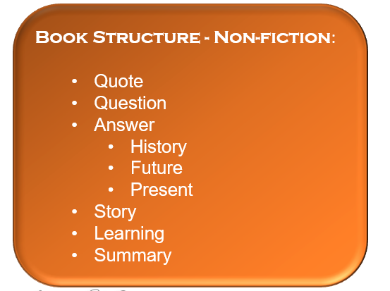
MILLIONAIRE MINDSET
DIGITAL ASSET CREATION & MONETIZATION: EBOOK PUBLISHING FRAMEWORK
DIGITAL PRODUCT : EBOOK
DAY 8
E BOOK PUBLISHING
TOPIC RESEARCH
DEEPER RESEARCH
BOOK WRITING
IDEATING
COVER DESIGN
PROMOTION
SELF PUBLISHING
GLOBAL BEST SELLER
SERIES
LANGUAGE & FORMATS
BOOK WRITING
PUBLISHING
PROMOTION
MONETIZING
Book Structure - Non-fiction:
  Quote
  Question
  Answer
    History
    Future
    Present
  Story
  Learning
  Summary
Book Structure Fiction:
Completely open and is author dependent
Typical Structure:
Character Introduction
Scenario Creation
Main Character Circumstances
Plot creation
Suspense creation throughout
Mystery solved
Conclusion
CAUSE
EFFECT
SOLUTION
DIGITAL BUSINESS HUB

Slide 31
MILLIONAIRE MINDSET
DIGITAL ASSET CREATION & MONETIZATION: EBOOK PUBLISHING FRAMEWORK
DIGITAL PRODUCT : EBOOK
DAY 8
E BOOK PUBLISHING
TOPIC RESEARCH
DEEPER RESEARCH
BOOK WRITING
IDEATING
COVER DESIGN
PROMOTION
SELF PUBLISHING
GLOBAL BEST SELLER
SERIES
LANGUAGE & FORMATS
BOOK WRITING
PUBLISHING
PROMOTION
MONETIZING
CHALLENGE
Download your template for KDP
  RISE_2_KDP_Template.docx
Select a Subject
Research
Write your First Dirty Draft
DIGITAL BUSINESS HUB

Slide 32
RISE 2_5
DAY 5 : RESEARCH
Methodology
Formats
Process

Slide 33





MILLIONAIRE MINDSET
DIGITAL ASSET CREATION & MONETIZATION: RESEARCH FRAMEWORK
DIGITAL PRODUCT : RESEARCH
DAY 7
RESEARCH FRAMEWORK
ANALYZE
EXAMINE
PROCESSING
ANALYZE the information you have found
EVALUATE ideas
ORGANIZE and synthesize your findings
INVESTIGATION
CAUSE
EFFECT
SOLUTION
EXTERNAL FORCES
PRODUCE
CREATING
Medium
Format
Audience
Feedback Mechanism to Improve
DIG
EXPLORING
PROBLEM
NEED
AUDIENCE
RELEVANCE
DEAPER
RESEARRCH METHODOLOGY
& FRAMEWORK
EVALUATE & REPEAT
ASSESS FEEDBACK
REPEAT THE CYCLE
DIGITAL BUSINESS HUB

Slide 34
MILLIONAIRE MINDSET
DIGITAL ASSET CREATION & MONETIZATION: RESEARCH TECHNIQUES
DIGITAL PRODUCT : RESEARCH
DAY 7
RESEARCH METHODLOGY
CAUSE | 1 | 2 | 3 | 4 | 5
WHY | WHY 1
WHAT
WHERE
WHEN
HOW
EFFECT | 1 | 2 | 3 | 4 | 5
WHY | CAUSE –WHY 1 | CAUSE –WHY 1 | CAUSE –WHY 1 | CAUSE –WHY 1 | CAUSE –WHY 1
WHAT | CAUSE –WHY 1 | CAUSE –WHY 1 | CAUSE –WHY 1 | CAUSE –WHY 1 | CAUSE –WHY 1
WHERE | CAUSE –WHY 1 | CAUSE –WHY 1 | CAUSE –WHY 1 | CAUSE –WHY 1 | CAUSE –WHY 1
WHEN | CAUSE –WHY 1 | CAUSE –WHY 1 | CAUSE –WHY 1 | CAUSE –WHY 1 | CAUSE –WHY 1
HOW | CAUSE –WHY 1 | CAUSE –WHY 1 | CAUSE –WHY 1 | CAUSE –WHY 1 | CAUSE –WHY 1
EFFECT | 1 | 2 | 3 | 4 | 5
WHY | CAUSE –WHY 2 | CAUSE –WHY 2 | CAUSE –WHY 2 | CAUSE –WHY 2 | CAUSE –WHY 2
WHAT | CAUSE –WHY 2 | CAUSE –WHY 2 | CAUSE –WHY 2 | CAUSE –WHY 2 | CAUSE –WHY 2
WHERE | CAUSE –WHY 2 | CAUSE –WHY 2 | CAUSE –WHY 2 | CAUSE –WHY 2 | CAUSE –WHY 2
WHEN | CAUSE –WHY 2 | CAUSE –WHY 2 | CAUSE –WHY 2 | CAUSE –WHY 2 | CAUSE –WHY 2
HOW | CAUSE –WHY 2 | CAUSE –WHY 2 | CAUSE –WHY 2 | CAUSE –WHY 2 | CAUSE –WHY 2
DIG :- Exploring,
PROBLEM
NEED
AUDIENCE
RELEVANCE
EXAMINE :-Investigating
CAUSE
EFFECT
SOLUTION
EXTERNAL FORCES
ANALYZE : Processing
Analyze the information you have found
Evaluate ideas
Organize and synthesize your findings
PRODUCE : Creating.
Medium
Format
Audience
Feedback Mechanism to Improve
SOLUTION | 1 | 2 | 3 | 4 | 5
WHY | CAUSE –WHY 1 | CAUSE –WHY 1 | CAUSE –WHY 1 | CAUSE –WHY 1 | CAUSE –WHY 1
WHAT | CAUSE –WHY 1 | CAUSE –WHY 1 | CAUSE –WHY 1 | CAUSE –WHY 1 | CAUSE –WHY 1
WHERE | CAUSE –WHY 1 | CAUSE –WHY 1 | CAUSE –WHY 1 | CAUSE –WHY 1 | CAUSE –WHY 1
WHEN | CAUSE –WHY 1 | CAUSE –WHY 1 | CAUSE –WHY 1 | CAUSE –WHY 1 | CAUSE –WHY 1
HOW | CAUSE –WHY 1 | CAUSE –WHY 1 | CAUSE –WHY 1 | CAUSE –WHY 1 | CAUSE –WHY 1
SOLUTION | 1 | 2 | 3 | 4 | 5
WHY | CAUSE –WHY 2 | CAUSE –WHY 2 | CAUSE –WHY 2 | CAUSE –WHY 2 | CAUSE –WHY 2
WHAT | CAUSE –WHY 2 | CAUSE –WHY 2 | CAUSE –WHY 2 | CAUSE –WHY 2 | CAUSE –WHY 2
WHERE | CAUSE –WHY 2 | CAUSE –WHY 2 | CAUSE –WHY 2 | CAUSE –WHY 2 | CAUSE –WHY 2
WHEN | CAUSE –WHY 2 | CAUSE –WHY 2 | CAUSE –WHY 2 | CAUSE –WHY 2 | CAUSE –WHY 2
HOW | CAUSE –WHY 2 | CAUSE –WHY 2 | CAUSE –WHY 2 | CAUSE –WHY 2 | CAUSE –WHY 2
DIGITAL BUSINESS HUB

Slide 35
MILLIONAIRE MINDSET
DIGITAL ASSET CREATION & MONETIZATION: RESEARCH SOURCES
DIGITAL PRODUCT : RESEARCH
DAY 7
RESEARCH SOURCES
 | Theme | Question - answerthepublic.com | Story 1 | Story 2 | Story 3
1 | Industry Facts | What Are The Different Type Of Digital Assets?
2 | Industry Facts | What Are Benefits of creating Digital Assets?
3 | Industry Facts | What Are The Most popular Digital Assets Being Consumed ?
4 | Industry Facts
5 | Industry Facts
6 | Industry Facts
7 | Industry Facts
8 | Industry Facts
9 | Industry Facts
10 | Industry Facts
11 | SUBJECT
12 | SUBJECT
13 | SUBJECT
14 | SUBJECT
15 | SUBJECT
16 | SUBJECT
17 | SUBJECT
18 | SUBJECT
19 | SUBJECT
20 | SUBJECT
21 | Theme 3
22 | Theme 3
23 | Theme 3
24 | Theme 3
25-100 | Theme 3
SOURCES | MATERIAL & DATA EXPECTED
News | basic facts, current events opinions about current events/trends (editorial news)
Website – general | facts, statistics, definitions, examples
Website of organization/company : GOOGLE | answerthepublic| | connection between a particular stakeholder and a topic may include fact, opinion, current trends/solutions/products
Journal article (print or online database) | expert research and opinion analysis of statistics and trends current research findings
Encyclopedia, Dictionary (Print or Online database) | basic facts, definitions, statistics
Nonfiction book – general | in-depth facts about a topic
Nonfiction in-depth book by an expert | in-depth expert analysis, opinions and research often deeper connections and analysis
Biography/Memoir | personal connections to a topic
Documentary (full length) | in-depth examination of topic often includes examination of the impact of a topic on a particular place or group of people
DIGITAL BUSINESS HUB

Slide 36
MILLIONAIRE MINDSET
DIGITAL ASSET CREATION & MONETIZATION: RESEARCH FORMATS
DIGITAL PRODUCT : RESEARCH
DAY 7
FORMATS
Contents
1Relevant
2Focused
3Concise
4Organized
CAUSE | 1 | 2 | 3 | 4 | 5
WHY | WHY 1
WHAT
WHERE
WHEN
HOW
Choose the ones for sp. audience
Shortlist the Data for the Subject
EFFECT | 1 | 2 | 3 | 4 | 5
WHY | CAUSE –WHY 1 | CAUSE –WHY 1 | CAUSE –WHY 1 | CAUSE –WHY 1 | CAUSE –WHY 1
WHAT | CAUSE –WHY 1 | CAUSE –WHY 1 | CAUSE –WHY 1 | CAUSE –WHY 1 | CAUSE –WHY 1
WHERE | CAUSE –WHY 1 | CAUSE –WHY 1 | CAUSE –WHY 1 | CAUSE –WHY 1 | CAUSE –WHY 1
WHEN | CAUSE –WHY 1 | CAUSE –WHY 1 | CAUSE –WHY 1 | CAUSE –WHY 1 | CAUSE –WHY 1
HOW | CAUSE –WHY 1 | CAUSE –WHY 1 | CAUSE –WHY 1 | CAUSE –WHY 1 | CAUSE –WHY 1
Streamline Data for its USE
Systemic Data
DOWNLOAD : RISE_REFERENCE_RESEARCH_TEMPLATE.xlsx
DIGITAL BUSINESS HUB

Slide 37
MILLIONAIRE MINDSET
DIGITAL ASSET CREATION & MONETIZATION: RESEARCH FORMATS
DIGITAL PRODUCT : RESEARCH
DAY 7
FORMATS
CHALLENGE
CREATE A RESEARCH FOR YOUR ASSET IN THE NEXT 7 DAYS USING
DEAPER
A STEP CLOSER TO BECOME A PIONEER IN YOUR SUBJECT
DIGITAL BUSINESS HUB

Slide 38
RISE 2_6
DAY 6: COPYWRITING
Methodology
Formats
Process

Slide 39
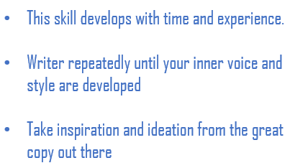
MILLIONAIRE MINDSET
DIGITAL ASSET CREATION & MONETIZATION: COPY SPECIALIZATION
COPYWRITING
DAY 8
COPYWRITING SECRET | 5 ELEMENTS
Foundation Setting
This is a lifelong skill
Copy & Music
  Both need to have a great rhythm and symphony
Deep Connection & find your style
Study Great Copywriters
  Gary Halbert
  John Carlton
Develop your inner voice
Research – Rise 2 –Day 5
  Google
  AnswerThePublic
  Buzzsumo
  ClickBank
  Swipe.co
  Forums
  Create a question document
This skill develops with time and experience.
Writer repeatedly until your inner voice and style are developed
Take inspiration and ideation from the great copy out there
DIGITAL BUSINESS HUB

Slide 40

MILLIONAIRE MINDSET
DIGITAL ASSET CREATION & MONETIZATION: 5 ELEMENTS
COPYWRITING
DAY 8
COPYWRITING SECRET | 5 ELEMENTS
EMAIL COPY
Psychology
Format
  Subject
  Hook
  Focus
  Plain
Follow-Ups
Broadcasts
Action Plan
  8 Day follow up
AD COPY
Headline
Description
Body Content
  Break Attention
  Focus On Problem
  Give a Solution
  Explain Benefits
  Call to Action
Action Plan
  Study & Write 5 Ads
BLOG COPY
Keywords
  Ubersuggest
  LSI Graph
Headlines
  181 Headlines
  CoSchedule
Body Content
  Sub-headlines
  Sections
    Why | What | How | What If
  Images
Call to Action
  Link to Lead Magnet
Action Plan
  1 Blog on FB : Facebook/notes
  1 on Linked In
Email Copy
Ad Copy
Blog Copy
Social Copy
Sales Copy

Slide 41
MILLIONAIRE MINDSET
DIGITAL ASSET CREATION & MONETIZATION: 5 ELEMENTS
COPYWRITING
DAY 8
COPYWRITING SECRET | 5 ELEMENTS
SALES COPY
Headline
  Pitch
Sub-Headline
  Purpose
Description
Social Proof
CTA
Action Plan
  Research 8 Sales Pages
SOCIAL COPY
Platforms
  Facebook
  LinkedIn
  Quora
  Instagram
  Twitter
Format
  Curiosity
  Emotion
  CTA
Types
  Stories
  Lessons Learnt
  Quotes
  Questions
  Comments
Email Copy
Ad Copy
Blog Copy
Social Copy
Sales Copy

Slide 42
MILLIONAIRE MINDSET
DIGITAL ASSET CREATION & MONETIZATION: 5 ELEMENTS
COPYWRITING CHALLENGE
DAY 7
COPYWRITING SECRETS
CHALLENGE
WRITE ATLEAST 1 COPY FOR EACH OF THE 5 ELEMENTS FOR ONE OF YOUR ASSETS
USING ABOVE PRINCIPLEs
Email Copy
Ad Copy
Blog Copy
Social Copy
Sales Copy
A STEP CLOSER TO BECOMING A PIONEER IN YOUR SUBJECT
BRING YOUR QUERIES FOR RESOLUTION DURING THE RISE CIRCLE MEETS
DIGITAL BUSINESS HUB

