Slide 1
RISE 3_1
DAY 1 : BLITZSCALING
DIGITAL TRAFFIC
DIGITAL LEADGEN
DIGITAL SCALING
  WEBINAR SELLING FRAMEWORK
  FACEBOOK TRAFFIC SYSTEM
DIGITAL FUNNEL
DIGITAL SYSTEM BUILDING FRAMEWORK
COMMUNITY BUILDING METHODOLOGY

Slide 2
MILLIONAIRE MINDSET
BLITZSCALING : UNDERSTAND
BLITZSCALING
DAY 1
TRAFFIC | LEADGEN | FUNNEL | SCALING | SYSTEM COMMUNITY
BLITZSCALING RELATES TO SCALING YOUR BUSINESS VERY RAPIDLY BOTH VERTICALLY & HORIZONTALLY
Nazi Germany's military successes
Digitalization has made this possible
Netflix used it most effectively
Ecosystem
[consisting of internal and external stakeholders]
WHAT IS BLITZSCALING ?
Platform Based
[Using platforms to create digital assets like courses, eCommerce activities, Publishing, Vlogs, sales, and Mktg. through various platforms]
Digitally Enhanced:
[creating eBooks/Blogs, configuring mobile, social media with the application, etc.]
Different types of Business Scaling ?
How is Blitzscaling different?
Startup
Scaling Up
Fastscaling
Blitzscaling
  Blitzscaling is both an offensive strategy and a defensive strategy
  Blitzscaling thrives on positive feedback loops: The company that grows to scale first reaps significant competitive advantages
  Despite its incredible advantages and potential payoffs, Blitzscaling also comes with massive risks
Digitization
(at the individual level) :[digitally enabled: use of computing, application software, etc.]
BLITSCALING THROUGH
DIGITALIZATION AT INDIVIDUAL P2P level
DIGITAL BUSINESS HUB

Slide 3
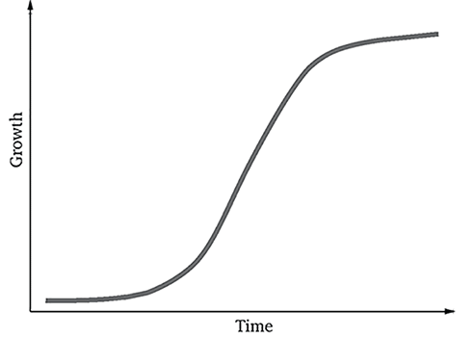




MILLIONAIRE MINDSET
BLITZSCALING : PROCESS
BLITZSCALING
DAY 1
TRAFFIC | LEADGEN | FUNNEL | SCALING | SYSTEM | COMMUNITY
BLITZSCALING
STRATEGY
Automated Traffic & Leadgen – 24x7
Influencer Media
CPA Traffic Media
Additional Digital Assets – Horitzontal
Vertical Improvement - Feedback
Continuous Communication
Community Build
Classic Blitzscaling
Followed by Scaling Up
After achieving critical mass
LEADGEN
FUNNEL
Targeted Traffic Strategy
Targeted Webinar
Targeted Free Consumption Campaign
Retargeting
3-Pronged Strategy
Repeated Communication
Repeated Branding
Repeated Feedback
TRAFFIC GENERATION
Website
Landing Page
Blogs / Vlogs
Mktg Campaigns
Display Media
Social Media
DIGITAL BUSINESS HUB

Slide 4
MILLIONAIRE MINDSET
BLITZSCALING: PROCESS
BLITZSCALING
DAY 1
TRAFFIC | LEADGEN | FUNNEL | SCALING | SYSTEM COMMUNITY
THE RISE BAAP SYSTEM
L1
L3 : PROLIFERATE
BLITZSCALING
DATA ANALYSIS & FEEDBACK MECHANISM WITH REPORTS
Automated Traffic & Leadgen – 24x7
Influencer Media
CPA Traffic Media
Additional Digital Assets – Horitzontal
Vertical Improvement - Feedback
Continuous Communication
Community Build
BLITZSCALE
Marketing campaigns
INTERNAL & EXTERNAL
System & The Control Hub
Community
FUNNEL
Lead Segregation
FUNNEL
L3
Automated Traffic & Retargeting System
Retargeting
3-Pronged Strategy
Repeated Communication
Repeated Branding
Repeated Feedback
L2 : ADMINSTER : Control & Manage
LeadGen
L2
L1 : ACTIVATE
Website – Blogs/Vlogs
Communication
Webinar
Landing Pages
Automated Tracking
LEADGEN
Traffic
L1
Targeted Traffic Strategy
Targeted Webinar
Targeted Free Consumption Campaign
SOCIAL MEDIA
( Pick one Source when beginning)
YOUR CUSTOMERS
DIGITAL ASSET CONSUMPTION`
TRAFFIC GENERATION
Website
Landing Page
Blogs / Vlogs
Mktg Campaigns
Display Media
Social Media
DIGITAL BUSINESS HUB

Slide 5
RISE 3_2
DAY 2 : BLITZSCALING - TRAFFIC
DIGITAL TRAFFIC
DIGITAL LEADGEN
DIGITAL SCALING
  WEBINAR SELLING FRAMEWORK
  FACEBOOK TRAFFIC SYSTEM
DIGITAL FUNNEL
DIGITAL SYSTEM BUILDING FRAMEWORK
COMMUNITY BUILDING METHODOLOGY

Slide 6
MILLIONAIRE MINDSET
BLITZSCALING: TRAFFIC GENERATION – 10 COMMANDMENTS
BLITZSCALING
DAY2
TRAFFIC | LEADGEN | FUNNEL | SCALING | SYSTEM | COMMUNITY
10 Commandments of Traffic
TYPE
  INTERNAL : Email List
  EXTERNAL : Other Platforms
SOURCES
  INTERNAL
    Email
    Chatbot – manychats.com
    SMS – twilio | smshorizon
  External
    Influencer |Social | Search |Display
    Retargeting | CPA | Strategic Syndicate
PRINCIPLES
  All types of traffic is necessary
  Don’t waste traffic
  Traffic exist due to the offer ( product comes later)
  Master At Least One Traffic Source
MEASURE
  CPM (1K impression) | CPL ( lead)| CPA ( acquisition)
PROCESS
  L1 | L2 | L3 – Blitzscaling Through BAAP System
EXTERNAL CONVERSION
  Convert to Internal List 25-50%
  Retarget 90-100% ( of 25-50%)
  Acquisition 1-2.5%
CONVERSION STAKEHOLDERS
  Owner|Copy|Graphics|Persona|
  Capture System |Nurture | Offer | Tribes
KNOW YOUR TOOLS
  Social Media | ClickMagick | ClickFunnel| Converkit
RISE 1 SYSTEM CHALLENGE
  10 Day - MINDSET | 30 Day - SETUP
  90 Day SELL
GET PRACTICAL
  JUST DO IT – ANALYZE – JUST DO IT
  TPDA
DIGITAL BUSINESS HUB

Slide 7
MILLIONAIRE MINDSET
BLITZSCALING: TRAFFIC GENERATION - SOURCES
BLITZSCALING
DAY 2
TRAFFIC | LEADGEN | FUNNEL | SCALING | SYSTEM | COMMUNITY
S.No. | MODE | TRAFFIC SOURCES
1 | Email List (Personal) | Landing Page + Incentive + Subscription
2 | Chatbots (Messenger) | Manychat.com
3 | Facebook Pay Per Click Traffic | Business.facebook.com [ LEARN : https://www.facebookcom/blueprint/register]
4 | Email Media ( Solo Ads ) | Udimi.com : Buy clicks for solo ads
5 | Influencer Media | Ifluenz.com | shoutcart.com | bigspaghetti.com
6 | Google Pay Per Click | https://Ads.google.com : [ Used for Demand Fulfillment e.g. when someone searchers for courses]
7 | Bing Pay Per Click | https://Bingads.Microsoft.com
8 | Display Networks | https://Buysellads.com
9 | SEO Traffic | https://Ubersuggest.com : Organic System of traffic growth with high quality leads
10 | CPA Traffic | https://Maxbounty.com : Cost Per Action based traffic ( Clickbooth | Peerfly | Convert2Media)
11 | Social Media | https://Commentpicker.com : Random winner picker and generator for a contest on social media
12 | Retargeting | Google | Facebook | https://Adroll.com [ Magento direct integration ]
13 | Other Influencers | Influencers from : Insta | FB | Snapchat | Twitter | YouTube | Podcasters | Bloggers
14 | Other | Syndicate : Make allies to cross promote with a win-win strategy
 |  | Alpha Media : SimilarWeb | WhatRunsWhere | Adplexity
TRAFFIC SOURCES :
NO ONE SIZE FITS ALL
GET YOUR TECHNICAL HAT ON WITH CRITICAL THINKING
PRIORITIZE FUNNEL TO TRAFFIC
MASTER AT LEAST ONE
EVERY CLICK IS IMPORTANT
WITHOUT MONETIZATION TRAFFIC IS USELESS
DIGITAL BUSINESS HUB

Slide 8
MILLIONAIRE MINDSET
BLITZSCALING: TRAFFIC GENERATION - SYSTEM
BLITZSCALING
DAY2
TRAFFIC | LEADGEN | FUNNEL | SCALING | SYSTEM | COMMUNITY
Facebook
YouTube
LinkedIn
..
RFM RISE FUNNEL MONETIZATION SYSTEM
MONETIZATION
WEBSITE /
LANDING PAGES
Lead Capture
WEBINARS
OTHER SOCIAL SOURCES
EMAILS
DIGITAL BUSINESS HUB

Slide 9
MILLIONAIRE MINDSET
BLITZSCALING: MASTERING TRAFFIC - PYRAMID
BLITZSCALING
DAY 2
TRAFFIC | LEADGEN | FUNNEL | SCALING | SYSTEM | COMMUNITY
CENTRAL HUB
  YourName.com (personal brand) | Members – Community | Blog & Social Channels
FUNNEL BUILDER
  Clickfunnels | Demio | Teachable
AUTO_RESPONDER
  ConvertKit
TRACKING SYSTEM
  ClickMagick
TOOLS
TECHNIQUE
SUCCESS MANTRA
FRAMEWORK
THE RFM SYSTEM
THE RISE BAAP SYSTEM
DIGITAL BUSINESS HUB
80% Mindset/goalsetting – internal communication
15 % Communication – external
5% - System setup

Slide 10
RISE 3_3
DAY 3 : BLITZSCALING - LEADGEN
DIGITAL TRAFFIC
DIGITAL LEADGEN
DIGITAL SCALING
  WEBINAR SELLING FRAMEWORK
  FACEBOOK TRAFFIC SYSTEM
DIGITAL FUNNEL
DIGITAL SYSTEM BUILDING FRAMEWORK
COMMUNITY BUILDING METHODOLOGY

Slide 11
MILLIONAIRE MINDSET
BLITZSCALING: LEAD GENERATION – 10 COMMANDMENTS
BLITZSCALING
DAY 3
TRAFFIC | LEADGEN | FUNNEL | SCALING | SYSTEM | COMMUNITY
10 Commandments of Digital Lead Generation
STRATEGY
  GOAL SETTING: 300 Leads | Revenue : INR 50K ( 10 Customers @5K)
    CONCEPT :
      Mode
        Hunting (Creativity to reach and attract)
        Farming (Plant Seeds | Spread honey to attract)
      Format :
        80% Long Form - Educator
        20% Short Form - Entertainer
      Type : 80% Strategy | 20% Techniques & Tools
    FOCUS : Create | Share | Connect [ Rule of 30/day ]
MAGNET
  FREE / DISCOUNTED Content
  FREE/ DISCOUNTED Memberships
  FREE / DISCOUNTED Early Birds
KNOW YOUR TOOLS
  Attract.io : Ebook Creation
  ConvertKit : Landing Pages | Email Sequence
  VIP FB : Setup – Post 2-3 /day - Quotes |Polls etc.
  BuzzSprout : Podcast
  Video : YouTube
DIGITAL BUSINESS HUB

Slide 12
MILLIONAIRE MINDSET
BLITZSCALING: LEAD GENERATION – 10 COMMANDMENTS
BLITZSCALING
DAY 3
TRAFFIC | LEADGEN | FUNNEL | SCALING | SYSTEM | COMMUNITY
10 Commandments of Digital Lead Generation
STRATEGY
  GOAL SETTING: 500 Leads | Revenue: USD/INR 50K ( 10 Customers @5K)
    CONCEPT :
      Mode
        Hunting (Creativity to reach and attract)
        Farming (Plant Seeds | Spread honey to attract)
      Format :
        80% Long Form - Educator
        20% Short Form - Entertainer
      Type : 80% Strategy | 20% Techniques & Tools
    FOCUS: Create | Share | Connect [ Rule of 30/day ]
MAGNET
  FREE / DISCOUNTED Content
  FREE/ DISCOUNTED Memberships
  FREE / DISCOUNTED Early Birds
KNOW YOUR TOOLS
  Attract.io : Lead Magnets / Ebook Creation ( FREE )
  ConvertKit: Landing Pages | Email Sequence
  VIP FB : Setup – Post 2-3 /day - Quotes |Polls etc.
  BuzzSprout: Podcast
  Video : YouTube
STORY TELLING TECHNIQUE
  List of 10 Stories | Use a Format most relevant
MEDIA SETUP
  Video | Audio | Visuals : Based on your Niche
EMOTIONAL CONNNECTIONS
  Join 10 groups/day : FB | Linkedin
  30 Meaningful comments/day: Groups | Hashtags |Likes
  Private Messages : 30 /day | Respond to Messages
APPLICATION SETUP
  Setup up the Application Tools
  Get them Automated
  Get the content and visuals organised
SYSTEM SETUP
  BAAP
  RFM System
  Social Media | ClickMagick | ClickFunnel | Convertkit
LEADGEN CHALLENGE
  30 Day - Challenge
KNOW YOUR NEXT STEPS
  Using the Leads
  Creating Funnels
DIGITAL BUSINESS HUB

Slide 13
MILLIONAIRE MINDSET
BLITZSCALING: LEAD GENERATION - SYSTEM
BLITZSCALING
DAY 3
TRAFFIC | LEADGEN | FUNNEL | SCALING | SYSTEM | COMMUNITY
Facebook
YouTube
LinkedIn
..
RFM RISE FUNNEL MONETIZATION SYSTEM
MONETIZATION
WEBSITE /
LANDING PAGES
Lead Capture
WEBINARS
OTHER SOCIAL SOURCES
EMAILS
DIGITAL BUSINESS HUB

Slide 14
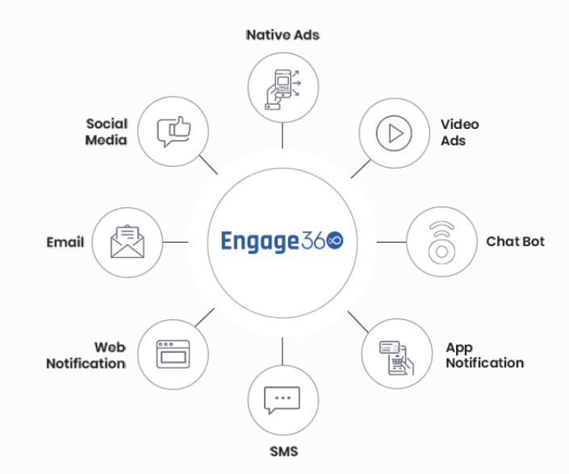
MILLIONAIRE MINDSET
BLITZSCALING: LEAD GENERATION – OMNICHANNEL FUNDAMENTALS
BLITZSCALING
DAY 3
TRAFFIC | LEADGEN | FUNNEL | SCALING | SYSTEM | COMMUNITY
Social Platforms
OMNICHANNEL FOR LEADGEN
A CORPORATE VIEW
OMNICHANNEL
Website
Social Media
Mass Notifications
DIGITAL BUSINESS HUB
EARNED MEDIA | PAID MEDIA | OWNED MEDIA | INDUSTRY FORUMS

Slide 15












MILLIONAIRE MINDSET
BLITZSCALING: LEAD GENERATION – NEXT 90 DAYS
BLITZSCALING
DAY 3
TRAFFIC | LEADGEN | FUNNEL | SCALING | SYSTEM | COMMUNITY
RISE 2 GOLD
FINISHER 90 DAYS
MVP DIGITAL ASSET
CREATION
COMPLETE 50
Consultations
RESULT PLANNING
FUNNEL
BUILDING
BUILD
SOCIAL GROUP
GOAL :
In 90DAYS
CREATION &
MONETIZATION
Long Form Videos : 1/day, 3/ Wk , 2/ wk
500 Organic Leads
RESULT PLANNING
Private Group to >500 Members
NICHE CLARITY
LAUNCH ASSET
SETUP SYSTEMS
RISE UP MODEL
LEAD MAGNET
LAUNCH
START
DIGITAL BUSINESS HUB

Slide 16




MILLIONAIRE MINDSET
BLITZSCALING: LEAD GENERATION
BLITZSCALING
DAY 3
TRAFFIC | LEADGEN | FUNNEL | SCALING | SYSTEM | COMMUNITY
COPY
WRITING
FACEBOOK
ADS
WEBINAR SELLING
SETUP
RISE 3 DIAMOND
FINISHER 180 DAYS
LEADGEN
CONTENT BREAK
GOAL :
In 90DAYS
EXPANSION
40 Sales @ USD 75 /
INR 4999 ( L1 Membership)
Curriculum MVP 2 –L2
Wkly. Inner Circle Call
5 Sales @ USD 250 /
INR 19999( L2 Membership )
GOALS
Launch L2 Membership
2 Webinars / Wk.
RISE 2 GOLD
Run Ads
FB | Google
YouTube Videos2/wk.
DIGITAL BUSINESS HUB

Slide 17
RISE 3_4
DAY 4 : BLITZSCALING – WEBINAR SCALING FRAMEWORK
DIGITAL TRAFFIC
DIGITAL LEADGEN
DIGITAL SCALING
  WEBINAR SELLING FRAMEWORK
  FACEBOOK TRAFFIC SYSTEM
DIGITAL FUNNEL
DIGITAL SYSTEM BUILDING FRAMEWORK
COMMUNITY BUILDING METHODOLOGY

Slide 18
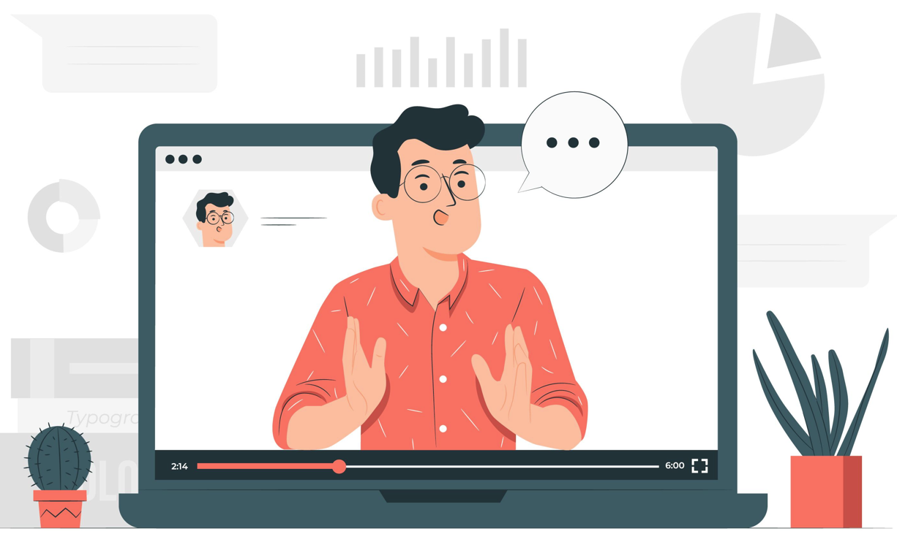
MILLIONAIRE MINDSET
BLITZSCALING: WEBINAR SCALING PROCESS - INTRODUCTION
BLITZSCALING
DAY 4
TRAFFIC | LEADGEN | FUNNEL | SCALING | SYSTEM | COMMUNITY
WEBINAR STRUCTURE
Introduction
3 Value Propositions or Secrets
Sales bridge
Sales Pitch
Questions & Answers
Next Steps
EFFECTIVE WEBINAR VALUE PROPOSITIONS
Understanding & Smoothening Resistance
Audience Buy The Presenter
Presenters Consistency
Aesthetics & Recurrence
Template
Ambience
Frequency
DIGITAL BUSINESS HUB

Slide 19
MILLIONAIRE MINDSET
BLITZSCALING: WEBINAR SCALING – STRUCTURE
BLITZSCALING
DAY 4
TRAFFIC | LEADGEN | FUNNEL | SCALING | SYSTEM | COMMUNITY
FIRST 35 MINUTES
VALUE PROPOSITION #3 : 15 mins each
Value 1
  Concept
  Experience
Value 2
  Concept
  Experience
Value 3
  Concept
  Experience
INTRODUCTION: 15 mins
High Energy
What’s In it for them
Acknowledgment
Context Setting for audience
  90 Mins Webinar
  Take notes
  Ask Questions in the end
Industry Stats
  Vital statistics
  Credit the source
Short Intro
  Ethics: as permission
  Establish credibility: Experience
  Mission: true endeavor
Trial Close
  Show the value of tripwire
WEBINAR STRUCTURE
Introduction
3 Value Propositions
or Secrets
Sales bridge
Sales Pitch
Questions & Answers
Next Steps
SALES BRIDGE: 5 Mins
Ask 2 Questions
  Suggest lots more to learn
  Create a state of urgency
The reason for the course for 2 questions
LIVE Qualification
  Request exit for unqualified audience
  Request for permission before starting the sales
DIGITAL BUSINESS HUB
Buffer 10 mins

Slide 20
MILLIONAIRE MINDSET
BLITZSCALING: WEBINAR SCALING PROCESS – SALES PITCH
BLITZSCALING
DAY 4
TRAFFIC | LEADGEN | FUNNEL | SCALING | SYSTEM | COMMUNITY
NEXT 45 MINUTES
SALES PITCH: 20 mins
Content of Product
  Show Value
Extra Bonuses
  Value and Details
Show Total Value & Purpose
Experiential Story
  Problem
  Solution
  Effectivity of the product in
  similar situation
Create Urgency
  Limiter ( timer )
  Show Scarcity ( only for the first 50)
Call to Action
Continue with high enthusiasm
Call Out and applaud people
Questions & Answers: 15 mins
Allow questions in the permitted time limit
Should be at the end of the sales pitch
True and valued answers to be provided
Focus on problem solving
Focus on the reason of question asked
WEBINAR STRUCTURE
Introduction
3 Value Propositions
or Secrets
Sales bridge
Sales Pitch
Questions & Answers
Next Steps
NEXT STEPS: 10 Mins
Be Precise
Show value on each next step
Showcase an experience and the problems that were
overcome
DIGITAL BUSINESS HUB
Buffer 10 mins

Slide 21

MILLIONAIRE MINDSET
BLITZSCALING: WEBINAR SCALING PROCESS – VALUE PROPOSITION
BLITZSCALING
DAY 4
TRAFFIC | LEADGEN | FUNNEL | SCALING | SYSTEM | COMMUNITY
Smoothening Resistance:
Vehicle
  2 Experiences
  Problem Solved
  Statistics
  Effectivity of your product
Internal Fears
  2 Experiences
  Problem Solved
  Statistics
  Effectivity of your product
External Fear
  2 Experiences
  Problem Solved
  Statistics
  Effectivity of your product
Audience Buy The Presenter:
Authentic
Empath
Transparent
Communicative
True Mission
Walking the Talk
EFFECTIVE WEBINAR VALUE PROPOSITIONS
Understanding & Smoothening Resistance
Audience Buy The Presenter
Presenters Consistency
Consistency:
Practice consistently
Learn from each webinar
Go without any expectations
  Over deliver
  Enjoy
  Connect
Know your subject well
DIGITAL BUSINESS HUB

Slide 22
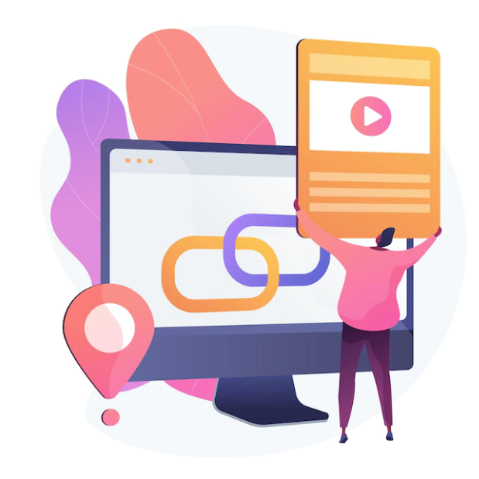
MILLIONAIRE MINDSET
BLITZSCALING: WEBINAR SCALING PROCESS - AESTHETICS
BLITZSCALING
DAY 4
TRAFFIC | LEADGEN | FUNNEL | SCALING | SYSTEM | COMMUNITY
Template:
Simple & Clear
  Less Verbose
  More Illustrations
Precise & Vibrant
  Presentaitongo.com
  Pexels.com
  Canva.com
  Freepik.com
To the Point
  Experiences
  Problem Solved
  Statistics
  Effectivity of your product
Ambiance:
Good Aesthetics
Clear Audio
Clear Video
Tested several time before
Aesthetics & Recurrence
Template
Ambiance
Frequency
Frequency:
1 Webinar / Wk. : 1-3 Months
  9 am on a weekday
2 Webinar /Wk.: 3-6 Months
DIGITAL BUSINESS HUB

Slide 23
MILLIONAIRE MINDSET
BLITZSCALING: WEBINAR SCALING PROCESS - AESTHETICS
BLITZSCALING
DAY 4
TRAFFIC | LEADGEN | FUNNEL | SCALING | SYSTEM | COMMUNITY
CHALLENGE
CONDUCT :
# 5 SELF WEBINAR
# 2 WEBINAR WITH A LIVE AUDIENCE
USING ABOVE PRINCIPLES
DIGITAL BUSINESS HUB

Slide 24
RISE 3_5
DAY 5 : BLITZSCALING – FACEBOOK TRAFFIC
DIGITAL TRAFFIC
DIGITAL LEADGEN
DIGITAL SCALING
  WEBINAR SELLING FRAMEWORK
  FACEBOOK TRAFFIC SYSTEM
DIGITAL FUNNEL
DIGITAL SYSTEM BUILDING FRAMEWORK
COMMUNITY BUILDING METHODOLOGY

Slide 25
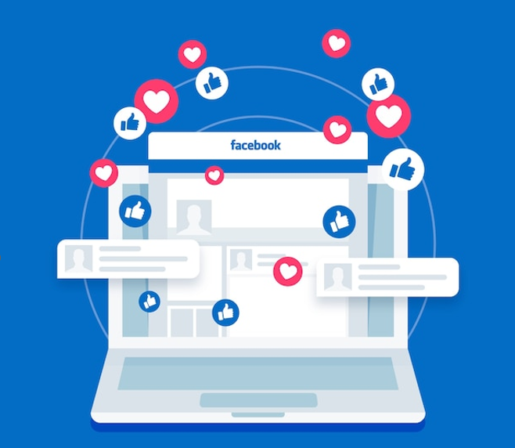
MILLIONAIRE MINDSET
BLITZSCALING: FACEBOOK SCALING PROCESS - INTRODUCTION
BLITZSCALING
DAY 5
TRAFFIC | LEADGEN | FUNNEL | SCALING | SYSTEM
FACEBOOK SCALING
Foundation
SETUPS
  Landing Pages
  FB Tracking Pixel
  Click Magic Tracking Pixel
  Video Ad on FB
Audience Persona Targeting
Video Ad creation – 45 Sec
Budgets
Precautions with FB
DIGITAL BUSINESS HUB

Slide 26
MILLIONAIRE MINDSET
BLITZSCALING: FACEBOOK SCALING PROCESS - FOUNDATION
BLITZSCALING
DAY 5
TRAFFIC | LEADGEN | FUNNEL | SCALING | SYSTEM
FOUNDATIONS
Right Digital Asset
  Product
  Problem It Is Solving
System Setup
  Landing Page | Thank You Page
  Webinar Process
  Email System
  Tracking System
  FB Pixel Setup
Winning Ad Creation
  45s – 1min Video Ad
  Ad Copy
  Audience Persona Targeting
  Multiple campaigns
Governance
  Monitor
  Analyze
  Tweak
FACEBOOK SCALING
Foundation
SETUPS
  Landing Pages
  FB Tracking Pixel
  Click Magic Tracking Pixel
  Video Ad on FB
Audience Persona Targeting
Video Ad creation – 45 Sec
Budgets
Precautions with FB
DIGITAL BUSINESS HUB

Slide 27
MILLIONAIRE MINDSET
BLITZSCALING: FACEBOOK SCALING PROCESS - SETUP
BLITZSCALING
DAY 5
TRAFFIC | LEADGEN | FUNNEL | SCALING | SYSTEM
SETUPS
Landing Pages
  ClickFunnel
  ConvertKit
FB Tracking Pixel
  FB Pixel
    https://www.youtube.com/watch?v=ynTNs5FAUm8
  Tracking FB Pixel with ClickFunnel
    https://www.youtube.com/watch?v=gtkVl2viYJw
ClickMagick Tracking
  ClickMagick setup and track
    https://www.youtube.com/watch?v=lzqF2_gwdIo&t=0s
    https://www.youtube.com/watch?v=NDN5b2TxXu0
Video AD on FB
  Setup Video Ad on FB
    https://www.youtube.com/watch?v=925PK2D0Y0I
FACEBOOK SCALING
Foundation
SETUPS
  Landing Pages
  FB Tracking Pixel
  Click Magic Tracking Pixel
  Video Ad on FB
Audience Persona Targeting
Video Ad creation – 45 Sec
Budgets
Precautions with FB
DIGITAL BUSINESS HUB

Slide 28
MILLIONAIRE MINDSET
BLITZSCALING: FACEBOOK SCALING PROCESS – AUDIENCE
BLITZSCALING
DAY 5
TRAFFIC | LEADGEN | FUNNEL | SCALING | SYSTEM
AUDIENCE PERSONA
Audience Geography
Audience Profession
Audience Age group
Audience Preferences
Audience in Situation
TWEAK AND GET CREATIVE
FACEBOOK SCALING
Foundation
SETUPS
  Landing Pages
  FB Tracking Pixel
  Click Magic Tracking Pixel
  Video Ad on FB
Audience Persona Targeting
Video Ad creation – 45 Sec
Budgets
Precautions with FB
DIGITAL BUSINESS HUB

Slide 29
MILLIONAIRE MINDSET
BLITZSCALING: FACEBOOK SCALING PROCESS – VIDEO AD CREATION
BLITZSCALING
DAY 5
TRAFFIC | LEADGEN | FUNNEL | SCALING | SYSTEM
VIDEO AD CREATION
Problem 5 sec
Solution 5 sec
Stats on results 5 sec
Audience persona 5 sec
Introduce webinar/Info 5 sec
Call to action 5 sec
Introduce yourself 5 sec
Your experience 5 Sec
FACEBOOK SCALING
Foundation
SETUPS
  Landing Pages
  FB Tracking Pixel
  Click Magic Tracking Pixel
  Video Ad on FB
Audience Persona Targeting
Video Ad creation – 45 Sec
Budgets
Precautions with FB
DIGITAL BUSINESS HUB

Slide 30
MILLIONAIRE MINDSET
BLITZSCALING: FACEBOOK SCALING PROCESS – BUDGETS & CONVERSIONS
BLITZSCALING
DAY 5
TRAFFIC | LEADGEN | FUNNEL | SCALING | SYSTEM
BUDGETS & Conversion
Start
  USD 15 ( INR 1000) /day
  Duration 5 Days
Intermediate
  USD 30 ( INR 2500 )/day
  Duration 1 Month
Conversion Ratios
  CPL
    USD 0.25-1.5/lead ( INR100)
    50 -100 Leads [ 100*1.5=150]
  Webinar ShowUp
    15%-30%
      20 Show up (say) [20%]
  Cost Per Show Up -CPL
    USD 7.5 (INR 250 -500 ) [ 150/20=7.5]
  Sales Conversion
    5% - 25% (say 20% = 4)
  CPA
    USD 25 – 30 ( INR 2000-3000)
    CPA = USD 150/4 = USD37.5 [INR2500]
FACEBOOK SCALING
Foundation
SETUPS
  Landing Pages
  FB Tracking Pixel
  Click Magic Tracking Pixel
  Video Ad on FB
Audience Persona Targeting
Video Ad creation – 45 Sec
Budgets
Precautions with FB
DIGITAL BUSINESS HUB

Slide 31
MILLIONAIRE MINDSET
BLITZSCALING: FACEBOOK SCALING PROCESS - PRECAUTIONS
BLITZSCALING
DAY 5
TRAFFIC | LEADGEN | FUNNEL | SCALING | SYSTEM
PRECAUTIONS With Facebook
https://www.facebook.com/business/help/1711863145774142
FACEBOOK SCALING
Foundation
SETUPS
  Landing Pages
  FB Tracking Pixel
  Click Magic Tracking Pixel
  Video Ad on FB
Audience Persona Targeting
Video Ad creation – 45 Sec
Budgets
Precautions with FB
DIGITAL BUSINESS HUB

Slide 32
MILLIONAIRE MINDSET
BLITZSCALING: FACEBOOK SCALING PROCESS - PRECAUTIONS
BLITZSCALING
DAY 5
TRAFFIC | LEADGEN | FUNNEL | SCALING | SYSTEM
CHALLENGE
CONDUCT :
Create your Facebook
  Landing Pages
  Tracking Pixel
  Click Magic Tracking Pixel
  Video Ad on FB
USING THE PRINCIPLES & SETUPS MENTIONED
IN THE COURSE
FACEBOOK SCALING
Foundation
SETUPS
  Landing Pages
  FB Tracking Pixel
  Click Magic Tracking Pixel
  Video Ad on FB
Audience Persona Targeting
Video Ad creation – 45 Sec
Budgets
Precautions with FB
DIGITAL BUSINESS HUB

Slide 33
RISE 3_6
DAY 6 : BLITZSCALING - FUNNEL
DIGITAL TRAFFIC
DIGITAL LEADGEN
DIGITAL SCALING
  WEBINAR SELLING FRAMEWORK
  FACEBOOK TRAFFIC SYSTEM
DIGITAL FUNNEL
DIGITAL SYSTEM BUILDING FRAMEWORK
COMMUNITY BUILDING METHODOLOGY

Slide 34
MILLIONAIRE MINDSET
BLITZSCALING: FUNNEL GENERATION – 10 COMMANDMENTS
BLITZSCALING
DAY 6
TRAFFIC | LEADGEN | FUNNEL | SCALING | SYSTEM | COMMUNITY
10 Commandments of Digital FUNNEL
Business Funnel
  Lead Magnet
  TripWire
  Core Product
  Profit Maximiser
Membership Funnel
  Level 1 - > USD 125
    Strategy : Asset | Train | Community | Challenge | Award
  Level 2 - > USD 250
    Tactical Usage and Tools to integrate
  Level 3 - > USD 1500
    Quality Collaborations | Advanced community build
Gamification Funnel
  Milestone 1 : Activity Based Reward
  Milestone 2 : Result Based Reward
  Milestone 3 : Recognition – CEO Club | Millionaire Club
Marketing Funnel
  Spread | Attract | Want | Action ( SAWA )
  Awareness | Consideration | Effect ( ACE )
  Top 12 Funnels
Lead Magnet
  FREE / DISCOUNTED Content
  FREE/ DISCOUNTED Memberships
  FREE / DISCOUNTED Early Birds
APPLICATION SETUP
  Setup up the Application Tools
  Get them Automated
  Get the content and visuals organized
SYSTEM SETUP
  BAAP
  RFM System
  Social Media | ClickMagick | ClickFunnel | Convertkit
JOIN THE DOTS
  Bring it All Together
FUNNEL SETUP CHALLENGE
  30-Day - Challenge
  Sell Webinars and 121’s
  Build Your Funnel for L2
KNOW YOUR NEXT STEPS
  Using the Leads
  Creating Funnels
DIGITAL BUSINESS HUB

Slide 35




MILLIONAIRE MINDSET
BLITZSCALING: BUSINESS FUNNEL – EXAMPLE IN ACTION
BLITZSCALING
DAY 6
TRAFFIC | LEADGEN | FUNNEL | SCALING | SYSTEM | COMMUNITY
BUSINESS FUNNEL – Course Example
LEAD MAGNET
Profit Maximiser
  WEBINARS
  Tutorial Videos
  Live Videos
  Small Videos
  Blogs & Podcasts
  FREE
100%
L 3 Group Coaching
121 Coaching
High Ticket Programs
25%
TRIPWIRE
Core Product
  BASIC LEVEL
  10 Video - 90 Mins
  > USD 125
L 2 Implementation Course
Tactics
Action
60%
CORE PRODUCT
  ACTION LEVEL
  Implementation
  5 – 10 Hr.
  > USD 250
LEAD MAGNET
50%
Live Webinar : 2 Hr
Live Online Seminar 1-Day
Mini Course ( Recorded)
5 Day Mini Course
10 Day Challenge
Profit Maximiser
  HIGH TICKET
  Mastermind
  < USD 1200
TripWire
DIGITAL BUSINESS HUB
L 1 Conceptual Course
Principles
Strategies

Slide 36
MILLIONAIRE MINDSET
BLITZSCALING: FUNNEL PREPARATION – EXAMPLE MEMBERSHIP
BLITZSCALING
DAY 6
TRAFFIC | LEADGEN | FUNNEL | SCALING | SYSTEM | COMMUNITY
MEMBERSHIP FUNNEL – Course Example
Profit Maximiser
  Level 3 - > USD 1500
    Quality Collaborations | Advanced community build
LEVEL 1
  e.g. Silver
LEVEL 2
LEVEl2
  Level 2 - > USD 250
    Tactical Usage and Tools to integrate
  e.g. Gold
  Implementation
LEVEL 3
  e.g. Platinum
LEVEL 1
Strategy :
Asset | Train | Community | Challenge | Certifiy
Target > 125
DIGITAL BUSINESS HUB

Slide 37



MILLIONAIRE MINDSET
BLITZSCALING: GAMIFICATION FUNNEL - GAMIFICATION
BLITZSCALING
DAY 6
TRAFFIC | LEADGEN | FUNNEL | SCALING | SYSTEM | COMMUNITY
Gamification FUNNEL – Course Example
Milestone 3
  Recognition
  Ceo Club
  Millionaire Club
Milestone 1
  Activity Reward
Milestone 2
  Result Oriented Reward
Milestone 2
  Result Based Reward
MilestonE 3
  Exclusive Recognition
Milestone 1
  Activity Based Reward
DIGITAL BUSINESS HUB

Slide 38
MILLIONAIRE MINDSET
BLITZSCALING: MARKETING FUNNEL - CLASSIFICATIONS
BLITZSCALING
DAY 6
TRAFFIC | LEADGEN | FUNNEL | SCALING | SYSTEM | COMMUNITY
MARKETING FUNNEL CLASSIFICATIONS
SPREAD
Direct Sales Funnel
Book Launch Funnel
Messenger Class Funnel
Free Webinar Funnel
Paid Webinar Funnel
Auto Webinar Funnel
High Ticket Consulting funnel
The Live Seminar Funnel
The Live Bootcamp Funnel
Multi Speaker Summit Funnel
Quiz Funnel
Hybrid Funnels
AWARENESS
ATTRACT
CONSIDER
WANT
ACTION
EFFECT
ACE
SAWA
DIGITAL BUSINESS HUB

Slide 39
MILLIONAIRE MINDSET
BLITZSCALING: MARKETING FUNNEL – CLASSIFICATION IN ACTION 1
BLITZSCALING
DAY 6
TRAFFIC | LEADGEN | FUNNEL | SCALING | SYSTEM | COMMUNITY
MARKETING FUNNEL
SPREAD
A
C
E
1 Direct Sales Funnel
ATTRACT
Traffic
Lead Capture
Payment
Access Asset
WANT
FB | GOOGLE | Promotions
Landing Page
PayPal | Stripe
Live Program | Assets | Memberships | Consulting | Services
ACTION
2 Book Launch Funnel
Direct Sales Funnel
Book Launch Funnel
Messenger Class Funnel
Free Webinar Funnel
Paid Webinar Funnel
Auto Webinar Funnel
High Ticket Consulting funnel
The Live Seminar Funnel
The Live Bootcamp Funnel
Multi Speaker Summit Funnel
Quiz Funnel
Hybrid Funnels
Traffic
Book Launch
Live Webinar
Payments
Bonus Course
FB | GOOGLE | Promotions
Landing Page | Free Chapters | Free Shipping
Pre - Frame
Zoom / Demio
PayPal | Stripe
3 Messenger Class Funnel
Traffic
Lead Capture
WhatsApp Grp
Sell Asset
FB | GOOGLE | Promotions
Landing Page | Coupon
Daily Assignments | Gamification
PayPal | Stripe
DIGITAL BUSINESS HUB

Slide 40
MILLIONAIRE MINDSET
BLITZSCALING: MARKETING FUNNEL – CLASSIFICATION IN ACTION 2
BLITZSCALING
DAY 6
TRAFFIC | LEADGEN | FUNNEL | SCALING | SYSTEM | COMMUNITY
Marketing FUNNEL
SPREAD
A
C
E
4 Live Webinar Funnel
ATTRACT
Traffic
Lead Capture
Live Webinar
Payment
Access Program
WANT
FB | GOOGLE | Promotions
Landing Page
Zoom | Demio
PayPal | Stripe
ACTION
5 Paid Webinar Funnel ( Download Workbook before webinar through landing Page)
Direct Sales Funnel
Book Launch Funnel
Messenger Class Funnel
Free Webinar Funnel
Paid Webinar Funnel
Auto Webinar Funnel
High Ticket Consulting funnel
The Live Seminar Funnel
The Live Bootcamp Funnel
Multi Speaker Summit Funnel
Quiz Funnel
Hybrid Funnels
Traffic
Lead Capture
Live Webinar
Payments
Webinar Ticket
FB | GOOGLE | Promotions
Landing Page | Free Chapters | Free Shipping
Insta Mojo | RazorPay
Zoom | Demio | Webinar Jam
PayPal | Stripe
6 Automated Webinar Funnel
Traffic
Lead Capture
Auto Webinar
Payment
Access Program
FB | GOOGLE | Promotions
Landing Page
EverWebinar
PayPal | Stripe
DIGITAL BUSINESS HUB

Slide 41
MILLIONAIRE MINDSET
BLITZSCALING: MARKETING FUNNEL – CLASSIFICATION IN ACTION 3
BLITZSCALING
DAY 6
TRAFFIC | LEADGEN | FUNNEL | SCALING | SYSTEM | COMMUNITY
Marketing FUNNEL
SPREAD
A
C
E
7 High Ticket Consulting Funnel
ATTRACT
Traffic
Lead Capture
Value Video
Strategy Call
Close Deal
WANT
FB | GOOGLE | Promotions
Landing Page
TypeForm | Survey
Calendly | Zoom
PayPal | Stripe
ACTION
8 Live Seminar Funnel [ 1 Day ]
Direct Sales Funnel
Book Launch Funnel
Messenger Class Funnel
Free Webinar Funnel
Paid Webinar Funnel
Auto Webinar Funnel
High Ticket Consulting funnel
The Live Seminar Funnel
The Live Bootcamp Funnel
Multi Speaker Summit Funnel
Quiz Funnel
Hybrid Funnels
Traffic
$19 ticket
1 Day Live
Payments
VIP Group
FB | GOOGLE | Promotions
PayPal | Stripe
WhatsApp | Telegram
Zoom | Demio | Webinar Jam
PayPal | Stripe
9 Live Bootcamp Funnel [ 3 Day ]
Traffic
$ 19 Ticket
VIP Group
3 Day Event
Payment
FB | GOOGLE | Promotions
PayPal | Stripe
WhatsApp | Telegram
PayPal | Stripe
DIGITAL BUSINESS HUB

Slide 42
MILLIONAIRE MINDSET
BLITZSCALING: MARKETING FUNNEL – CLASSIFICATION IN ACTION 4
BLITZSCALING
DAY 6
TRAFFIC | LEADGEN | FUNNEL | SCALING | SYSTEM | COMMUNITY
Marketing FUNNEL
SPREAD
A
C
E
10 Multi-Speaker Summit
ATTRACT
Traffic
0 - $ 199 Ticket
1 Day Summit
4 Hr. Bootcamp
Payment
WANT
FB | GOOGLE | Promotions
PayPal | Stripe
Multi-Speaker | Zoom | Demio | WebinarJam
Individual Spear | Zoom | Demio | WebinarJam
PayPal | Stripe
ACTION
11 Quiz Funnel
Direct Sales Funnel
Book Launch Funnel
Messenger Class Funnel
Free Webinar Funnel
Paid Webinar Funnel
Auto Webinar Funnel
High Ticket Consulting funnel
The Live Seminar Funnel
The Live Bootcamp Funnel
Multi Speaker Summit Funnel
Quiz Funnel
Hybrid Funnels
Traffic
Free Quiz
Custom Training
Payments
Segmenting
FB | GOOGLE | Promotions
Bucket.io | TypeForm
Profile Based Demographics | Specific Problems
Live Webinar | Auto Webinar | Live Workshop
PayPal | Stripe
12 Hybrid Funnel [Creative Mix and Match ]
Traffic
Lead Capture
Group
Live Webinar
Payment
FB | GOOGLE | Promotions
Landing Page
FaceBook | Telegram
2 Hours
Automated Orientation
Payment
Access Program
DIGITAL BUSINESS HUB
45 Minutes
InstaMojo | RazorPay|Paypal

Slide 43
MILLIONAIRE MINDSET
BLITZSCALING: FUNNEL APPLICATION SETUP
BLITZSCALING
DAY 6
TRAFFIC | LEADGEN | FUNNEL | SCALING | SYSTEM | COMMUNITY
Facebook
YouTube
LinkedIn
..
RFM RISE FUNNEL MONETIZATION SYSTEM
Business Funnel
Membership Funnel
Gamification Funnel
Marketing Funnel
Lead Magnet
APPLICATION SETUP
SYSTEM SETUP
JOIN THE DOTS
FUNNEL SETUP CHALLENGE
KNOW YOUR NEXT STEPS
MONETIZATION
ClickFunnels
ClickFunnels
WEBSITE /
LANDING PAGES
Lead Capture
WEBINARS
OptimizePress
ClickFunnels
OTHER SOCIAL SOURCES
EMAILS
SwipePages
ConvertKit
DIGITAL BUSINESS HUB

Slide 44
Business Funnel
Membership Funnel
Gamification Funnel
Marketing Funnel
Lead Magnet
APPLICATION SETUP
SYSTEM SETUP
JOIN THE DOTS
FUNNEL SETUP CHALLENGE
KNOW YOUR NEXT STEPS
MILLIONAIRE MINDSET
BLITZSCALING: FUNNEL - JOINING THE DOTS
BLITZSCALING
DAY 6
TRAFFIC | LEADGEN | FUNNEL | SCALING | SYSTEM | COMMUNITY
FUNNEL
PREFRAMING
Videos
Conversion
Stages
Posts
Blogs
The Hook
The Product
The Offer
Community
FB Group
Private Group
Telegram Group
Concepts
Lead Magnet
Free Webinar
Tripwire
Conceptual Course
Core Product
Implementation
Profit Maximiser
Coaching
Affiliate
Blueprint
Maximum Potential
BAAP System
Facebook
YouTube
LinkedIn
..
RFM RISE FUNNEL MONETIZATION SYSTEM
MONETIZATION
ClickFunnels
ClickFunnels
WEBSITE /
LANDING PAGES
Lead Capture
WEBINARS
OptimizePress
ClickFunnels
OTHER SOCIAL SOURCES
EMAILS
DIGITAL BUSINESS HUB
SwipePages
ConvertKit

Slide 45
MILLIONAIRE MINDSET
BLITZSCALING: FUNNEL HOMEWORK
BLITZSCALING
DAY 6
TRAFFIC | LEADGEN | FUNNEL | SCALING | SYSTEM | COMMUNITY
REFERENCE
CHALLENGE
Define & Design Business Funnel
Curriculum
Step 2
Step 5
Pricing
Setup Funnel Pages
Capture Page
Thank You Page
Step 4
Define & Design Lead Magnets
Webinar
Step 1
YouTube
Step 6
Start Selling
Webinars
121
Step 3
Define & Setup Gamification Funnel
Milestones
Rewards
eBook
Influence Building
Podcast
FUNNEL
PREFRAMING
Videos
Conversion
Stages
Posts
Blogs
The Hook
The Product
The Offer
Community
FB Group
Private Group
Telegram Group
Concepts
Lead Magnet
Free Webinar
Tripwire
Conceptual Course
Core Product
Implementation
Profit Maximiser
Coaching
Affiliate
Blueprint
Maximum Potential
BAAP System
CHALLENGE
60 Minutes Challenge
SETUP THE FUNNEL AS PER THE
12 CLASSIFICATIONS FOR
YOUR DIGITAL PRODUCTS
Business Funnel
Membership Funnel
Gamification Funnel
Marketing Funnel
Lead Magnet
APPLICATION SETUP
SYSTEM SETUP
JOIN THE DOTS
FUNNEL SETUP CHALLENGE
KNOW YOUR NEXT STEPS
DIGITAL BUSINESS HUB

Slide 46
MILLIONAIRE MINDSET
BLITZSCALING: NEXT LEVEL
BLITZSCALING
DAY 6
TRAFFIC | LEADGEN | FUNNEL | SCALING | SYSTEM | COMMUNITY
FINISH 90 DAYS
DIGITAL ASSET
CREATION
COMPLETE 50
Consultations
RESULT PLANNING
FUNNEL
BUILDING
BUILD
SOCIAL GROUP
NICHE CLARITY
LAUNCH ASSET
SETUP SYSTEMS
RISE UP MODEL
LEAD MAGNET
LAUNCH
START
DIGITAL BUSINESS HUB

Slide 47
MILLIONAIRE MINDSET
BLITZSCALING: FUNNEL GENERATION
BLITZSCALING
DAY 6
TRAFFIC | LEADGEN | FUNNEL | SCALING | SYSTEM | COMMUNITY
COPY
WRITING
SCALE
FACEBOOK
ADS
WEBINAR SELLING
FUNNEL
SCALING
RISE 3 DIAMOND
FINISHER 180 DAYS
LEADGEN
SCALING
CONTENT BREAK
GOAL :
In 90DAYS
EXPANSION
40 Sales @ USD 75 /
INR 4999 ( L1 Membership)
Curriculum MVP 2 –L2
Wkly. Inner Circle Call
5 Sales @ USD 250 /
INR 19999( L2 Membership )
GOALS
Launch L2 Membership
1 Webinar / Wk.
RISE 2 GOLD
SCALE AD
FB | Google
YouTube Videos
2-3/wk.
DIGITAL BUSINESS HUB

Slide 48
RISE 3_7
DAY 7 : BLITZSCALING – DIGITAL SYSTEM BUILDING FRAMEWORK
DIGITAL TRAFFIC
DIGITAL LEADGEN
DIGITAL SCALING
  WEBINAR SELLING FRAMEWORK
  FACEBOOK TRAFFIC SYSTEM
DIGITAL FUNNEL
DIGITAL SYSTEM BUILDING FRAMEWORK
COMMUNITY BUILDING METHODOLOGY

Slide 49
MILLIONAIRE MINDSET
BLITZSCALING: DIGITAL SYSTEM BUILDING FRAMEWORK - INTRODUCTION
BLITZSCALING
DAY 7
TRAFFIC | LEADGEN | FUNNEL | SCALING | SYSTEM | COMMUNITY
L3 : PROLIFERATE
THE RISE BAAP SYSTEM
L1
ClickMagic
ClickFunnel
DATA ANALYSIS & FEEDBACK MECHANISM WITH REPORTS
FB | GOOGLE
ConvertKit
ClickFunnel
BLITZSCALE
Marketing campaigns
INTERNAL & EXTERNAL
System &
The Control Hub
FUNNEL
ClickMagic
ClickFunnel
ZAPIER
Community
FB
Mightynetworks
L3
Lead Segregation
ClickMagic
ClickFunnel
Automated Traffic & Retargeting System
LeadGen
L2 : ADMINSTER : Control & Manage
L2
L1 : ACTIVATE
Website – Blogs/Vlogs
Communication
Webinar
Landing Pages
OrientExpress
ConvertKit
Zoom / Demo
Automated Tracking
Traffic
L1
ClickMagick
ClickFunnel
SOCIAL MEDIA
( Pick one Source when beginning)
YOUR CUSTOMERS
DIGITAL ASSET CONSUMPTION`
DIGITAL BUSINESS HUB

Slide 50
MILLIONAIRE MINDSET
BLITZSCALING: DIGITAL SYSTEM BUILDING F/W – SYSTEM IN ACTION
BLITZSCALING
DAY 7
TRAFFIC | LEADGEN | FUNNEL | SCALING | SYSTEM | COMMUNITY
Facebook
YouTube
LinkedIn
..
RFM RISE FUNNEL MONETIZATION SYSTEM
MONETIZATION
ClickFunnels
ClickFunnels
WEBSITE /
LANDING PAGES
Lead Capture
WEBINARS
OptimizePress
ClickFunnels
OTHER SOCIAL SOURCES
EMAILS
SwipePages
ConvertKit
DIGITAL BUSINESS HUB

Slide 51
RISE 3_8
DAY 8 : BLITZSCALING – COMMUNITY BUILDING METHODOLOGY
DIGITAL TRAFFIC
DIGITAL LEADGEN
DIGITAL SCALING
  WEBINAR SELLING FRAMEWORK
  FACEBOOK TRAFFIC SYSTEM
DIGITAL FUNNEL
DIGITAL SYSTEM BUILDING FRAMEWORK
COMMUNITY BUILDING METHODOLOGY

Slide 52
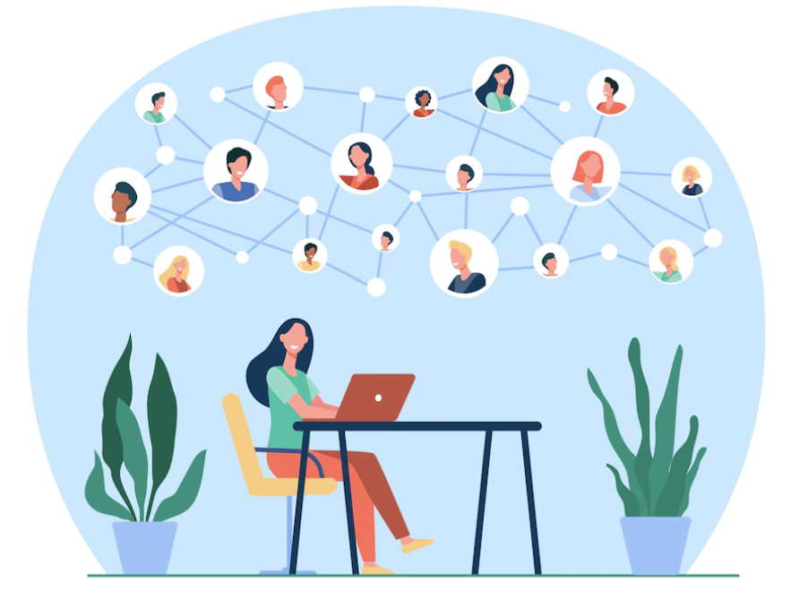
MILLIONAIRE MINDSET
BLITZSCALING: DIGITAL COMMUNITY SYSTEM - INTRODUCTION
BLITZSCALING
DAY 8
TRAFFIC | LEADGEN | FUNNEL | SCALING | SYSTEM | COMMUNITY
DIGITAL COMMUNITY BUILDING
FRAMEWORK
Key Principles & Classification
7 Steps to build a community
4 Key Stages
Audience
Community-Based Sales
Framework and Formula
Tools
DIGITAL BUSINESS HUB

Slide 53
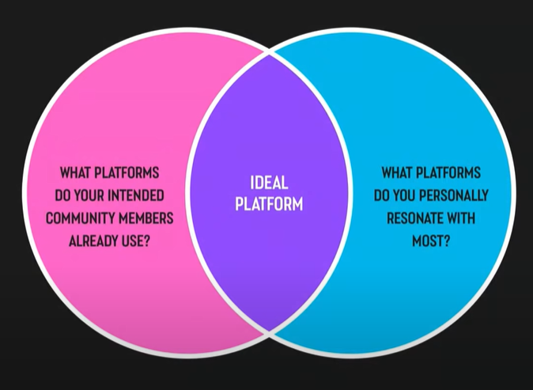
MILLIONAIRE MINDSET
BLITZSCALING: DIGITAL COMMUNITY KEY PRINCIPLES
BLITZSCALING
DAY 8
TRAFFIC | LEADGEN | FUNNEL | SCALING | SYSTEM | COMMUNITY
KEY PRINCIPLES
Capacity to serve the Community
Be Authentic
Have a Deeper Purpose
Be highly communicative
Have a Sufficient number of potential members
Potential Community members are over-served by other similar communities
Like-minded community members with similar purpose & focus
Key Principles & Classification
7 Steps to build a community
4 Key Stages
Audience
Community-Based Sales
Framework and Formula
Tools
MEDIUM | PROS | CONS
Public Social | Mass Reach | Change with changing times Less to No Control
Branded Community Platforms | Better Control Private Community & closed groups Community tend to become loyal & exclusive | Challenging to start new The stickiness of members to their current groups
Classifications
Public Social Networks
Branded Communities
DIGITAL BUSINESS HUB

Slide 54
MILLIONAIRE MINDSET
BLITZSCALING: DIGITAL COMMUNITY - 7 STEPS
BLITZSCALING
DAY 8
TRAFFIC | LEADGEN | FUNNEL | SCALING | SYSTEM | COMMUNITY
Steps To Build A Community
Define a deep purpose
Choose a relevant platform
Build a member profile
Define the rules
Define the communication norms and frequency
Identify key stakeholders
Define governance principles
Communication Ideas
Internal Community
Blogs
Newsletter
Social Posts
Live Social events
Podcasts
Live Webinar
Like-Minded External Communities
All above on their communities
Advertise on their platform
Invite for an influencer partnership
Be active in their comment section
Key Principles & Classification
7 Steps to build a community
4 Key Stages
Audience
Community-Based Sales
Framework and Formula
Tools
Benefits
Increased Loyalty & Attention
Encouraging Feedback to build with them
Defended against haters
Relationship and constant touch with members
DIGITAL BUSINESS HUB

Slide 55



MILLIONAIRE MINDSET
BLITZSCALING: DIGITAL COMMUNITY - 4 KEY STAGES
BLITZSCALING
DAY 8
TRAFFIC | LEADGEN | FUNNEL | SCALING | SYSTEM | COMMUNITY
Early Direction & Clarity
Grade 1 to 10 for
Size of Target Market
Level of Existing Competition
Target Market Passion levels
Decision should be based on> 50%
 | 1 | 2 | 3 | 4 | 5 | 6 | 7 | 8 | 9 | 10
Mkt Size
Competition
Passion
Start with Any 4 Values That Community Can Bring
Networking
Information & Knowledge
Belonging & Empathy
Entertainment
Key Principles & Classification
7 Steps to build a community
4 Key Stages
Audience
Community-Based Sales
Framework and Formula
Tools
NETWORKING
EMPATHY
KNOWLEDGE
ENTERTAINMENT
DIGITAL BUSINESS HUB

Slide 56





MILLIONAIRE MINDSET
BLITZSCALING: DIGITAL COMMUNITY - 4 KEY STAGES
BLITZSCALING
DAY 8
TRAFFIC | LEADGEN | FUNNEL | SCALING | SYSTEM | COMMUNITY
NURTURING THE COMMUNITY
GROWING THE COMMUNITY
STRANGERS
AQUAINTANCES
FRIENDS
COUPLE
ENGAGED
LIFE PARTNERS
One On One
WORD OF MOUTH
INBOUND
DISTRIBUTION
Key Principles & Classification
7 Steps to build a community
4 Key Stages
Audience
Community-Based Sales
Framework and Formula
Tools
4 KEY METHODS
DIGITAL BUSINESS HUB

Slide 57
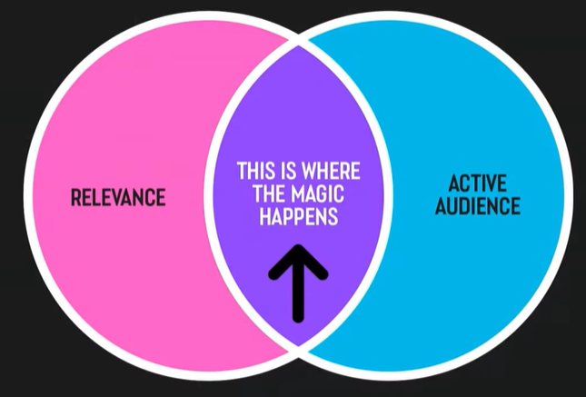




MILLIONAIRE MINDSET
BLITZSCALING: DIGITAL COMMUNITY - AUDIENCE
BLITZSCALING
DAY 8
TRAFFIC | LEADGEN | FUNNEL | SCALING | SYSTEM | COMMUNITY
BREAKDOWN OF 500,000 COMMUNITY MEMBERS : 0.4%
250,000 INACTIVE | MEMBERS DO NOT EVER SEE DISTRIBUTION EFFORTS
200,000 NOT PARTICULARLY ACTIVE
40,000 SOMEWHAT ENGAGED | SOMEWHAT LIKELY TO SEE DISTRIBUTION EFFORTS
5000 FREQUENTLY ENGAGED
4000 SUPER ENGAGED | MOST LIKELY TO BE ATTRACTED BY THE DISTRIBUTION EFFORTS
1000 PERFECT MEMBERS – TRUE FANS!
FAST-GROWING COMMUNITY PLATFORMS
Key Principles & Classification
7 Steps to build a community
4 Key Stages
Audience
Community-Based Sales
Framework and Formula
Tools
AUDIENCE WITH BETTER COMMUNITY PLATFORM CONTROL
PROS | CONS
HIGHER REACH | VULNERABLE TO ALGORITHM SHIFTS
HIGH SHAREABILITY | PLATFORM CONTROL MINIMAL
GOOD CONNECT WITH NATIVE PLATFORM | COMPETING FOR ATTENTION
MIGHTY
NETWORKS
SLACK
DIGITAL BUSINESS HUB
FACEBOOK
Discord

Slide 58
MILLIONAIRE MINDSET
BLITZSCALING: DIGITAL COMMUNITY - BASED SALES
BLITZSCALING
DAY 8
TRAFFIC | LEADGEN | FUNNEL | SCALING | SYSTEM | COMMUNITY
Community-Based Sales
Increases with the relevance of the community
Size of the community
Premium Offerings for the community
Marketing of the premium offering for the community
Key Principles & Classification
7 Steps to build a community
4 Key Stages
Audience
Community-Based Sales
Framework and Formula
Tools
DIGITAL BUSINESS HUB

Slide 59
MILLIONAIRE MINDSET
BLITZSCALING: DIGITAL COMMUNITY - VALIDATION
BLITZSCALING
DAY 8
TRAFFIC | LEADGEN | FUNNEL | SCALING | SYSTEM | COMMUNITY
Validation Formula
Use this formula to validate the demand of your intended community
Size of the Target Market X Passion of Target Market = DEMAND
Existing Competition
DEMAND | EASINESS OF THE COMMUNITY TO SUCCEED
1 - 4 | Very Difficult
5 – 9 | Difficult
10 – 14 | Reasonable Chance
15 – 19 | Great Chance
20+ | Absolute Chance
EXERCISE
Use the Framework to evaluate your community targets of the current community’s success
Ideate and evaluate how can your community become more passionate about the cause
Choose a Niche to eliminate competition
Reevaluate the updated approach and analyze the result to repeat or continue
Key Principles & Classification
7 Steps to build a community
4 Key Stages
Audience
Community-Based Sales
Framework and Formula
Tools
 | 1 | 2 | 3 | 4 | 5 | 6 | 7 | 8 | 9 | 10
Mkt Size
Competition
Passion
DIGITAL BUSINESS HUB
Size of the target market
Existing Competition
X
Target Mkt
Passion Level
=
DEMAND

Slide 60
MILLIONAIRE MINDSET
BLITZSCALING: DIGITAL COMMUNITY - TOOLS
BLITZSCALING
DAY 8
TRAFFIC | LEADGEN | FUNNEL | SCALING | SYSTEM | COMMUNITY
TOOLS
Mighty Networks
https://www.youtube.com/watch?v=5CGANTIqlKk
https://www.mightynetworks.com/pro/learn
https://www.mightynetworks.com/pro/learn/sophia-amoruso-business-class-online-coursen
Facebook Groups
https://www.youtube.com/watch?v=Eh6BdkKPslo
Key Principles & Classification
7 Steps to build a community
4 Key Stages
Audience
Community-Based Sales
Framework and Formula
Tools
FACEBOOK
DIGITAL BUSINESS HUB

Slide 61
MILLIONAIRE MINDSET
BLITZSCALING: NEXT LEVEL
BLITZSCALING
DAY 8
TRAFFIC | LEADGEN | FUNNEL | SCALING | SYSTEM | COMMUNITY
FINISH 90 DAYS
DIGITAL ASSET
CREATION
COMPLETE 50
Consultations
RESULT PLANNING
FUNNEL
BUILDING
BUILD
SOCIAL GROUP
NICHE CLARITY
LAUNCH ASSET
SETUP SYSTEMS
RISE UP MODEL
LEAD MAGNET
LAUNCH
START
DIGITAL BUSINESS HUB

Slide 62
MILLIONAIRE MINDSET
BLITZSCALING: FUNNEL GENERATION
BLITZSCALING
DAY 8
TRAFFIC | LEADGEN | FUNNEL | SCALING | SYSTEM | COMMUNITY
COPY
WRITING
SCALE
FACEBOOK
ADS
WEBINAR SELLING
FUNNEL
SCALING
YOU ARE HERE
RISE 3 DIAMOND
FINISHER 180 DAYS
LEADGEN
SCALING
CONTENT BREAK
GOAL :
In 90DAYS
EXPANSION
40 Sales @ USD 75 /
INR 4999 ( L1 Membership)
Curriculum MVP 2 –L2
Wkly. RISE Circle Call
5 Sales @ USD 250 /
INR 19999( L2 Membership )
GOALS
Launch L2 Membership
1 Webinar / Wk.
RISE 2 GOLD
SCALE AD
FB | Google
YouTube Videos
2-3/wk.
DIGITAL BUSINESS HUB

Slide 63
MILLIONAIRE MINDSET
BLITZSCALING: FUNNEL GENERATION
BLITZSCALING
DAY 8
TRAFFIC | LEADGEN | FUNNEL | SCALING | SYSTEM | COMMUNITY
EXERCISE
Use the Framework to evaluate your community targets of the current community’s success
Create a Community based on the principles mentioned
Ideate and evaluate how can your community become more passionate about the cause
Choose a Niche to eliminate competition
Reevaluate the updated approach and analyze the result to repeat or continue
CHALLENGE
 | 1 | 2 | 3 | 4 | 5 | 6 | 7 | 8 | 9 | 10
Mkt Size
Competition
Passion
Size of the target market
Existing Competition
X
Target Mkt
Passion Level
=
DEMAND
DIGITAL BUSINESS HUB

Slide 64
MILLIONAIRE MINDSET
BLITZSCALING: FUNNEL GENERATION
BLITZSCALING
DAY 8
TRAFFIC | LEADGEN | FUNNEL | SCALING | SYSTEM | COMMUNITY
END OF BLITZSCALING
COMPLETE YOUR CHALLENGE & PRINT YOUR CERTIFICATE
DIGITAL BUSINESS HUB

