Slide 1
RISE 4_1
DAY 1 : DIGITAL PLATFORM FOR INCOME GROWTH
INCOME SOURCES
MONEY SPIN
FINANCIAL ASSET PORTFOLIO STRATEGY
  TECHNICAL ANALYSIS
  FUNDAMENTAL ANALYSIS
  SHORT TERM & LONG TERM
KEY PLATFORMS

Slide 2


MILLIONAIRE MINDSET
DIGITAL PLATFORMS FOR INCOME GROWTH: INCOME SOURCES
INCOME GROWTH
DAY 1
SOURCES|MONEY SPIN|PORTFOLIO|KEY PLATFORMS
INCOME SOURCES
ACTIVE
Earned/Profit
Salary
PASSIVE
Interest
Dividend
Rental
Capital Gain
Royalty
TRADE TIME
TRADE ASSET
DIGITAL BUSINESS HUB

Slide 3
RISE 4_2
DAY 2 : DIGITAL PLATFORM FOR INCOME GROWTH
INCOME SOURCES
MONEY SPIN
FINANCIAL ASSET PORTFOLIO STRATEGY
  TECHNICAL ANALYSIS
  FUNDAMENTAL ANALYSIS
  SHORT TERM & LONG TERM
KEY PLATFORMS

Slide 4
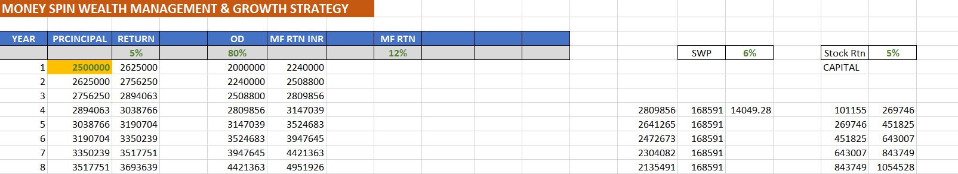
MILLIONAIRE MINDSET
DIGITAL PLATFORMS FOR INCOME GROWTH: MONEY SPIN GROWTH STRATEGY
INCOME GROWTH
DAY 2
SOURCES|MONEY SPIN|PORTFOLIO|KEY PLATFORMS
MONEY SPIN WEALTH MANAGEMENT & GROWTH STRATEGY
You orchestrate the symphony
And let your partners manage
The musicians and the instruments
Using capital as ASSET to generate Interest and Debt for >500% return over a period of time
Debt will be used to create additional Asset in form of an Investment Portfolio
This Portfolio will be used as an asset for additional passive income.
This additional passive income will be used to preserve & create Wealth generation
And dividend-based passive income through a portfolio of Financial Assets
DOWNLOAD
Money_spin_wealth_mgmnt.xlsx
DIGITAL BUSINESS HUB

Slide 5
MILLIONAIRE MINDSET
DIGITAL PLATFORMS FOR INCOME GROWTH: MONEY SPIN GROWTH STRATEGY
INCOME GROWTH
DAY 2
SOURCES|MONEY SPIN|PORTFOLIO|KEY PLATFORMS
CHALLENGE
DOWNLOAD: Money_spin_wealth_mgmnt.xlsx
PUT THE CRITERIA OF YOUR DETAILS ( your investments, % of return as per your local and personal norms ) FOR YOUR LONG-TERM GOAL
BRING YOUR QUERIES TO THE RISE CIRCLE
DIGITAL BUSINESS HUB

Slide 6
RISE 4_3
DAY 3 : DIGITAL PLATFORM FOR INCOME GROWTH
INCOME SOURCES
MONEY SPIN
FINANCIAL ASSET PORTFOLIO STRATEGY – SHORT TERM
  TECHNICAL ANALYSIS
  FUNDAMENTAL ANALYSIS
  SHORT TERM & LONG TERM
KEY PLATFORMS

Slide 7
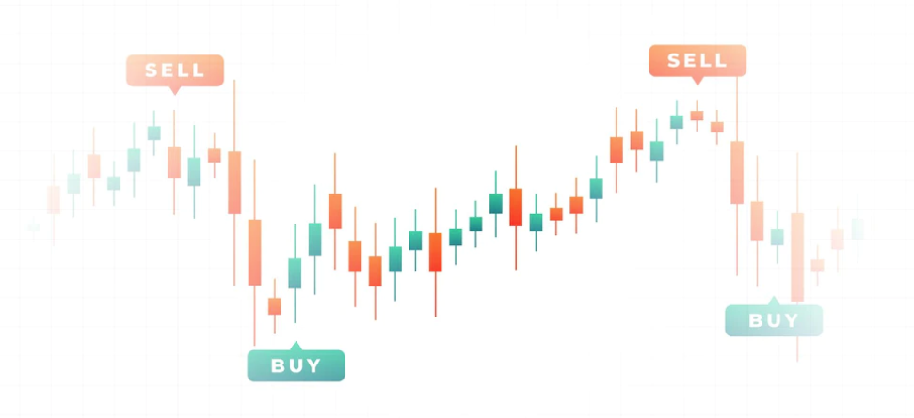
MILLIONAIRE MINDSET
DIGITAL PLATFORMS FOR INCOME GROWTH : STOCK PORTFOLIO STRATEGY
INCOME GROWTH
DAY 3
SOURCES|MONEY SPIN|PORTFOLIO|KEY PLATFORMS
PA
FINANCIAL ASSETS
CURRENT
NON-CURRENT
10%
4%
50%
3%
PA
10%
KEY FINANCIAL ASSETS PORTFOLIO
BUSINESSES: RISE 5
STOCKS
MUTUAL FUNDS / ETF
COMMODITIES
BONDS
OTHER PORTFOLIOS
REAL ESTATE
PRECIOUS METALS
CASH
FIXED DEPOSITS
LOANS & RECEIVABLES
FUNDS & GRATUITY
DIGITAL BUSINESS HUB

Slide 8
MILLIONAIRE MINDSET
DIGITAL PLATFORMS FOR INCOME GROWTH : STOCK PORTFOLIO STRATEGY - SHORT
INCOME GROWTH
DAY 3
SOURCES|MONEY SPIN|PORTFOLIO|KEY PLATFORMS
PA
10%
4%
50%
3%
PA
10%
PATIENCE | PERSEVERANCE | PASSION | DISCIPLINE
KEY TYPES OF TRADES
Scalping
Swing Trade
Positional Trade
SHORT TERM STRATEGY
5 Pt. Technical Indicator Strategy - MARBS
10/4 RULE
Pyramiding
Price Action
DIGITAL BUSINESS HUB

Slide 9
MILLIONAIRE MINDSET
DIGITAL PLATFORMS FOR INCOME GROWTH : STOCK PORTFOLIO STRATEGY - SHORT
INCOME GROWTH
DAY 3
SOURCES|MONEY SPIN|PORTFOLIO|KEY PLATFORMS
KEY TYPES OF TRADES
Scalping – Very Short Term
Swing Trade – Short Term
Positional Trade – Mid Term
10%
4%
50%
3%
PA
PA
10%
SHORT-TERM STRATEGY - PORTFOLIO
4 Pt. SAPR Strategy
10/4 RULE Leading to Long Pyramid
Pyramiding with Momentum
Price Action
4 Pt. STEPS: SAPR
Screen
T. Analyze – PA + MARBS / TERB
Position Sizing
Risk Management
  Entry / Re-Entry /Average
  S/L: Monitor / Pyramiding
  Exit
DOWNLOAD
POSITION.xlsx
DIGITAL BUSINESS HUB

Slide 10
MILLIONAIRE MINDSET
DIGITAL PLATFORMS FOR INCOME GROWTH : STOCK PORTFOLIO STRATEGY
INCOME GROWTH
DAY 3
SOURCES|MONEY SPIN|PORTFOLIO|KEY PLATFORMS
QUICK PRACTICAL FOR
CHALLENGE
OPEN YOUR TRADING ACCOUNT IF NOT OPENED
CREATE YOUR TEMPLATES IN Tradingview.com
USE THE LEARNED PRINCIPLES FOR 5 DUMMY TRADES WITH MINIMAL CAPITAL / OR JUST OBSERVE YOUR ANTICIPATED TRADE
BRING YOUR QUERIES TO RISE CIRCLES
PRACTICALS WILL BE CARRIED OUT ON RISE CIRCLE PERIODICALLY
DIGITAL BUSINESS HUB

Slide 11
RISE 4_4
DAY 4 : DIGITAL PLATFORM FOR INCOME GROWTH
INCOME SOURCES
MONEY SPIN
FINANCIAL ASSET PORTFOLIO STRATEGY – LONG TERM
  TECHNICAL ANALYSIS
  FUNDAMENTAL ANALYSIS
  SHORT TERM & LONG TERM
KEY PLATFORMS

Slide 12

MILLIONAIRE MINDSET
DIGITAL PLATFORMS FOR INCOME GROWTH : STOCK PORTFOLIO STRATEGY
INCOME GROWTH
DAY 4
SOURCES|MONEY SPIN|PORTFOLIO|KEY PLATFORMS
 | FRAMEWORK STEPS FOR LONG TERM AND MID TERM PORTFOLIO
 | 1 | 2 | 3 | 4 | 5
 | S | A | P | R | M
 | SCREEN | ANALYZE | PRICE | RISK REWARD | MANAGEMENT
MID/Long | Stock Sourcing | Technical | Entry | RR Ratio | Trade Management
MID/Long | Stock Screening | Fundamental | Exit | SL / T S/L | Invest Management
Long Term |  | Buff Strat'!A1 |  |  | Max 5% of inv in 1 stock
 |  | Moat / Spawn Cos
  LONG TERM STRATEGY
  Pyramiding
  Price Action
  Fundamental Analysis
  Sector Analysis
  Key Ratios
  Long-Term Portfolio Management
DIGITAL BUSINESS HUB

Slide 13
MILLIONAIRE MINDSET
DIGITAL PLATFORMS FOR INCOME GROWTH : STOCK PORTFOLIO STRATEGY – LONG
INCOME GROWTH
DAY 4
SOURCES|MONEY SPIN|PORTFOLIO|KEY PLATFORMS
LONG TERM STRATEGY
Fundamental Analysis
Sector Analysis
Key Ratios
Long-Term Portfolio Management
KEY ANALYSIS PARAMETERS :
Balance Sheet
Promoter Stockholdings
Assets / Liabilities
Revenue
Cash flow
Ebidta
Growth
DIGITAL BUSINESS HUB

Slide 14
MILLIONAIRE MINDSET
DIGITAL PLATFORMS FOR INCOME GROWTH : STOCK PORTFOLIO STRATEGY
INCOME GROWTH
DAY 4
SOURCES|MONEY SPIN|PORTFOLIO|KEY PLATFORMS
LONG TERM STRATEGY
Fundamental Analysis
Sector Analysis
Key Ratios
Long-Term Portfolio Management
SECTOR ANALYSIS PARAMETERS :
Technical Analysis - Price Action
Comprising Companies
Peer Company Performance
News
DIGITAL BUSINESS HUB

Slide 15
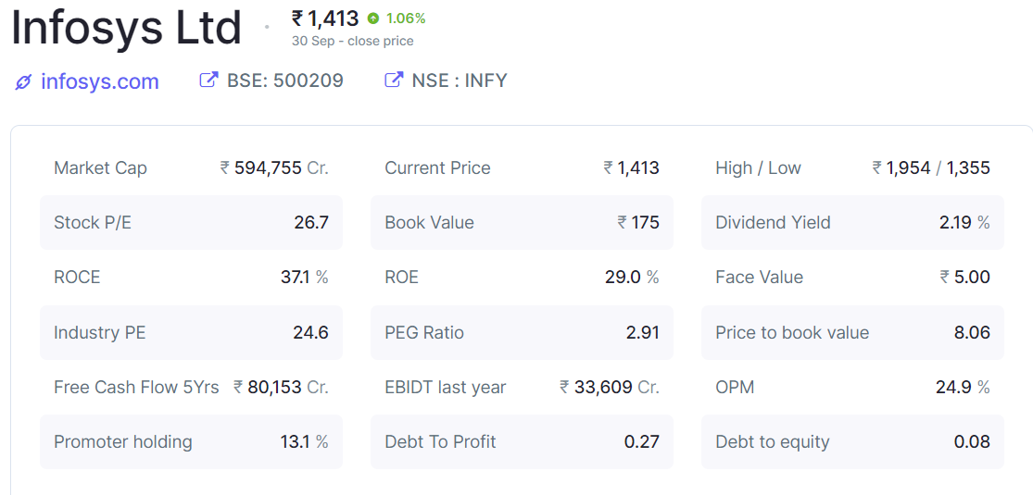
MILLIONAIRE MINDSET
DIGITAL PLATFORMS FOR INCOME GROWTH : STOCK PORTFOLIO STRATEGY
INCOME GROWTH
DAY 4
SOURCES|MONEY SPIN|PORTFOLIO|KEY PLATFORMS
LONG TERM STRATEGY
Fundamental Analysis
Sector Analysis
Key Ratios
Long-Term Portfolio Management
KEY RATIOS :
PE / IPE / PE/G
EPS
Book Value
D to E = Liability/Shareholder Equity
Div Yield
Profit Efficiency = ROCE / ROE
OPM (ebidta)
Buffet Ratio : PE*P/BV
Piotroski Score
DOWNLOAD
POSITION.xlsx
DIGITAL BUSINESS HUB
FRAMEWORK-INVESTING-STOCK.xls

Slide 16
MILLIONAIRE MINDSET
DIGITAL PLATFORMS FOR INCOME GROWTH : STOCK PORTFOLIO STRATEGY
INCOME GROWTH
DAY 4
SOURCES|MONEY SPIN|PORTFOLIO|KEY PLATFORMS
LONG TERM STRATEGY
Fundamental Analysis
Sector Analysis
Key Ratios
Long-Term Portfolio Management
STEPS :
Long Time Frame Analysis
Qtly Sector Analysis
Analyze – PA + Technical Indicators(TSI)
News & Qtly Performance
Risk Management
  LOC: Monitor
  Exit / Pyramid
DIGITAL BUSINESS HUB

Slide 17
MILLIONAIRE MINDSET
DIGITAL PLATFORMS FOR INCOME GROWTH : STOCK PORTFOLIO STRATEGY
INCOME GROWTH
DAY 4
SOURCES|MONEY SPIN|PORTFOLIO|KEY PLATFORMS
CHALLENGE
OPEN YOUR TRADING ACCOUNT IF NOT OPENED
CREATE YOUR TEMPLATES IN Tradingview.com
WORK OUT YOUR INVESTING CAPITAL BASED ON THE CRITERIA DISCUSSED
USE THE LEARNED PRINCIPLES FOR CHOOSING AT LEAST 5 PORTFOLIO COMPANIES
BRING YOUR QUERIES TO RISE CIRCLES
DIGITAL BUSINESS HUB

Slide 18
RISE 4_5
DAY 5 : DIGITAL PLATFORM FOR INCOME GROWTH
INCOME SOURCES
MONEY SPIN
FINANCIAL ASSET PORTFOLIO STRATEGY – LONG TERM
  TECHNICAL ANALYSIS
  FUNDAMENTAL ANALYSIS
  SHORT TERM & LONG TERM
KEY PLATFORMS

Slide 19
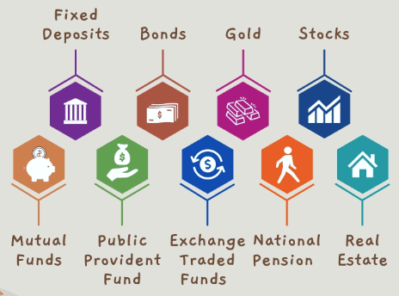

MILLIONAIRE MINDSET
DIGITAL PLATFORMS FOR INCOME GROWTH : STOCK PORTFOLIO STRATEGY - MF/ETF
INCOME GROWTH
DAY 5
SOURCES|MONEY SPIN|PORTFOLIO|KEY PLATFORMS
MUTUAL FUND Selection Criteria
Entry Exit Load
Past Present & MF Manager Reputation
Agency Ratings
Key Selection Parameters
NAV
KEY PARAMETERS:
Expense Ratio
Fund’s Portfolio
AUM
Category Returns
Risk Ratios
Technical Criteria:
Standard Deviation: Volatility – Rate of fluctuation
Beta: Sensitivity – Relevant Effect of small change
Sharpe Ratio: Measures the performance of an investment such as security or portfolio compared to a risk-free asset, after adjusting for its risk
Jensen’s Alpha: Used to determine the abnormal return of a security or portfolio of securities over the theoretical expected return
Treynor’s Ratio: A portfolio performance measure that adjusts for systematic risk ( reward/volatility).
DIGITAL BUSINESS HUB

Slide 20
MILLIONAIRE MINDSET
DIGITAL PLATFORMS FOR INCOME GROWTH : STOCK PORTFOLIO STRATEGY
INCOME GROWTH
DAY 5
SOURCES|MONEY SPIN|PORTFOLIO|KEY PLATFORMS
QUICK PRACTICAL SCREENING
CHALLENGE
WORK OUT YOUR INVESTING CAPITAL BASED ON THE CRITERIA DISCUSSED
USE THE LEARNED PRINCIPLES FOR CHOOSING AT LEAST 3 MUTUAL FUNDS
BRING YOUR QUERIES TO RISE CIRCLES
DIGITAL BUSINESS HUB

Slide 21
RISE 4_6
DAY 6 : DIGITAL PLATFORM FOR INCOME GROWTH
INCOME SOURCES
MONEY SPIN
FINANCIAL ASSET PORTFOLIO STRATEGY
  TECHNICAL ANALYSIS
  FUNDAMENTAL ANALYSIS
  SHORT TERM & LONG TERM
KEY PLATFORMS

Slide 22
MILLIONAIRE MINDSET
DIGITAL PLATFORMS FOR INCOME GROWTH : STOCK PORTFOLIO STRATEGY
INCOME GROWTH
DAY 6
SOURCES|MONEY SPIN|PORTFOLIO|KEY PLATFORMS
STOCK TRADE | SCREENERS | INFO PORTAL | LONG TERM PORTFOLIO | MUTUAL FUND
BANKs e.g BOFA etrade, HDFC, KOTAK, ICICI etc. | Tradingview.com | Investing.com | Banks e.G etrade, HDFC, KOTAK, ICICI etc. | Banks e.g BOFA etrade, HDFC, KOTAK, ICICI etc.
Webull | Screener.in | MoneyControl.com |  | icraanalytics.com
Blue Alice | Chartink.com | Trendlyne |  | Groww.in
ShareKhan |  | Screener.in |  | Fundsindia.com
Upstox |  | Nseindia
Zerodha |  | Bseindia
KEY PLATFORMS –
I have USED in US & INDIA
STOCK TRADING
SCREENERS
INFORMATION PORTALS
LONG-TERM PORTFOLIO
MUTUAL FUND
MONEY MANAGEMENT
DIGITAL BUSINESS HUB

Slide 23
MILLIONAIRE MINDSET
DIGITAL PLATFORMS FOR INCOME GROWTH : STOCK PORTFOLIO STRATEGY
INCOME GROWTH
DAY 6
SOURCES|MONEY SPIN|PORTFOLIO|KEY PLATFORMS
CHALLENGE
WORK OUT YOUR INVESTING CAPITAL BASED ON THE CRITERIA DISCUSSED
USE THE LEARNED PRINCIPLES FOR CHOOSING AT LEAST 3 MUTUAL FUNDS
BRING YOUR QUERIES TO RISE CIRCLES
DIGITAL BUSINESS HUB

Slide 24
MILLIONAIRE MINDSET
DIGITAL PLATFORMS FOR INCOME GROWTH : STOCK PORTFOLIO STRATEGY
INCOME GROWTH
DAY 6
SOURCES|MONEY SPIN|PORTFOLIO|KEY PLATFORMS
GREAT SHOW !!
CONGRATULATIONS ON
COMPLETING RISE 4
We’ll SEE YOU in RISE 5
FOR BUSINESS BASED
DIVERSIFICATION & INCOME FOR
EXPONENTIAL GROWTH
DIGITAL BUSINESS HUB

