Slide 1
RISE 5_1
DAY 1 : UTILIZE & DIVERSIFY - CONSULTING
CONSULTING PRINCIPLES
DIGITALIZATION CONSULTING
CHANGE MANAGEMENT CONSULTING
CONSULTING AS A BUSINESS

Slide 2
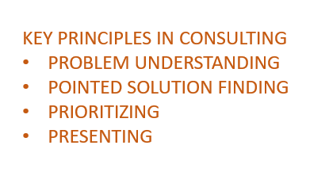
MILLIONAIRE MINDSET
DIVERSIFY – CONSULTING: CONSULTING PRINCIPLES
CONSULTING
DAY 1
DIGITALIZATION CONSULTING | CHANGE MANAGEMENT | AS A BUSINESS
KEY PERSONALITY ATTRIBUTES OF A CONSULTANT
KEY PRINCIPLES IN CONSULTING
PROBLEM UNDERSTANDING
POINTED SOLUTION FINDING
PRIORITIZING
PRESENTING
K – Knowledgeable in Geopolitical & Cultural Aspects
A – Analytical Skills
M – Methodical in approach
P – Practical in deriving solutions
PERSONA
A – Attitude of a consultant ( strategic solution finder )
C – Creative Thinker
T – Thinking out of the box
TRAITS
CONSULTING PRINCIPLES
Consulting Framework
Types of consulting
TRAITS
  SME AS CONSULTANT
  BUSINESS CONSULTANT
  TECHNOLOGY CONSULTANT
Successful Consulting
BEST PRACTICES
CASE STUDY
S – Solution Selling Capabilities
L – Listening Capability
E – Excellent problem solving
E – Effective writing
P – Presentation capabilities
CAPABILITIES
DIGITAL BUSINESS HUB

Slide 3
MILLIONAIRE MINDSET
DIVERSIFY – CONSULTING: CONSULTING FRAMEWORK
CONSULTING
DAY 1
DIGITALIZATION CONSULTING | CHANGE MANAGEMENT | AS A BUSINESS
Understand & DEFINE The Problem
RESEARCH
Organize & PRIORITIZE Data
ANALYZE & Verify
HYPOTHESIZE
SYNTHESIZE for the given scenario
Present RECOMMEND
CONSULTING PRINCIPLES
Consulting Framework
Types of consulting
TRAITS
  SME AS CONSULTANT
  BUSINESS CONSULTANT
  TECHNOLOGY CONSULTANT
Successful Consulting
BEST PRACTICES
CASE STUDY
KICK OFF
TECHNOLOGY OR EXECUTION
DIGITAL BUSINESS HUB
IMPLEMENT

Slide 4
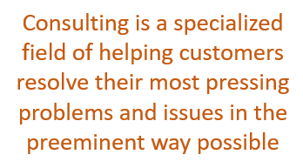
MILLIONAIRE MINDSET
DIVERSIFY – CONSULTING: CONSULTING TYPES
CONSULTING
DAY 1
DIGITALIZATION CONSULTING | CHANGE MANAGEMENT | AS A BUSINESS
Strategy consulting
Marketing consulting
Operations consulting
Financial consulting
HR consulting
Compliance consulting
IT/ Technology consulting
Legal consultant
Social media consultant
Sustainability consultant
Sales consultant
Wellness/Fitness consultant
Growth Marketing Consultant
Career coaching consultancy
PR consultancy
SEO consulting
Leadership consulting
Product development consulting
Design consultant
TYPES OF CONSULTING
BUSINESS
  Strategy consulting
  Operations consulting
TECHNOLOGY
  Information technology consulting
SUBJECT MATTER EXPERT
  Financial Consulting
  Human resources consulting
Consulting is a specialized field of helping customers resolve their most pressing problems and issues in the preeminent way possible
CONSULTING PRINCIPLES
Consulting Framework
Types of consulting
TRAITS
  SME AS CONSULTANT
  BUSINESS CONSULTANT
  TECHNOLOGY CONSULTANT
Successful Consulting
BEST PRACTICES
CASE STUDY
DIGITAL BUSINESS HUB

Slide 5
MILLIONAIRE MINDSET
DIVERSIFY - CONSULTING: CONSULTING TRAITS
CONSULTING
DAY 1
DIGITALIZATION CONSULTING | CHANGE MANAGEMENT | AS A BUSINESS
K – Knowledgeable in Geopolitical & Cultural Aspects
A – Analytical Skills
M – Methodical in approach
P – Practical in deriving solutions
CONSULTING PRINCIPLES
Consulting Framework
Types of consulting
TRAITS
  SME AS CONSULTANT
  BUSINESS CONSULTANT
  TECHNOLOGY CONSULTANT
Successful Consulting
BEST PRACTICES
CASE STUDY
PERSONA
Problem Understanding
Pointed Solution
Prioritizing
Presenting
A – Attitude of a consultant ( strategic solution finder )
C – Creative Thinker
T – Thinking out of the box
TRAITS
S – Solution Selling Capabilities
L – Listening Capability
E – Excellent problem solving
E – Effective writing
P – Presentation capabilities
CAPABILITIES
DIGITAL BUSINESS HUB
TRAITS DIFFER FOR 3 TYPES OF CONSULTANT ONLY IN SOLUTION THAT THEY SELL

Slide 6
MILLIONAIRE MINDSET
DIVERSIFY - CONSULTING: CONSULTING SUCCESS
CONSULTING
DAY 1
DIGITALIZATION CONSULTING | CHANGE MANAGEMENT | AS A BUSINESS
SUCCESSFUL CONSULTING
Intuitive outcome
Right Quality ( Quality is what the customer wants )
  Communication
  Interpersonal relationships
  Cultural nuance of the company
Within Time
Within Budget
Easy to implement
As per the SLA
All Stakeholders Delighted
CONSULTING PRINCIPLES
Consulting Framework
Types of consulting
TRAITS
  SME AS CONSULTANT
  BUSINESS CONSULTANT
  TECHNOLOGY CONSULTANT
Successful Consulting
BEST PRACTICES
CASE STUDY
DIGITAL BUSINESS HUB

Slide 7

MILLIONAIRE MINDSET
DIVERSIFY - CONSULTING: CONSULTING BEST PRACTICES
CONSULTING
DAY 1
DIGITALIZATION CONSULTING | CHANGE MANAGEMENT | AS A BUSINESS
CONSULTING PRINCIPLES
Consulting Framework
Types of consulting
TRAITS
  SME AS CONSULTANT
  BUSINESS CONSULTANT
  TECHNOLOGY CONSULTANT
Successful Consulting
BEST PRACTICES
CASE STUDY
Be the Listener
Understand the Problem
Communicate at Right Levels
Keep it Super Simple
Transparent & Honest
Adapt to the environment
Under Value and Overdeliver
Provide high Quality
Punctual
Make an Impact
LISTEN
ANALYZE
COMMUNICATE
CONSULT
DIGITAL BUSINESS HUB

Slide 8
MILLIONAIRE MINDSET
DIVERSIFY - CONSULTING: CONSULTING CASE STUDY
CONSULTING
DAY 1
DIGITALIZATION CONSULTING | CHANGE MANAGEMENT | AS A BUSINESS
Understand & DEFINE The Problem
RESEARCH
Organize & PRIORITIZE Data
ANALYZE & Verify
HYPOTHESIZE
SYNTHESIZE for the given scenario
Present RECOMMEND
CONSULTING PRINCIPLES
Consulting Framework
Types of consulting
TRAITS
  SME AS CONSULTANT
  BUSINESS CONSULTANT
  TECHNOLOGY CONSULTANT
Successful Consulting
BEST PRACTICES
CASE STUDY
SUCCESSFUL CONSULTING
Intuitive outcome
Right Quality
Within Time
Within Budget
Easy to implement
As per the SLA
All Stakeholders Delighted
LISTEN
ANALYZE
COMMUNICATE
CASE STUDY
CONSULT
Download the WALMART Case Study and suggest
How would have you consulted and provided a different Solution
Support your proposition, suggesting how would your solution be better

Slide 9
RISE 5_2
DAY 2 : UTILIZE & DIVERSIFY – DIGITALIZATION CONSULTING
DIGITALIZATION CONSULTING
CHANGE MANAGEMENT CONSULTINGG
CONSULTING AS A BUSINESS

Slide 10
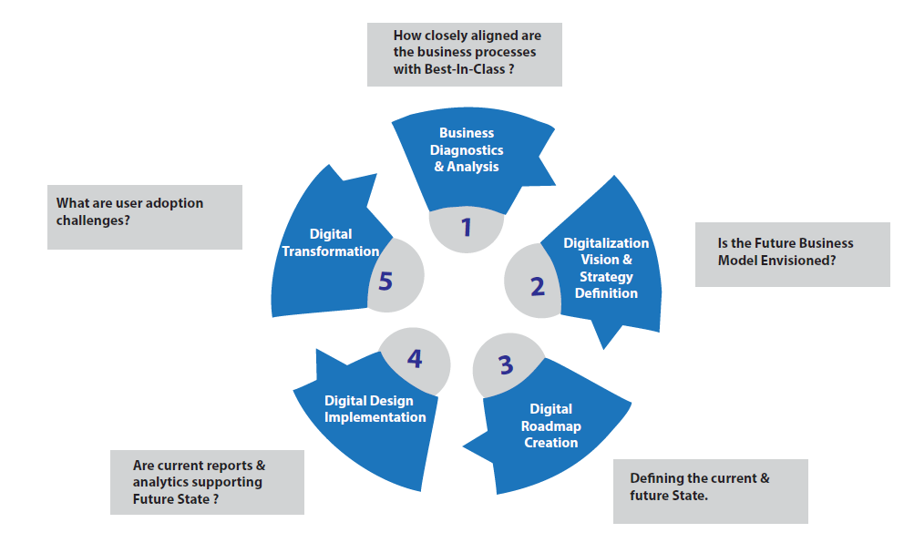
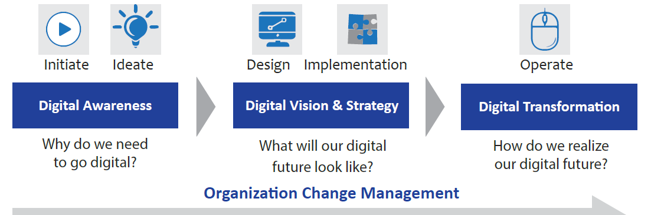
MILLIONAIRE MINDSET
DIVERSIFY - CONSULTING: DIGITALIZATION CONSULTING
CONSULTING
DAY 2
DIGITAL CONSULTING | CHANGE MANAGEMENT | AS A BUSINESS
DOWNLOAD THE WHITE PAPER
PREPARATION
APPROACH
  Understand the Vision
  Understand the Level of digitalization currently
  Evaluate the current systems
  Do the Gap Analysis
  Create a Road Map
  Evaluate & Recommend Partners for execution
  Recommend a Structure to execute
  Suggest the change management strategy
DIGITAL CONSULTING FUNDAMENTALS
APPROACH
STRATEGY FRAMEWORK
TOOLS
EXECUTION
DIGITAL BUSINESS HUB

Slide 11
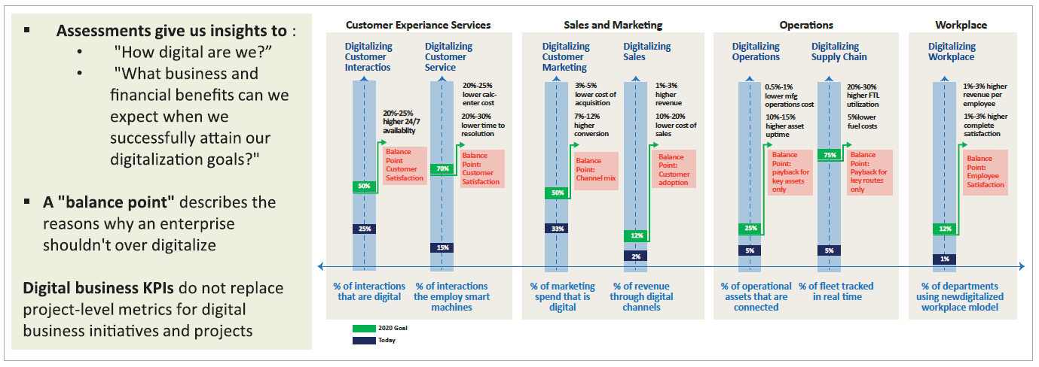
MILLIONAIRE MINDSET
DIVERSIFY - CONSULTING: DIGITALIZATION CONSULTING APPROACH
CONSULTING
DAY 2
DIGITAL CONSULTING | CHANGE MANAGEMENT | AS A BUSINESS
2023 GOAL
2017
DIGITAL CONSULTING FUNDAMENTALS
APPROACH
STRATEGY FRAMEWORK
TOOLS
EXECUTION
UNDERSTANDING THE LEVEL OF
DIGITIZATION REQUIRED FOR DIGITALIZATION
DIGITAL BUSINESS HUB

Slide 12
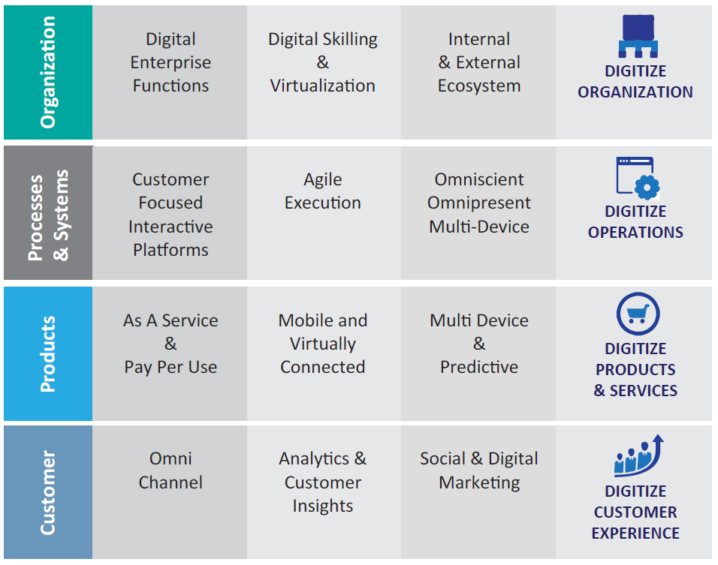
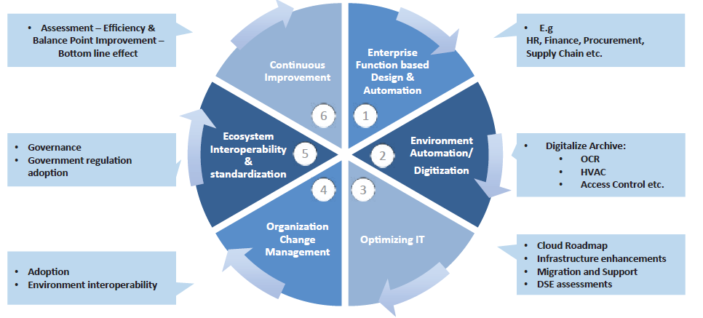
MILLIONAIRE MINDSET
DIVERSIFY - CONSULTING: STRATEGY FRAMEWORK
CONSULTING
DAY 2
DIGITAL CONSULTING | CHANGE MANAGEMENT | AS A BUSINESS
AREAS OF DIGITIZATION
Organization | Operations | Products | Experience
FRAMEWORK FOR DIGITIZATON IMPLEMENTATION
HEXAGONAL APPROACH – 6-STEP MODEL
DIGITAL CONSULTING FUNDAMENTALS
APPROACH
STRATEGY FRAMEWORK
TOOLS
EXECUTION
DIGITAL BUSINESS HUB
AREAS OF DIGITIZATION & IMPELEMENTATION

Slide 13
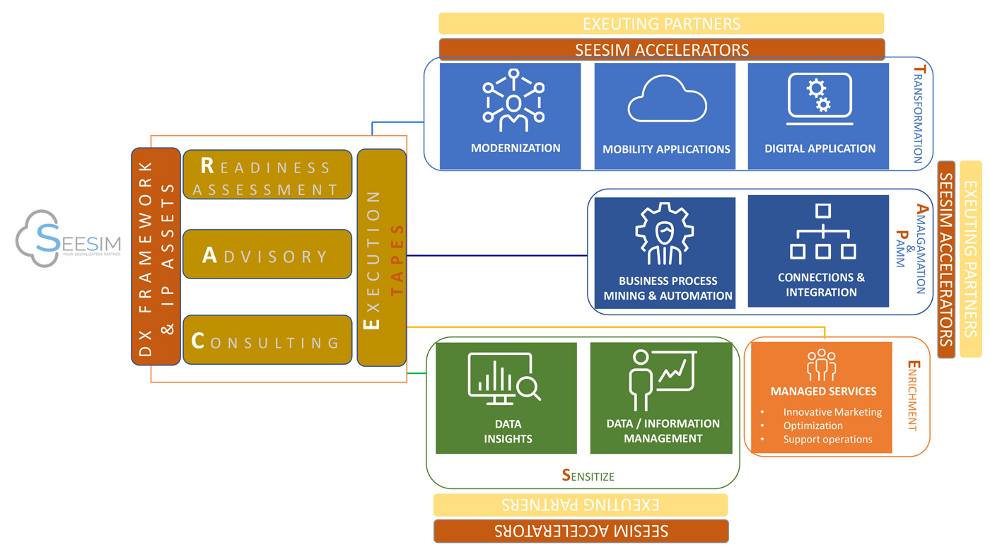
MILLIONAIRE MINDSET
DIVERSIFY - CONSULTING: FRAMEWORK & TOOLS
CONSULTING
DAY 2
DIGITAL CONSULTING | CHANGE MANAGEMENT | AS A BUSINESS
Native
Hybrid
Web
IOS, Android, Java
Xamarin , Appcelerator
ERP : SAP, Oracle, MS Azure
CRM : SF, Netsuite, Zendesk
HCM : SAP Success Factor, Ramco, Oracle fusion
SCM : SAP SCM, JDA ( blue yonder), Manhattan
Process Transformation
BPM TOOLS ( JIRA , PEGA etc.), ERP, CRM, etc.
Business Model Transformation
PLATFORMS
Cultural/Organizational Transformation
Change Mgmnt Tools – BMC etc. (Changealization book )
Word processors
spreadsheets
databases
graphics
presentation software
Custom Apps
Some Tools essential during digitalization
Digital adoption platforms (DAPs)
Digital workplace suites
Team collaboration & communication tools
Social intranet tools
Cloud CRMs
HCM platforms
Employee self-service platforms
Cloud storage tools
Project management software
Digital accounting tools
CMS platforms
Boomi.
Amazon Web Services (AWS)
Microsoft.
TIBCO Software.
IBM.
Oracle.
SAP.
Axway
Zapier
SPSS, Stata, and R for statistical analysis of quantitative data,
Nvivo for qualitative (textual and audio-visual) data analysis (QDA)
ArcGIS for analyzing geospatial data
AI – Tensor Flow, Watson, SF Einstein
ML – Amazon ML. Google AI, Azure ML, Tensor, Anaconda etc.
As A Service
Usually uses ITIL
Deals with Support Services
DIGITAL CONSULTING FUNDAMENTALS
APPROACH
STRATEGY FRAMEWORK
TOOLS
EXECUTION
nTask.
Microsoft SQL Server.
Profisee.
IBM Infosphere Master Data Management.
Ataccama.
Microsoft Azure.
Amazon Web Services.
Google Cloud Platform
DIGITAL BUSINESS HUB
DIGITALIZATION FRAMEWORK & TOOLS

Slide 14
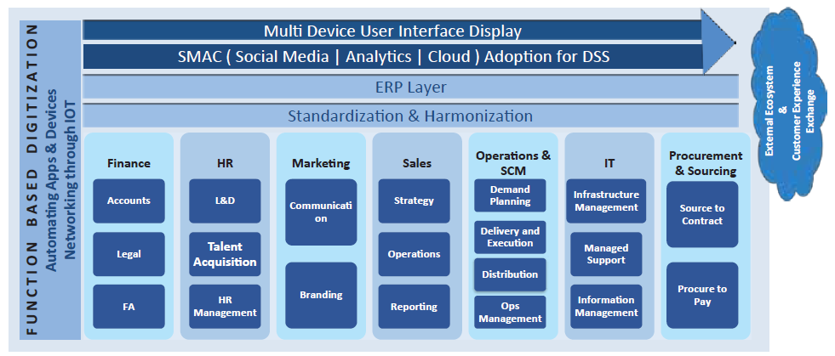
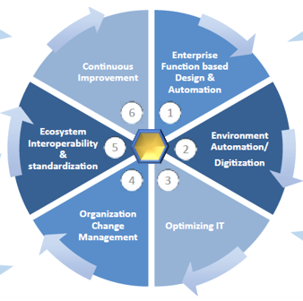
MILLIONAIRE MINDSET
DIVERSIFY - CONSULTING: DIGITALIZATION EXECUTION
CONSULTING
DAY 2
DIGITAL CONSULTING | CHANGE MANAGEMENT | AS A BUSINESS
HEXAGONAL APPROACH – 6 STEP MODEL
DIGITAL CONSULTING FUNDAMENTALS
APPROACH
STRATEGY FRAMEWORK
TOOLS
EXECUTION
DIGITALIZATION EXECUTION

Slide 15

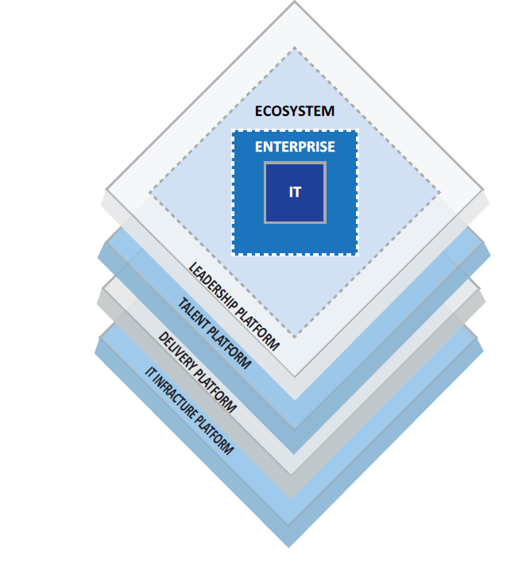
MILLIONAIRE MINDSET
DIVERSIFY - CONSULTING: ECOSYSTEM THROUGH DIGITALIZATION
CONSULTING
DAY 2
DIGITAL CONSULTING | CHANGE MANAGEMENT | AS A BUSINESS
DIGITAL CONSULTING FUNDAMENTALS
APPROACH
STRATEGY FRAMEWORK
TOOLS
EXECUTION
DIGITAL BUSINESS HUB
ECOSYSTEM CREATION THROUGH DIGITALIZATION

Slide 16
MILLIONAIRE MINDSET
DIVERSIFY - CONSULTING: DIGITALIZATION CASE STUDY
CONSULTING
DAY 2
DIGITAL CONSULTING | CHANGE MANAGEMENT | AS A BUSINESS
Downstream O&G Company
  Production - 4 million b/d
  Revenue: USD12 Bn
Incurs 15% of Losses in spite of full order book
Operations View:
  Pilferage
  Delivery system & Routing Operations – 100 people team
  Reconciliation with warehouse inconsistent
  Missing invoices
Downstream O&G Company
  Production - 4 million b/d
  Revenue: USD12 Bn
Incurs 15% of Losses in spite of full order book
Operations View:
  Pilferage
  Delivery system & Routing
  Reconciliation with warehouse inconsistent
  Missing invoices
CHALLENGE
DIGITAL CONSULTING FUNDAMENTALS
APPROACH
STRATEGY FRAMEWORK
TOOLS
EXECUTION
HOW CAN YOU HELP THEM ?
DIGITAL BUSINESS HUB

Slide 17
RISE 5_3
DAY 3 : UTILIZE & DIVERSIFY – CHANGE MANAGEMENT CONSULTING
CHANGE MANAGEMENT
CONSULTING FUNDAMENTALS
Types of Change
Understanding Change
HUMAN CHANGE
TECHNOLOGY CHANGE
DIGITALIZATION
Implementing Change
Change Management Structure
Change Management Strategies
3 M Strategies
Change Governance
Key Principles
Best Practices
Case Study
Reference Tools & Templates
DIGITALIZATION CONSULTING
CHANGE MANAGEMENT CONSULTINGG
CONSULTING AS A BUSINESS

Slide 18
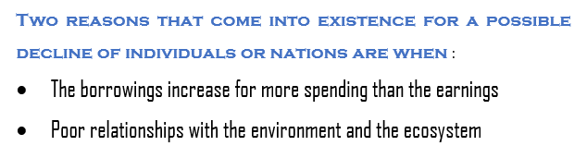
MILLIONAIRE MINDSET
DIVERSIFY - CONSULTING: CHANGE MANAGEMENT FUNDAMENTALS
CONSULTING
DAY 3
DIGITAL CONSULTING | CHANGE MANAGEMENT | AS A BUSINESS
Two reasons that come into existence for a possible decline of individuals or nations are when :
The borrowings increase for more spending than the earnings
Poor relationships with the environment and the ecosystem
KEY TENETS OF CHANGE
The Problem Statement
Change Objective
Change Benefits
CHANGE MANAGEMENT
CONSULTING FUNDAMENTALS
Types of Change
Understanding Change
HUMAN CHANGE
TECHNOLOGY CHANGE
DIGITALIZATION
Implementing Change
Change Management Structure
Change Management Strategies
3 M Strategies
Change Governance
Key Principles
Best Practices
Case Study
Reference Tools & Templates
DIGITAL BUSINESS HUB
Notes:
Change being the new normal, the jury is still out there to figure out the speed of change. We, however, have seen that it is getting increasingly challenging to cope up with the changes around us. The usual cycle of GROWTH, STABILITY or maturity and DECLINE or degrowth has been observed repeatedly occurring in history for individuals, nations and even civilizations and these have been witnessed to follow quicker cycles than ever before as is the growth in technology.

Slide 19

MILLIONAIRE MINDSET
DIVERSIFY - CONSULTING: CHANGE MANAGEMENT TYPES
CONSULTING
DAY 3
DIGITAL CONSULTING | CHANGE MANAGEMENT | AS A BUSINESS
TYPES OF CHANGE
Unplanned
Planned
Incremental
Developmental
Transitional
Transformational
CHANGE MANAGEMENT
CONSULTING FUNDAMENTALS
Types of Change
Understanding Change
HUMAN CHANGE
TECHNOLOGY CHANGE
DIGITALIZATION
Implementing Change
Change Management Structure
Change Management Strategies
3 M Strategies
Change Governance
Key Principles
Best Practices
Case Study
Reference Tools & Templates
DIGITAL BUSINESS HUB

Slide 20
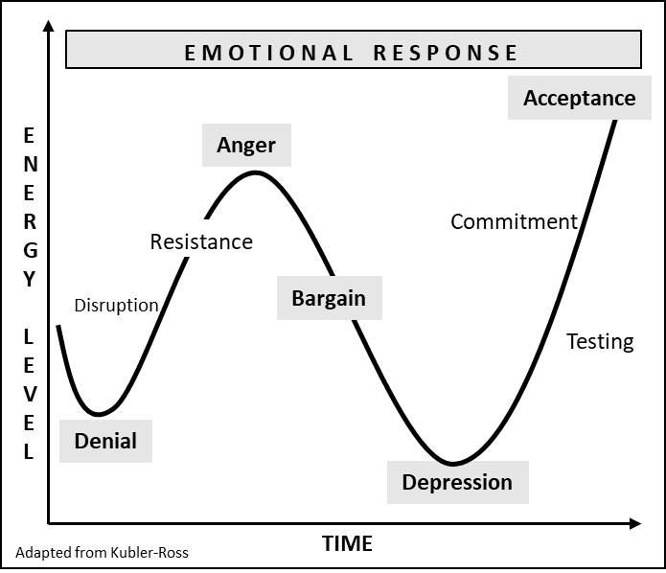
MILLIONAIRE MINDSET
DIVERSIFY - CONSULTING: CHANGE MANAGEMENT UNDERSTANDING
CONSULTING
DAY 3
DIGITAL CONSULTING | CHANGE MANAGEMENT | AS A BUSINESS
Human reactions to various situations are result of the fact that, our Observations result into Thoughts, our Thoughts result in our Beliefs, Beliefs in various situations result in our Experiences, our Experiences result in our Reaction. Our Reactions and their results create Wisdom for us to react in similar futuristic situations and seek answers therein if results are different than our earlier experiences
HUMAN CHANGE
TECHNOLOGY CHANGE
  DIGITALIZATION
ORGANIZATION CHANGE
CHANGE MANAGEMENT
CONSULTING FUNDAMENTALS
Types of Change
Understanding Change
HUMAN CHANGE
TECHNOLOGY CHANGE
DIGITALIZATION
Implementing Change
Change Management Structure
Change Management Strategies
3 M Strategies
Change Governance
Key Principles
Best Practices
Case Study
Reference Tools & Templates
DIGITAL BUSINESS HUB

Slide 21
MILLIONAIRE MINDSET
DIVERSIFY - CONSULTING: CHANGE MANAGEMENT - STRATEGIES
CONSULTING
DAY 3
DIGITAL CONSULTING | CHANGE MANAGEMENT | AS A BUSINESS
CHANGE/ TRANSFORMATION OFFICE (CHIEF CHANGE OFFICER)
TEAM LEADER (HUMAN CHANGE)
CHANGE MANAGER
CHANGE MANAGER
TEAM LEADER (TECHNICAL CHANGE)
CHANGE MANAGER
STRATEGY & PLANNING
PLANNING & EXECUTION
EXECUTION
CHANGE AGENTS
CHANGE AGENTS
PMO
TECH SKILLS
CHANGE AGENTS
ARCHITECTS
ANAYLYST
COMMUNICATION LEAD
GRIEVANCE & R&R OFFICE
TRAINING & COACHING
CHANGE MANAGEMENT
CONSULTING FUNDAMENTALS
Types of Change
Understanding Change
HUMAN CHANGE
TECHNOLOGY CHANGE
DIGITALIZATION
Implementing Change
Change Management Structure
Change Management Strategies
3 M Strategies
Change Governance
Key Principles
Best Practices
Case Study
Reference Tools & Templates
Lewin’s Change Management Model
McKinsey 7-S Model
Nudge Theory
The ADKAR Change Management Model
Kübler-Ross Change Curve
Kotter’s 8-Step Theory
Maurer 3 Levels of Resistance and Change Model
3M Strategy
DIGITAL BUSINESS HUB

Slide 22
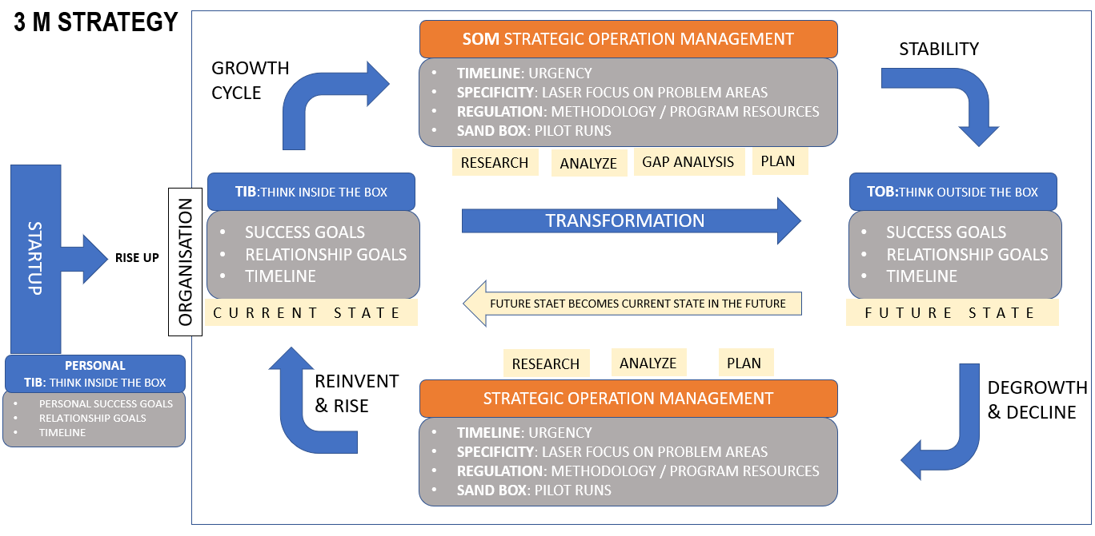
MILLIONAIRE MINDSET
DIVERSIFY - CONSULTING: CHANGE MANAGEMENT – 3M MODEL
CONSULTING
DAY 3
DIGITAL CONSULTING | CHANGE MANAGEMENT | AS A BUSINESS
CHANGE MANAGEMENT
CONSULTING FUNDAMENTALS
Types of Change
Understanding Change
HUMAN CHANGE
TECHNOLOGY CHANGE
DIGITALIZATION
Implementing Change
Change Management Structure
Change Management Strategies
3 M Strategies
Change Governance
Key Principles
Best Practices
Case Study
Reference Tools & Templates
DIGITAL BUSINESS HUB

Slide 23
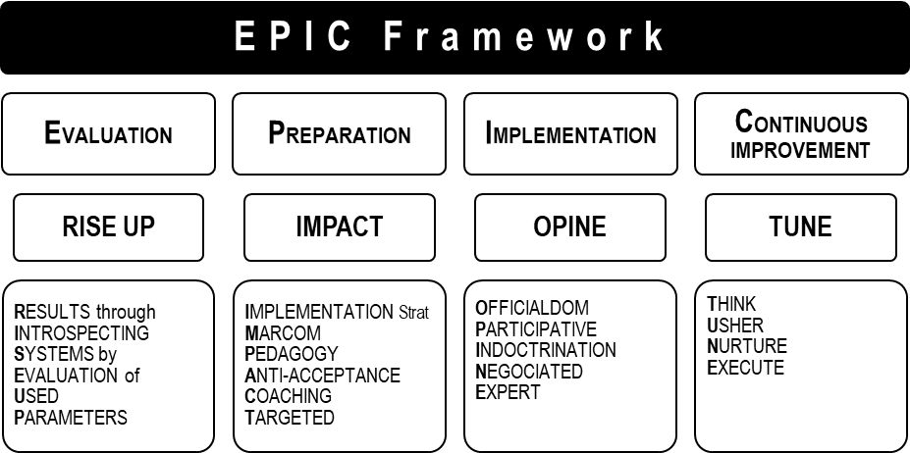
MILLIONAIRE MINDSET
DIVERSIFY - CONSULTING: CHANGE MANAGEMENT – FRAMEWORK
CONSULTING
DAY 3
DIGITAL CONSULTING | CHANGE MANAGEMENT | AS A BUSINESS
CHANGE MANAGEMENT
CONSULTING FUNDAMENTALS
Types of Change
Understanding Change
HUMAN CHANGE
TECHNOLOGY CHANGE
DIGITALIZATION
Implementing Change
Change Management Structure
Change Management Strategies
3 M Strategies
Change Governance
Key Principles
Best Practices
Case Study
Reference Tools & Templates
DIGITAL BUSINESS HUB

Slide 24
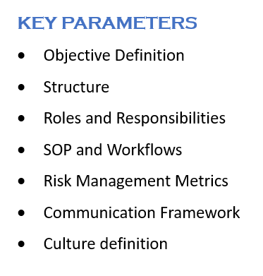
MILLIONAIRE MINDSET
DIVERSIFY - CONSULTING: CHANGE MANAGEMENT – GOVERNANCE
CONSULTING
DAY 3
DIGITAL CONSULTING | CHANGE MANAGEMENT | AS A BUSINESS
5 C PRINCIPLES
COURSE OF ACTION
  Set clear objectives that encapsulate the goals and the key outcomes of the program
CRITICAL PATH TO RISK MANAGEMENT:
  Risk and Risk Mitigation
COMMUNICAITON PRINCIPLES
  Efficient | Comprehensive | Simple | Thoughtful | Consistent | Defined Defined Timeline | Feedback Effectiveness
CULTURE PRINCIPLES
  Organization Culture and Behavioral pattern
CREED IN FORM OF A MANIFESTO
  Common behavior expectations and mannerism
CHANGE MANAGEMENT
CONSULTING FUNDAMENTALS
Types of Change
Understanding Change
HUMAN CHANGE
TECHNOLOGY CHANGE
DIGITALIZATION
Implementing Change
Change Management Structure
Change Management Strategies
3 M Strategies
Change Governance
Key Principles
Best Practices
Case Study
Reference Tools & Templates
DIGITAL BUSINESS HUB

Slide 25
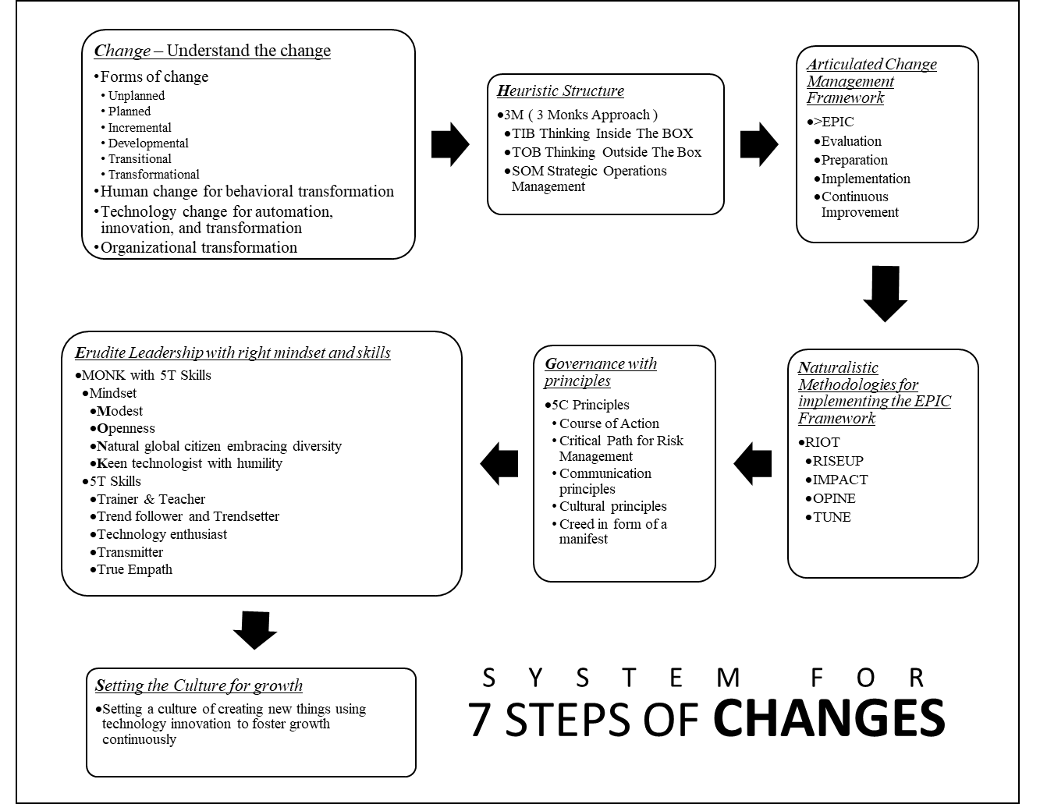
MILLIONAIRE MINDSET
DIVERSIFY - CONSULTING: CHANGE MANAGEMENT CONSULTING
CONSULTING
DAY 3
DIGITAL CONSULTING | CHANGE MANAGEMENT | AS A BUSINESS
CHANGE MANAGEMENT
CONSULTING FUNDAMENTALS
Types of Change
Understanding Change
HUMAN CHANGE
TECHNOLOGY CHANGE
DIGITALIZATION
Implementing Change
Change Management Structure
Change Management Strategies
3 M Strategies
Change Governance
Key Principles
Best Practices
Case Study
Reference Tools & Templates
DIGITAL BUSINESS HUB

Slide 26
MILLIONAIRE MINDSET
DIVERSIFY - CONSULTING: CHANGE MANAGEMENT CONSULTING
CONSULTING
DAY 3
DIGITAL CONSULTING | CHANGE MANAGEMENT | AS A BUSINESS
DOWNLOAD TEMPLATE HERE
CHANGE MANAGEMENT
CONSULTING FUNDAMENTALS
Types of Change
Understanding Change
HUMAN CHANGE
TECHNOLOGY CHANGE
DIGITALIZATION
Implementing Change
Change Management Structure
Change Management Strategies
3 M Strategies
Change Governance
Key Principles
Best Practices
Case Study
Reference Tools & Templates
DIGITAL BUSINESS HUB

Slide 27
MILLIONAIRE MINDSET
DIVERSIFY - CONSULTING: CHANGE MANAGEMENT CASE STUDY
CONSULTING
DAY 3
DIGITAL CONSULTING | CHANGE MANAGEMENT | AS A BUSINESS
Telecom Major in SE Asia
  Revenue: USD 6 Bn
  Group owns 5 companies – from acquisitions in different countries of SEA
Management does not receive Business Reports Appropriately
  Delayed reports & Formats
  Non-standardized Sourcing and procurement reports
Operations View:
  Different Sourcing and procurement platform being used
  CEO’s of 5 different companies have different cultural and operational activities
  Missing single source of truth and brids eye view
CHALLENGE
Downstream O&G Company
  Production - 4 million b/d
  Revenue: USD12 Bn
Incurs 15% of Losses in spite of full order book
Operations View:
  Pilferage
  Delivery system & Routing
  Reconciliation with warehouse inconsistent
  Missing invoices
HOW CAN YOU HELP THEM ?
USE THE
7 STEP CHANGES MODEL TO SOLVE A CASE STUDY
DIGITAL CONSULTING FUNDAMENTALS
APPROACH
STRATEGY FRAMEWORK
TOOLS
EXECUTION
DIGITAL BUSINESS HUB

Slide 28
RISE 5_4
DAY 4 : UTILIZE & DIVERSIFY - CONSULTING
DIGITALIZATION CONSULTING
CHANGE MANAGEMENT CONSULTINGG
CONSULTING AS A BUSINESS

Slide 29
MILLIONAIRE MINDSET
DIVERSIFY - CONSULTING: CONSULTING AS A BUSINESS
CONSULTING
DAY 4
DIGITAL CONSULTING | CHANGE MANAGEMENT | AS A BUSINESS
Wealth from Systems
Unlimited Growth
IDENTIFY YOUR CURRENT SELF & YOUR FUTURE SELF
Independent of the System
Unlimited Growth
Part of the System
Limited Growth
Part of the workforce
Limited Growth
INVESTOR
CONSULTING AS A BUSINESS
STEPS FOR CONSULTING PRACTICE
YOUR ECOSYSTEM
SME
TRAINERS
EXECUTIONIST
PARTNERS
FREELANCERS
BUSINESS
OWNER
SELF
EMPLOYED
ENTREPRENEUR
The Enterprising Risk Taker
Create their own Systems
DIGITAL BUSINESS HUB
EMPLOYED

Slide 30
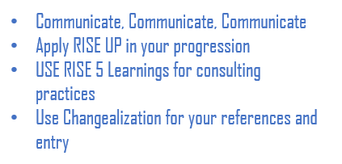
MILLIONAIRE MINDSET
DIVERSIFY - CONSULTING: CONSULTING AS A BUSINESS
CONSULTING
DAY 4
DIGITAL CONSULTING | CHANGE MANAGEMENT | AS A BUSINESS
NICHE: Choose Your Niche or Areas of expertise for CONSULTING
Communicate, Communicate, Communicate
Apply RISE UP in your progression
USE RISE 5 Learnings for consulting practices
Use Changealization for your references and entry
TARGET: Choose your Target Audience
SELL: Sell & Market your services in form of a product (Do a few targeted free consultations with the corporates)
DIVERSIFY: Increase your services in relevant consultation areas
04
03
CONSULTING AS A BUSINESS
STEPS FOR CONSULTING PRACTICE
YOUR ECOSYSTEM
SME
TRAINERS
EXECUTIONIST
PARTNERS
FREELANCERS
02
01
SELL
DIVERSIFY
DIGITAL BUSINESS HUB
TARGET
NICHE

Slide 31

MILLIONAIRE MINDSET
DIVERSIFY - CONSULTING: CONSULTING AS A BUSINESS
CONSULTING
DAY 4
DIGITAL CONSULTING | CHANGE MANAGEMENT | AS A BUSINESS
FREELANCERS
NICHE ENTERPRISES
PARTNERS
BOUTIQUE FIRMS
EXECUTIONIST
SUBJECT MATTER EXPERTS
CONSULTING AS A BUSINESS
STEPS FOR CONSULTING PRACTICE
YOUR ECOSYSTEM
SME
TRAINERS
EXECUTIONIST
PARTNERS
FREELANCERS
DIGITAL BUSINESS HUB

Slide 32
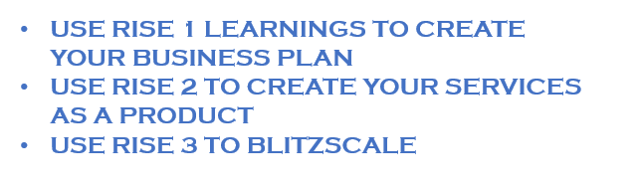
MILLIONAIRE MINDSET
DIVERSIFY - CONSULTING: CONSULTING AS A BUSINESS
CONSULTING
DAY 4
DIGITAL CONSULTING | CHANGE MANAGEMENT | AS A BUSINESS
CHALLENGE
USE RISE 1 LEARNINGS TO CREATE YOUR BUSINESS PLAN
USE RISE 2 TO CREATE YOUR SERVICES AS A PRODUCT
USE RISE 3 TO BLITZSCALE
CONSULTING AS A BUSINESS
STEPS FOR CONSULTING PRACTICE
YOUR ECOSYSTEM
SME
TRAINERS
EXECUTIONIST
PARTNERS
FREELANCERS
DIGITAL BUSINESS HUB

Slide 33
MILLIONAIRE MINDSET
DIVERSIFY - CONSULTING: CONSULTING AS A BUSINESS
CONSULTING
DAY 4
DIGITAL CONSULTING | CHANGE MANAGEMENT | AS A BUSINESS
CONGRATULATIONS ON COMPLETING
RISE 5
DIGITAL BUSINESS HUB

