Slide 1
RISE 1_3
DAY 3 – DIGITAL SYSTEM BUILDING FRAMEWORK
SYSTEM: DIGITAL SYSTEM
FUNNEL: PRINCIPLES OF FUNNEL GENERATION
JOURNEY: CATEGORIZE & MANAGE THE JOURNEY
GO: PUTTING IT ALL TOGETHER

Slide 2
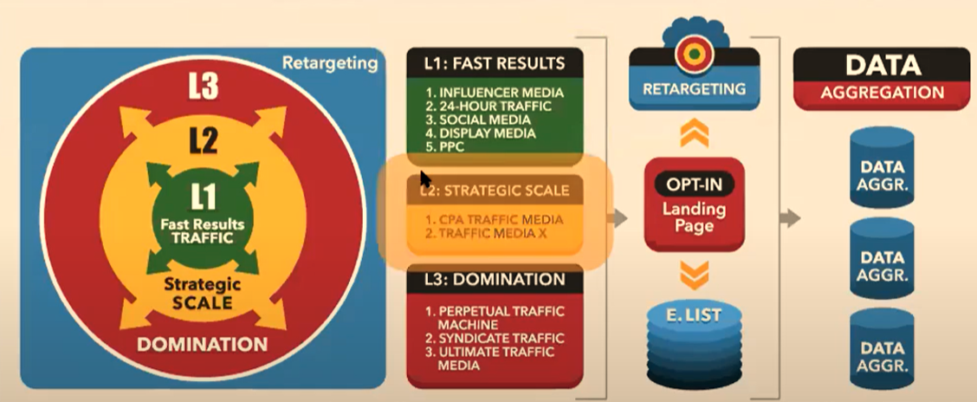
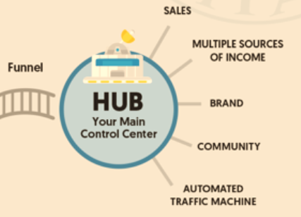
MILLIONAIRE MINDSET
DIGITAL BUSINESS ENGINEERING & GROWTH PLANNING: DIGITAL SYSTEM
Digital Business ENGINEERING
Digital Business Growth
DAY 3 :
SYSTEM | FUNNEL | JOURNEY | GO
DATA ANALYSIS & FEEDBACK MECHANISM WITH REPORTS
SYSTEMS | Purpose | Vendors (e.g.)
WEBSITE | Hosting Domains Documents & Reports | Bluehost Wpx Hosting Namecheap Google Drive
LMS | Courseware creation | Teachable
COMMUNICATION | Email Marketing Chatbots | Convertkit Getresponse Manychat
FUNNEL | Funnel Building | ClickFunnel
WEBINAR | Webinar On Demand Webinar | Demio Zoom Webinar Jam Ever Webinar
COMMUNITY | PC / Laptop Phone-based community building | Mighty Networks Telegram WA
LINK TRACKING | Click tracking system for Analysis and follow through | ClickMagick
PAYMENT | Online Payments Mobile Payments International Payments | RazorPay Instamojo Paypal Mint
AUTOMATION | Integrations between various systems for complete automation | Zapier
Marketing campaigns
Website – Blogs/Vlogs
Communication
Webinar
SOCIAL MEDIA
YOUR CUSTOMERS
DIGITAL ASSET CONSUMPTION
DIGITAL BUSINESS HUB

Slide 3
MILLIONAIRE MINDSET
DIGITAL BUSINESS ENGINEERING & GROWTH PLANNING: PRINCIPLES OF FUNNEL GENERATION
Digital Business ENGINEERING
Digital Business Growth
DAY 3 :
SYSTEM | FUNNEL | JOURNEY | GO
Facebook
YouTube
LinkedIn
..
FUNNEL
PREFRAMING
Videos
Conversion
Stages
Posts
Blogs
The Hook
The Product
The Offer
Community
FB Group
Private Group
Telegram Group
Concepts
Lead Magnet
Free Webinar
Tripwire
Conceptual Course
Core Product
Implementation
Profit Maximiser
Coaching
Affiliate
Blueprint
Maximum Potential
MONETIZATION
WEBSITE
Lead Capture
WEBINARS
EMAILS
DIGITAL BUSINESS HUB

Slide 4
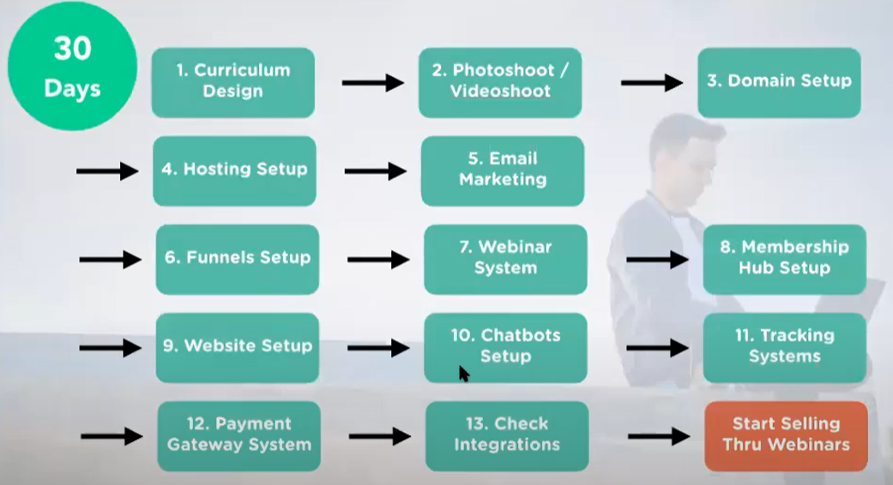
MILLIONAIRE MINDSET
DIGITAL BUSINESS ENGINEERING & GROWTH PLANNING: CATEGORY JOURNEY
Digital Business ENGINEERING
Digital Business Growth
DAY 3 :
SYSTEM | FUNNEL | JOURNEY | GO
30 DAYS
 | NOVICE | PRO | MASTER
Month 1 | Mindset Niche 121 consultation #100 100 Questions Grow Influence Build Tribe | Mindset Positioning 121 Consultation #20 100 Questions Grow online influence Build Tribe Build Other complementing Digital Assets | Mindset 121 Consultations #10 Grow the Tribe Setup advanced online systems
Month 2 |  | Master & Setup Systems Master FB Ads Master Webinar Selling Reiterate Business Plan | Master Traffic Master Webinar Sales Master Automation Reiterate Business Plan
Month 3 |  |  | Goals > INR 5 Mn / month Customers > 3000
Month 3-6 | Design Asset Setup Systems Master Facebook Ads Master Webinar Selling Reiterate Business Plan | Scale Budget to Grow Goals > INR 1Mn / month Customers > 1000
Month 6-12 | Scale Budget to Grow Goals > INR 0.5 Mn / month Customers > 500 | Scale Budget for further Growth Goals > INR 3 Mn / month Customers > 5000 | Scale Budget for further Grow Goals > INR 10 Mn / month Customers > 5000
DIGITAL ASSET CREATION
SCALE
90DAYS
SELL
30DAYS
SETUP
10DAYS
MIDSET FOCUS
DIGITAL BUSINESS HUB

Slide 5
















MILLIONAIRE MINDSET
DIGITAL BUSINESS ENGINEERING & GROWTH PLANNING: PUTTING IT ALL TOGETHER
Digital Business ENGINEERING
Digital Business Growth
DAY 3 :
SYSTEM | FUNNEL | JOURNEY | GO
FINISH 90 DAYS
DIGITAL ASSET
CREATION
COMPLETE 50
Consultations
INSPIRATION
GOAL
WORK
RETREAT
RESULT PLANNING
FUNNEL
BUILDING
BUILD
SOCIAL GROUP
OBSTACLES
PUSH & PERSEVERANCE
MINDSET & MISSION
BOOKS & THE COMPANY YOU KEEP
NICHE CLARITY
LAUNCH ASSET
SETUP SYSTEMS
Motivation video : Eagles Flight
Strangest Secret: EARL Nightingale
RISE UP MODEL
LEAD MAGNET
LAUNCH
PERSEVERANCE WHEEL
START
DIGITAL BUSINESS HUB

