Slide 1
RISE 1_4
DAY 4 – CHANGE & CONTINUOUS IMPROVEMENT THE MILLIONAIRE WAY
WHAT IS CHANGE MANAGEMENT
EPIC MODEL & RIOT METHODOLOGY
3M STRATEGY USING TIB | TOB | SOM

Slide 2
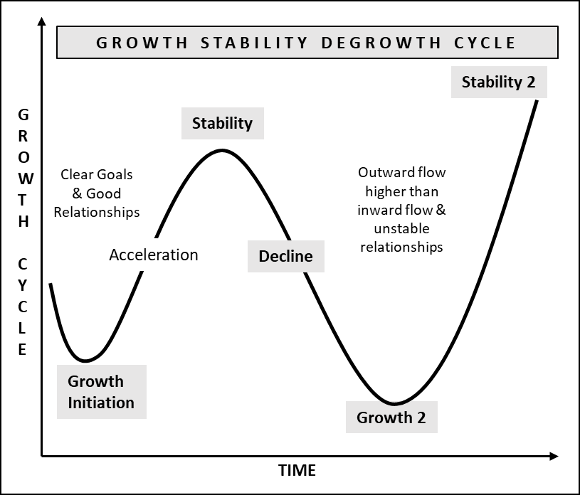
MILLIONAIRE MINDSET
DIGITAL BUSINESS ENGINEERING & GROWTH PLANNING: CHANGE MGMT THE MILLIONAIRE WAY
Digital Business ENGINEERING
Digital Business Growth
DAY 4 :
CHANGE | EPIC | RIOT | TIB | TOB | SOM
Change management is a systematic approach to dealing with the transition and discrete changes to achieve short-term goals.
Transformational change doesn’t focus on a few discrete, well-defined shifts, but rather on a portfolio of initiatives, which are interdependent or intersecting to meet the larger strategic goal.
DIGITAL BUSINESS HUB

Slide 3
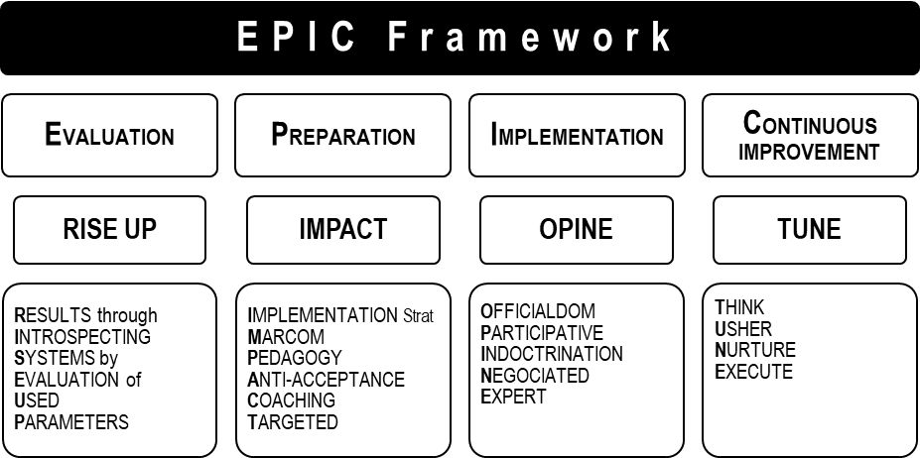
MILLIONAIRE MINDSET
DIGITAL BUSINESS ENGINEERING & GROWTH PLANNING: CHANGE MGMT THE MILLIONAIRE WAY
Digital Business ENGINEERING
Digital Business Growth
DAY 4 :
CHANGE | EPIC | RIOT | TIB | TOB | SOM
TRANSFORMATION USING EPIC FRAMEWORK and applying RIOT Methodology
ORGANIZATION CHANGE :
Human Change
Technology Change
  E.g., Digitalization
DIGITAL BUSINESS HUB

Slide 4
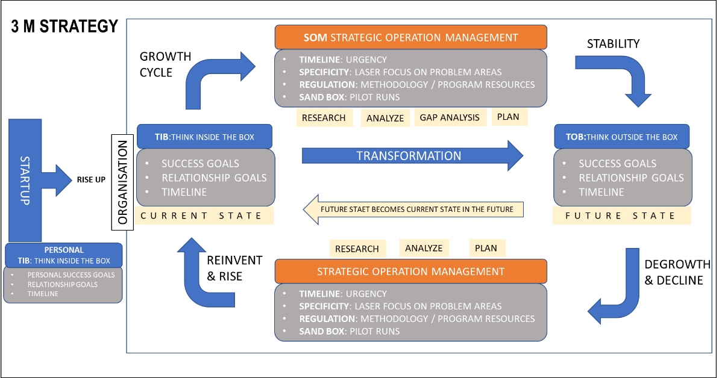
MILLIONAIRE MINDSET
DIGITAL BUSINESS ENGINEERING & GROWTH PLANNING: CHANGE MGMT THE MILLIONAIRE WAY
Digital Business ENGINEERING
Digital Business Growth
DAY 4 :
CHANGE | EPIC | RIOT | TIB | TOB | SOM
TRANSFORMATION WITH 3M STRATEGY
DIGITAL BUSINESS HUB

